Slide 1
Boosters
& Air Bags
Prepared/Revised by the
National Child Passenger Safety Board
October 2012
Notes:
1

Slide 2
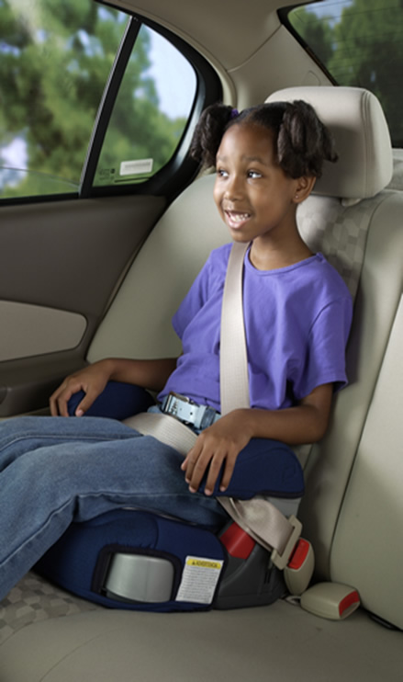
Objectives
Discuss the effectiveness of belt positioning booster (BPB) seats
Explain the advantages of using different types of BPB seats with children of different ages and sizes
Identify different types and locations of air bags in vehicles
Identify advanced air bag systems commonly seen in family vehicles
Discuss the NHTSA side air bag recommendations

Slide 3
Important Notice
Sponsoring organizations do not endorse or support products included in any modules.
Products included in this or any other module are used only as examples.
Examples do not represent all products on the market.
Check manufacturer’s websites for more products, explanations, and details.
Notes:
3

Slide 4
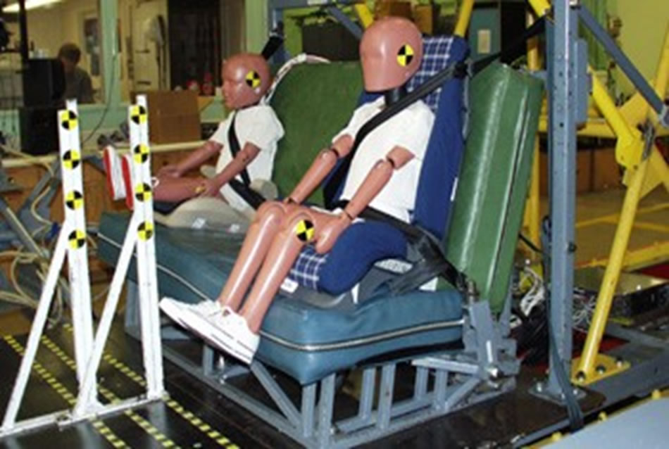
Boosters

Slide 5
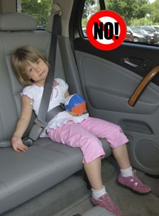
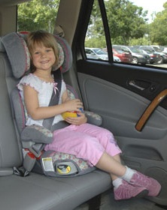
Belt Positioning Booster Effectiveness
A new study, including a greater percentage of children aged 6 to 8 years than in previous studies, found that children who were 4-8 years of age and using BPB seats were 45% less likely to sustain injuries than similarly aged children who were using the vehicle seat belt*.
*K.B. Arbogast, J.S. Jermakian, M.J. Kallan, and D.R. Durbin. Effectiveness of Belt Positioning Booster Seats: An Updated Assessment. Pediatrics 2009;124;1281-1286; originally published online Oct 19, 2009.

Slide 6
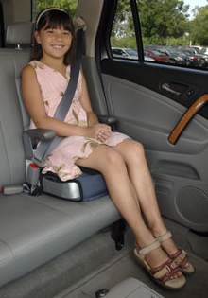
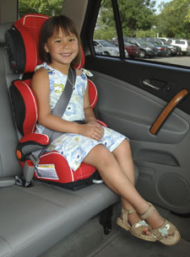
Types of Booster Seats:
Belt Positioning Boosters
BACKLESS
HIGH BACK

Slide 7
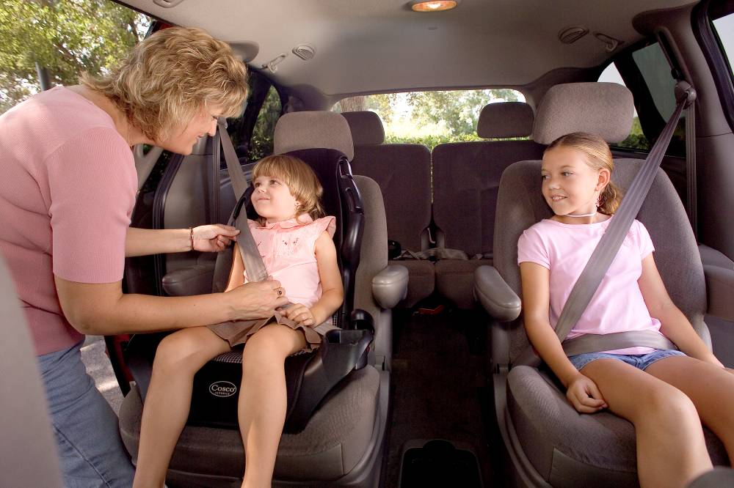
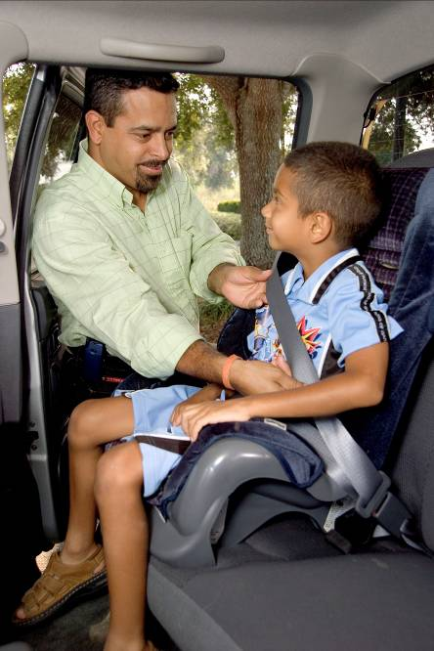
Is One Safer Than The Other?
Both provide protection in a crash
Both lift the child up so the adult lap-shoulder belt fits correctly.
Taller children benefit from the head, neck and back support of a high back booster, especially if there is no head restraint (such as a low bench seat).

Slide 8
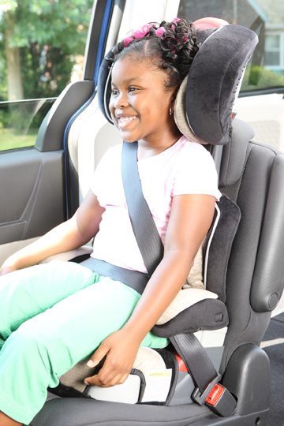
Is One Safer Than The Other?
High back boosters must be used when vehicle seat backs are low or do not have head restraints.

Slide 9
Backless Belt Positioning Booster: Benefits
Raises child up for good belt fit, but booster is not seen from outside the vehicle. Older children may not want to be seen using a “little kid’s seat”
Lower cost (as low as $20-25)
Narrow base of some may improve access to belt buckles if three children are in restraints in the back seat. (Some are also adjustable in width)
Compactness is convenient for carpools and travel.

Slide 10
Backless Belt Positioning Booster
Cautions:
  May require a belt guide for proper shoulder belt positioning.
  Belt guides may be difficult to use or lost.

Slide 11
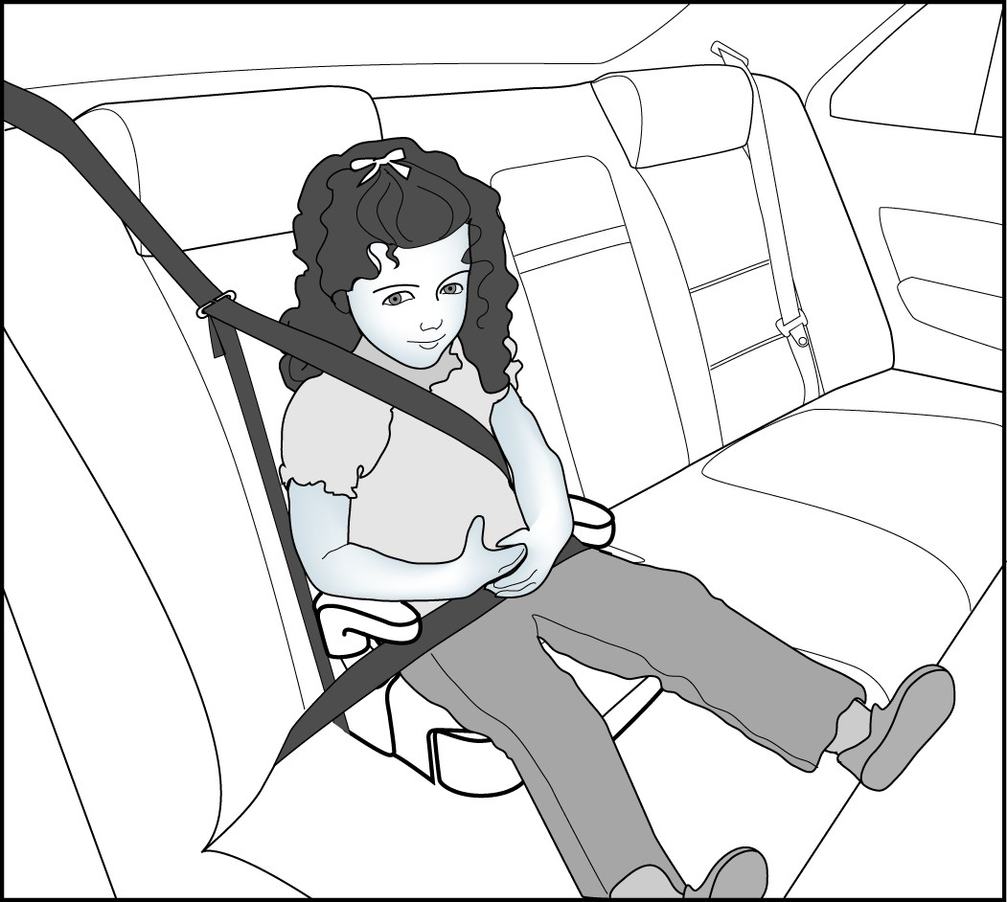
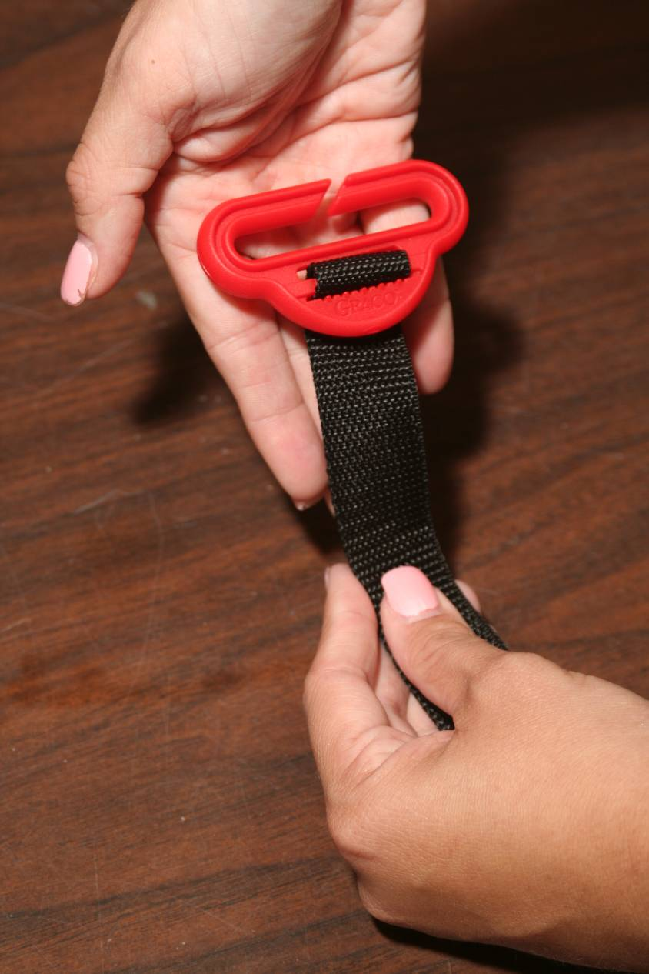
SAMPLE: Backless BPB Shoulder Belt Guide
Source: Partners for Child Passenger Safety Educational Illustrations

Slide 12
High Back BPB
Benefits:
  Built-in shoulder belt guides assist with proper positioning of the belt (across the shoulder).
  Adjustable headrests with side-wings help keep sleeping children upright with the shoulder belt positioned properly.
Cautions:
  More expensive than backless BPBs
  Some guides don’t allow the shoulder belt to retract freely so belt will stay snug.
    Always check to be sure the belt moves freely through the belt adjuster’s path.

Slide 13
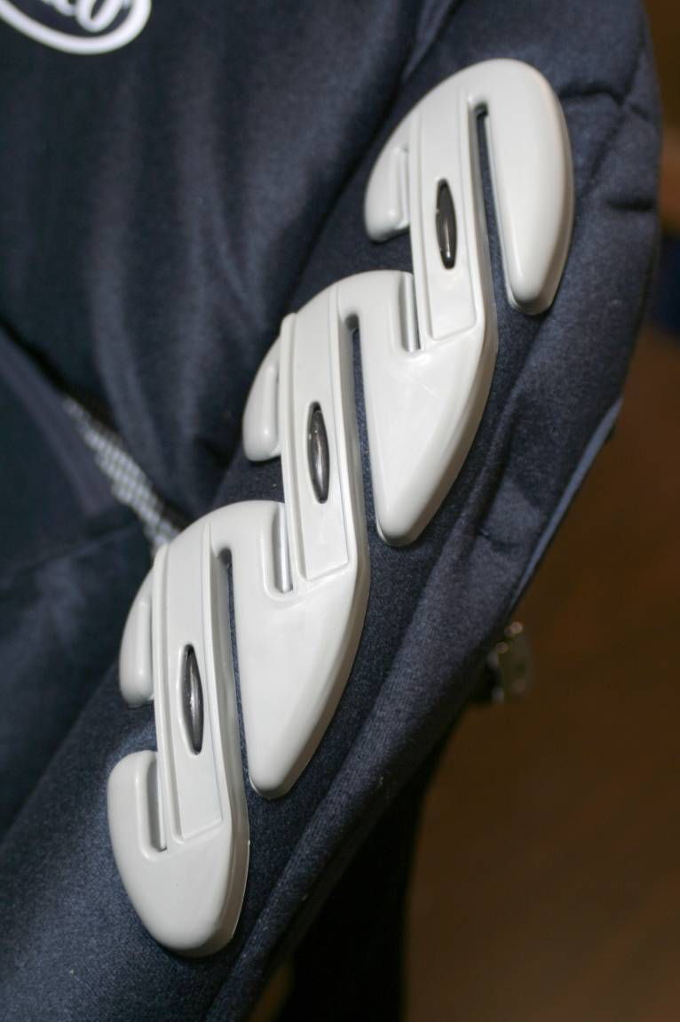
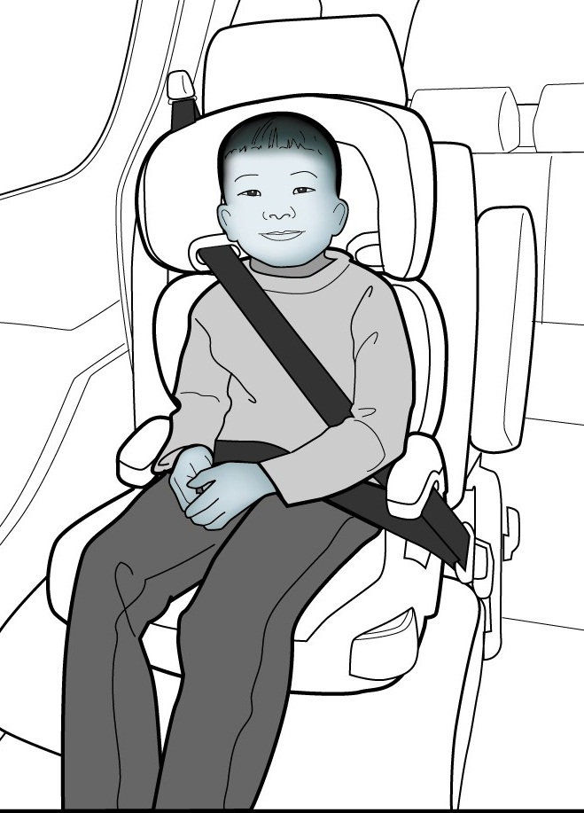
SAMPLE:
High Back Shoulder Belt Guide
Source: CHOP Partners for Child Passenger Safety Educational Illustrations

Slide 14
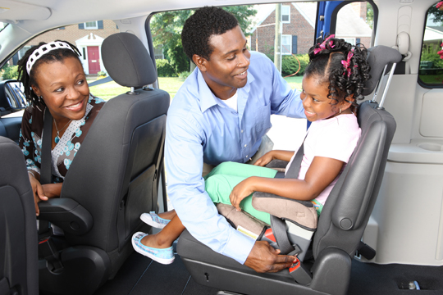
Good to Know…
Booster seat backs offer varying degrees of rear-impact head/neck protection
  Several HBBs do not allow use if the child’s head is above the vehicle seat back.
With new head restraints, some high back boosters may not sit flush against the vehicle seat back.
  Consult both vehicle and booster seat manuals for how to handle this situation

Slide 15
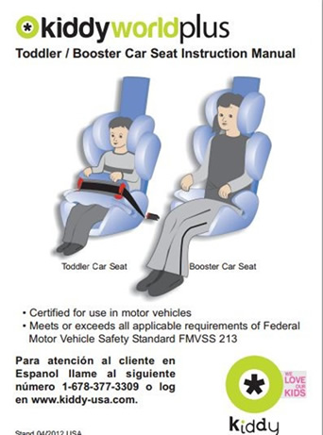
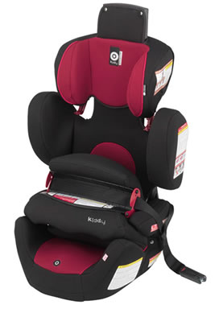
Types of Booster Seats:
A New Combo CR
Kiddy is only manufacturer to distribute a child restraint with e “protection shield”.
It is not the same thing as the older, discontinued “shield” boosters.
When the upper weight limit is met, the shield is removed and the CR becomes a belt positioning booster

Slide 16
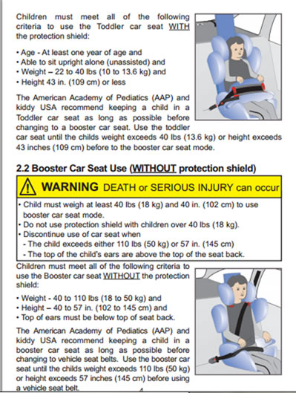
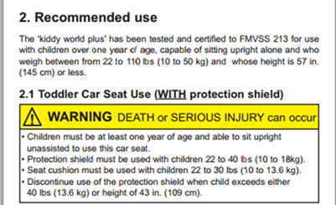
Always Review the Manual and Labeling

Slide 17
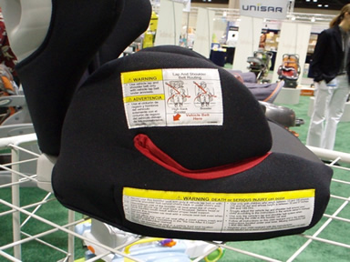
Weight Limits
Don’t graduate kids to a booster seat too early
  Keep kids in full harness
  for as long as the seat allows
Weight limits vary
  Usually 30-100 pounds for high back
  Usually 40-100 pounds for backless
Look on labels for specific
height and weight limits
  Some no longer have height limits
  Some BPBs go up to 120 pounds
Check for proper belt path and fit

Slide 18
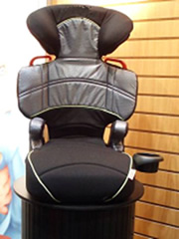
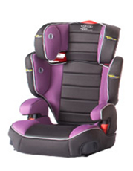
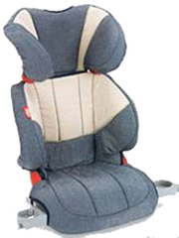
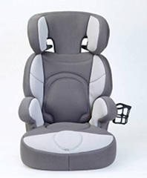
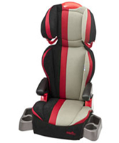
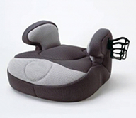
Lots to Choose From!

Slide 19
Boosters &
Side Impact Crashes
According to NHTSA, 42 percent of child fatalities to rear-seated children ages 0 to 8 years occur in side-impact collisions.
Overall, side-impact crashes kill about 300 American children under age 8 each year and result in more severe injuries at lower crash severities than frontal collisions.

Slide 20
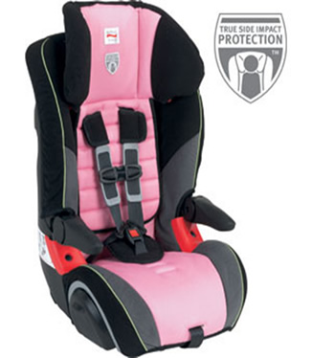
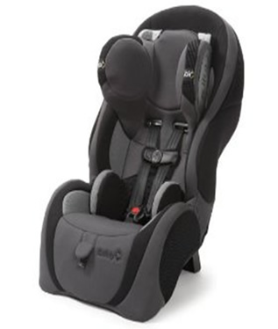
Stay Updated: New to the Market…
More CR manufacturers are designing seats with added side-impact protection in the area of the head and neck.

Slide 21
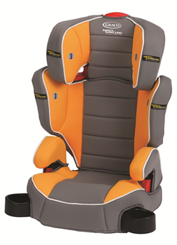
Boosters &
Side Impact Crashes
Although not federally mandated, more manufacturers are responding to side-impact crashes by designing seats with more protection in the area of the head and neck.
This diverts crash forces away from the head area, decreasing the severity of head trauma.

Slide 22
Side Impact Protection
Source: Pediatrics, Official Journal of the American Academy of Pediatrics, 10/19/09
Researchers at Children's Hospital of Philadelphia's Center for Injury Research and Prevention studied more than 7,000 children ages 4 to 8 involved in real-world crashes between 1998 and 2007.
Their 2009 study, revealed of those riding in booster seats, children involved in side-impact crashes saw the greatest reduction in injury risk.
This study shows a reduction in risk of 68% in near-side crashes and 82% in far-side crashes compared to children in standard (adult) seat belts.

Slide 23
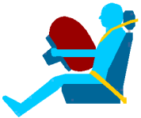
Air Bags
That’s a nice bag you have, but you need a belt to go with it.

Slide 24
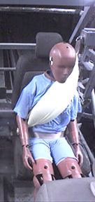
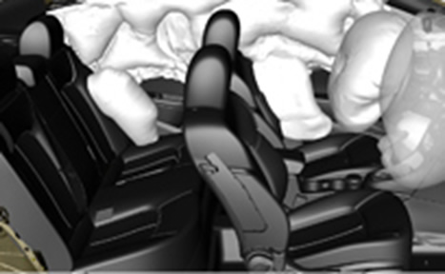
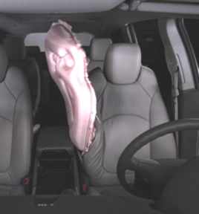
Air Bags in Vehicles
Air Bags may be found throughout the vehicle.
Different air bags provide protection for different types of crashes.
Inflatable Seat Belt
Front and Side Air Bags
Front Center Air Bag
Photos Courtesy of Ford Motor Company and General Motors

Slide 25
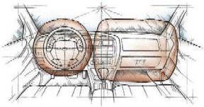
Air Bags for Front Crashes
Air Bags for front crashes work with seat belts to protect front occupants.
Newer vehicles may also have knee air bags to protect occupants’ legs, located below the steering wheel and the glove box.
Front air bags in the passenger seat, even in newer vehicles, still pose a risk to children.
Driver Air Bag
Front Passenger Air Bag
Knee Air Bags
(not shown)

Slide 26
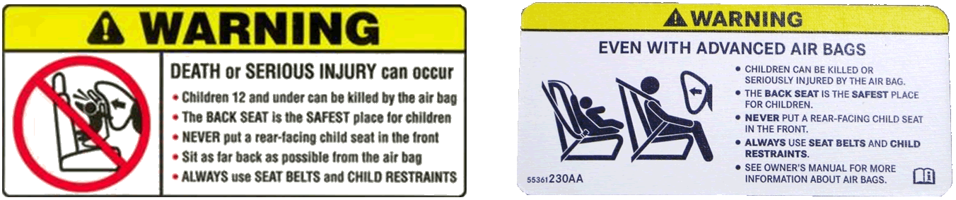
“Advanced” Frontal Air Bag Systems
Before 2004:
Starting in 2004:
Passenger Air Bag Systems with more powerful output force
Higher risk to small or out-of-position occupants in the front passenger seat
“Advanced” Air Bag Systems for Passenger Air Bags
Reduced risk to small or out-of-position occupants

Slide 27
Meeting FMVSS 208 Requirements For Children: “Advanced” Frontal Air Bags
PASSIVE SUPPRESSION: The frontal air bag system is automatically disabled for the front passenger if sensors in the vehicle detect a child or child-sized person in the front passenger seat. It is enabled when larger children or small adults are in the front passenger seat.
LOW RISK DEPLOYMENT: The frontal air bag is deployed in a way that's less likely to cause harm to an occupant (including a child in child restraint or an out-of-position small occupant).
  Vehicle manufacturers may use one or both of these types of systems to certify their vehicles to FMVSS 208 requirements.
NOTE: Our message is the same – CHILDREN 12 YEARS OLD and YOUNGER BELONG IN THE BACK SEAT.

Slide 28
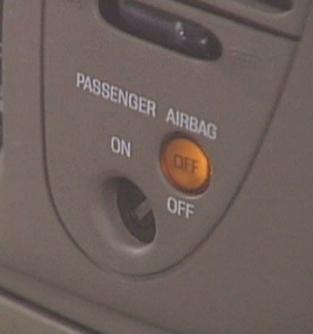
ACTIVE Air Bag Suppression
For detailed information on the switch and when to use – see the Vehicle Owner’s Manual
48% of all Manual ON/OFF switches are erroneously left ON even with child passengers *
*Source: www.safercar.gov
The passenger air bag must be turned on/off manually
(person must do something)
Manual ON/OFF switch, uses the vehicle key to operate
  Must be OFF for younger children in the front passenger seat
  Must be ON for older kids and adults
  Frontal passenger air bags only

Slide 29
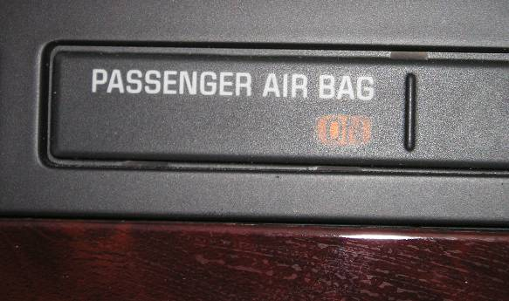
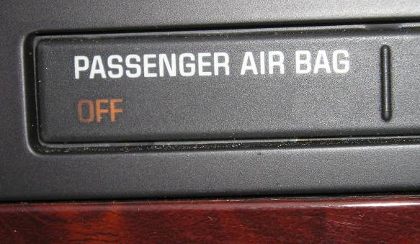
PASSIVE (or Automatic) Air Bag Suppression
Front passenger air bag system
Turns off the frontal and/or side passenger air bag systems under specific conditions.
Read the Owner’s Manual to understand:
  Is it present in the vehicle
  How status is indicated by the light(s)
  What size occupants turn “on” the air bag
  Any warnings about using this system
Notes:
29

Slide 30
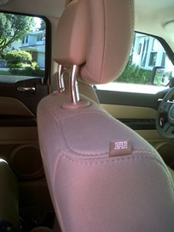
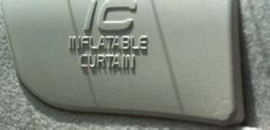
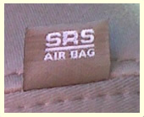
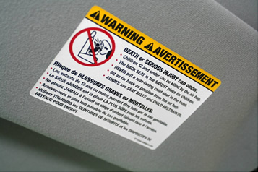
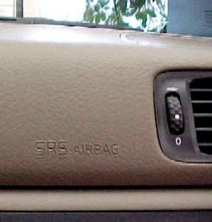
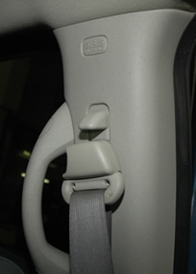
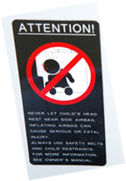
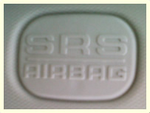
Air Bag Warning Labels & Markings (on visor and other locations)
Notes:
30

Slide 31
CPST’s Should Know…
When working with caregivers, CPSTs should investigate whether the vehicle has an Advanced Air Bag System (AABS):
  Read the visor label.
  Check the vehicle owner’s manual.
  Advise the caregiver to follow the manufacturer’s instructions and to read and understand all warnings.
  AABS’s are not all alike. The owner’s manual gives the caregiver guidance about when the air bag is suppressed (or “off”) and when it is active (or “on”).

Slide 32
CPST’s Should Know…
Source: Safe Ride News Jan/Feb 2010; Updated October 2012
Question: Why do some vehicle manuals warn that nothing should press against the back of the front passenger seat or be placed under that seat?
Short answer: Pressure on the seatback may cause a false reading by the sensors that regulate the passenger-side advanced air bag system (AABS), possibly causing either the AABS to deploy in a crash when it is not needed or to be suppressed in a crash when it is needed.

Slide 33
CPST’s Should Know…
If the vehicle owner’s manual warns against a RF CR pressing against the front passenger seatback, consider these options:
  Install the CR in the driver-side position instead. (Check the owner’s manual – some driver-side vehicle seats have sensors too!)
  Put the CR handle (if present) in the upright or fully lowered position, if allowed by the CR manufacturer.
  Use a CR that takes less front to backspace in the rear-facing mode.
  Install the CR in the center position as long as it does not press against the front passenger seatback.
Source: Safe Ride News Jan/Feb 2010; Updated October 2012

Slide 34
CPST’s Should Know…
Source: Safe Ride News Jan/Feb 2010; Updated October 2012
For vehicles that have an AABS and warn against contact with the front passenger seatback, also avoid pressure to the front passenger seat that may be applied by:
  a tightened (or over-tightened) RF tether
  the legs of forward-facing children who are stretching or pushing.

Slide 35
Low Risk Deployment
(LRD) AABs
Some vehicles have low risk deployment (LRD) advanced air bags that are never suppressed (turned off)
  The passenger air bag is always “on” and will deploy in frontal crashes, even with a rear-facing infant in the front seat.
  These vehicles do not have a lamp for the passenger air bag
Some vehicles may suppress the LRD air bag for rear facing infants, but not for larger children.
  These vehicles will have a lamp for the passenger air bag.
  Check the owner’s manual to understand what size occupants will suppress the air bag.
Some vehicles may have a manual on/off switch (pickup trucks or small rear seats) to turn off the LRD air bag
  See prior slide regarding the proper use of a manual on/off switch.

Slide 36
CPST’s Should Know…
Never place a rear-facing CR in the front passenger seat with an advanced air bag that is not turned off.
  If there is no rear seat, it is not safe to transport a rear-facing infant in the vehicle.
  Even if the AABS is suppressed, a rear-facing infant should ride in the back seat.
If a child in a Forward-Facing CR must sit in the front passenger seat, move the seat as far rearward as possible.

Slide 37
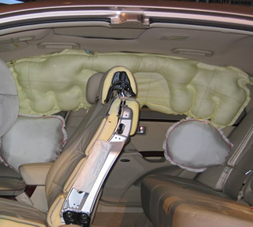
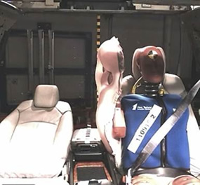
Air Bags for Side Crashes
Air bags for side crashes can be found in the door, the sides of the seat and along the edge of the roof.
Some side air bags may deploy in certain types of roll overs.
Most side air bags are tested to industry standards to minimize the risk of injury to small occupants.
The vehicle owner’s manual does not usually state when it is OK to use a CR near a side air bag, but will warn if it isn’t allowed. The CR owner’s manual must also allow use near a side air bag.
No warning against = OK to use.
Inflatable Curtain
Side Air Bag
Side Air Bag
Front Center Air Bag
Front Center Air Bag Photo Courtesy of General Motors

Slide 38
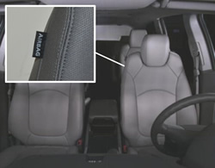
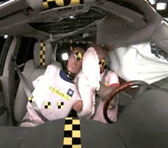
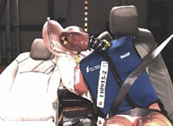
Front Center Air Bag
Located in the driver’s seat, on the inboard side. When present, a label is sewn on the inboard side of the seat.
Restrains drivers in side impact crashes to the passenger side of the vehicle
Provides cushioning between front seat occupants in side impacts and rollovers
There are no vehicle restrictions on CR placement with a front center air bag.
If a rear facing CR is installed in the 2nd row center seat, move the 2nd row seat rearward whenever possible to avoid interaction with the air bag.
Photos Courtesy of General Motors

Slide 39



Inflatable Seat Belts
Generally deploy in front, side and roll over crashes
Separate lap belt and shoulder belt with a sewn-on latch plate.
Lap belt is a switchable retractor, shoulder belt is ELR
The air bag is inside the shoulder belt webbing, which is thicker than the lap belt webbing.
Check CR Instructions or the SafeKids website to verify if a specific CR can be used with the inflatable seat belt.
Inflatable belts are identified with a permanent label on the shoulder belt
Photos Courtesy of Ford Motor Company

Slide 40
NHTSA Side Air Bag (SAB) Recommendations
All air bags (frontal or side) are supplemental safety devices and are intended to work best in combination with seat belts. Therefore, even with SABs that meet TWG* testing procedures, make sure that:
  ALL children use a safety restraint appropriate for their age and size (this could be a safety seat, booster seat or adult seat belt).
  NEVER place a rear-facing infant seat in the front seat of a vehicle with a front passenger air bag.
  To minimize injury risks, NHTSA recommends that children not lean or rest against chest-only or head/chest combination SABs.
  NHTSA has not seen any indication of risks to children from current [inflatable curtains].
*TWG = Technical Working Group: the industry group that established test procedures to confirm a low risk of injury to out-of-position small occupants from deploying side air bags (SABs).
Source: NHTSA: Frequently Asked Questions About Side-Impact Air Bags (SABs), April 15, 2005. National Child Passenger Safety Certification Training Student Manual, April 2007 (R01/08), pp 253-256.

Slide 41

Don’t Forget!
Children under the age of 13 are safest sitting in the rear seat properly restrained.

Slide 42

FYI
Pregnant women should always wear their seat belts.
They should sit as far back as possible from the air bag with the lap portion of the belt correctly positioned over the hips (not the stomach) and the shoulder portion across the chest.

Slide 43

When In Doubt, Check It Out! Read The Manual.
Source: 2012 Ford F150 Owner’s Manual.

Slide 44
Take the Quiz:
http://cpsboard.org/quiz-test-2/

