Slide 1
Learning Styles
Module 2

Slide 2
Module 2 Objectives
Upon completion of this module, the participant will be able to:
Define learning
Identify the factors that affect learning
Define teaching
Define the four step process of teaching and learning

Slide 3
Module 2 Objectives (Cont’d)
Compare the differences and similarities in learning styles across all generations
List the characteristics of different generations of adult learners
Identify basic adult learning rules to maximize training effectiveness
Notes:
3

Slide 4
Module 2 Objectives (Cont’d)
Explain the techniques for motivating multi-generational learners
Define interactive instruction
Explain interactive instruction methods
Notes:
4

Slide 5

Basic Questions About Learning
How do people learn?
How can we tell if someone has learned something?

Slide 6
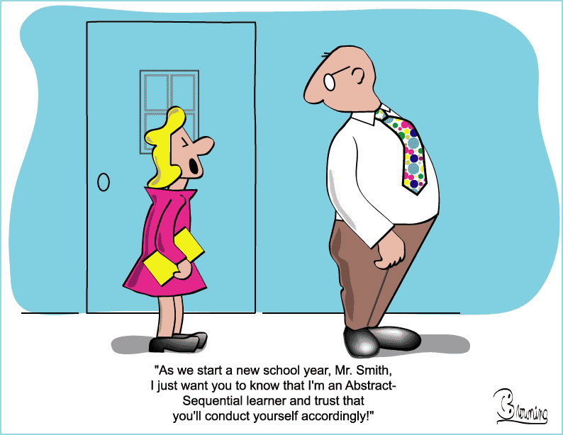
Definition of Learning
Learning is any activity involving the senses that affects a person’s ability to do something

Slide 7
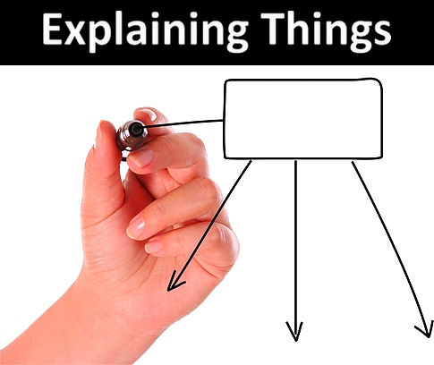
What is Teaching?
Illustrating
Guiding and coaching
Motivating
Encouraging/Inspiring
Explaining
Mentoring

Slide 8

Definition of Teaching
Teaching is providing an efficient learning environment for the participant.

Slide 9

Cardinal Rule
At the very least, a teacher or trainer must never do anything that makes it more difficult for the participant to learn

Slide 10
Four Step Process of Teaching/Learning
Step 1 - Preparation
Step 2 - Presentation
Step 3 - Coaching
Step 4 - Evaluation

Slide 11

Step 1: Preparation
Let them know what they’re going to learn
Explain the benefits (WIIFM)
Tie new information to knowledge they already have

Slide 12
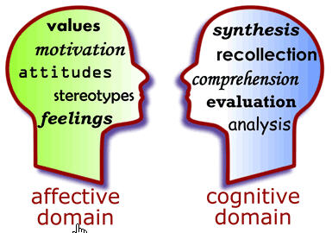
Step 2: Presentation
Cognitive Domain
Affective Domain
Psychomotor Domain
Adjust
Repair
Perform
Measure

Slide 13

Step 3: Coaching
Coaching means guiding the participant in practicing the new learning

Slide 14
Step 4: Evaluation
Determines how well the participant is learning
Occurs during the preparing to learn stage
Occurs during and immediately after a presentation

Slide 15

Differences and Similarities in Learning Styles Across All Generations
Children:
Rely on others
Accept information
Expect to use knowledge in the future
Have little experience
Offer limited resources

Slide 16

Differences and Similarities in Learning Styles Across All Generations (Cont’d)
Adults:
Decide for themselves
Need to validate information
Expect immediate use
Have past experience
Serve as a resource

Slide 17
Multi-Generational Instruction
Baby Boomers (born 1946 - 1965)
Generation X (born 1966 - 1980)
Generation Y (born 1981 - 2000)

Slide 18

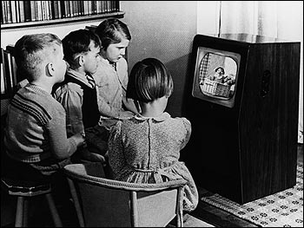
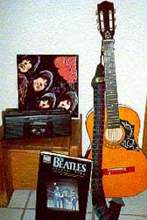


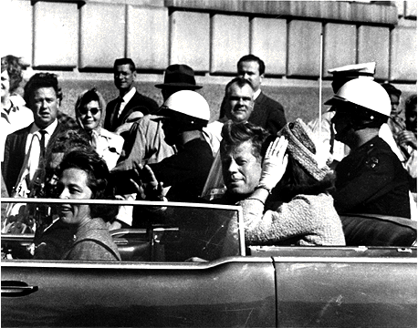


Baby Boomers

Slide 19
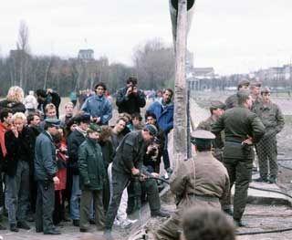


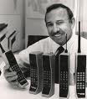






Generation X

Slide 20


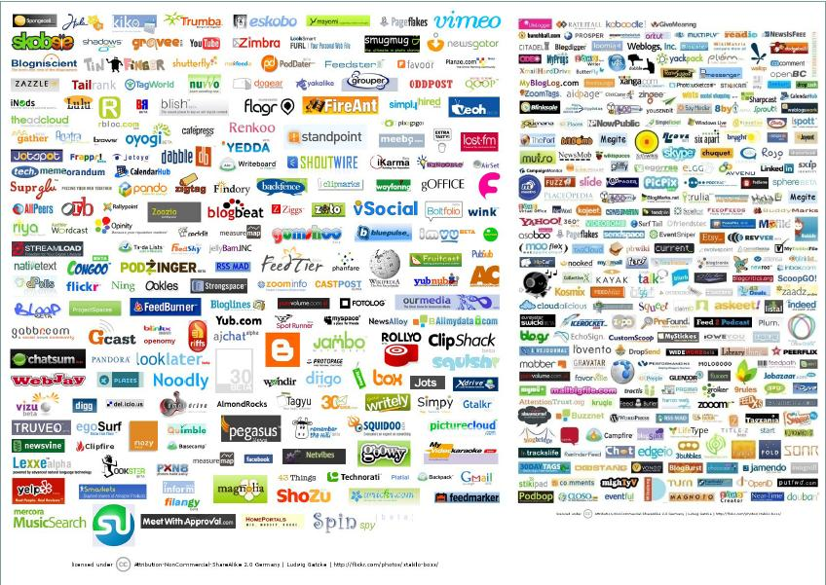





Generation Y

Slide 21
Individual Differences that Affect Learning
Intelligence level
Educational background
Prior knowledge and skills
Aptitude
Attitudes and interests
Learning styles
Culture/language

Slide 22
Interactive Instruction
There’s more to teaching than talking to them

Slide 23
Methods for Interaction
Oral questions
Response items
Worksheets
Work sessions
Simulations/Games
Labs
Group discussion
Field trips
Brainstorming
Study assignments

Slide 24
Module 2 Summary
Define learning
Identify the factors that affect learning
Define teaching
Define the four step process of teaching and learning

Slide 25
Module 2 Summary (Cont’d)
Compare the differences and similarities in learning styles across all generations
List the characteristics of different generations of adult learners
Identify basic adult learning rules to maximize training effectiveness

Slide 26
Module 2 Summary (Cont’d)
Define interactive instruction
Explain interactive instruction methods

