Slide 1
Speaking Effectively
Module 3

Slide 2
Module 3 Objectives
Upon completion of this module, the participant will be able to:
  List the four components of public speaking
  State how positive or negative components affect the audience’s reception to a presentation
  Prepare and deliver effective speaking presentations

Slide 3

Four Components of Speaking Effectively
Mental
Visual
Vocal
Language
Mental
Visual
Vocal
Language

Slide 4
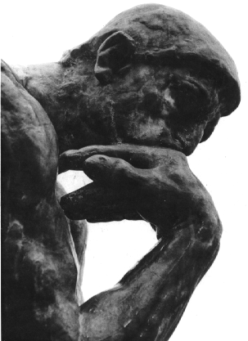
Mental
Professional Publications
Thinking
Visualizing
Stress Reduction Exercises

Slide 5

Visual
Impact
Posture
Gestures
Eye Contact

Slide 6
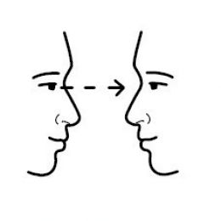
Eye Contact
Notes:
6

Slide 7


Vocal
Silence
Emotion
Professional

Slide 8

Language
Wording
Meaning

Slide 9
Personal Presentation
Background
Select a topic
Prepare to present
Bring Presentation #2 critique sheet to instructor (supplemental material)
Positive feedback to other participants

Slide 10
Personal Presentation
Example topics
  My greatest athletic accomplishment
  What was the funniest experience you had while working a CPS checklane
  The most frightening place I’ve ever been
  My favorite animal, other than a cat or dog
  What was the most unusual seat install you have seen
  My best vacation
  My most frightening moment

Slide 11
  A day (or week) I’ll never forget
  The best experience I have ever had at a check lane
  If I could go back in time to visit another era, it would be…
  My greatest adventure
  The most unforgettable person in a check lane that I ever met
  Any topic of your choice.
Three minutes
Incorporate the four components of Speaking Effectively

Slide 12
Module 3 Summary
  List the four components of public speaking
  State how positive or negative components affect the audience’s reception to a presentation
  Prepare and deliver effective speaking presentations

