Slide 1
Principles and Methods of Team Teaching
Module 5

Slide 2
Module 5 Objectives
Upon completion of this module, the participant will be able to:
Explain the advantages of team teaching
Explain the disadvantages of team teaching
Describe techniques for successful team teaching
Demonstrate effective team teaching

Slide 3
Team Teaching
Definition:
Team teaching is an organizational instructional arrangement in which two or more instructors work cooperatively in a classroom setting to provide learning opportunities for a group of participants
Notes:
3

Slide 4

Examples of Team Teaching
Sharing the stage
Lending a hand
Active listening
Support and Monitor
Notes:
4

Slide 5
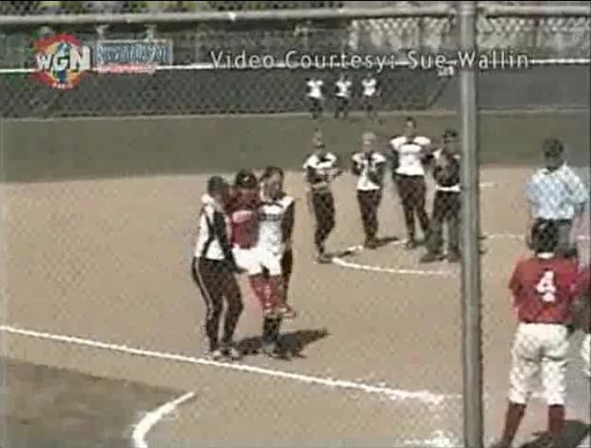
Team Spirit
Notes:
5

Slide 6

Team Teaching Advantages
Secondary knowledge resource
Shared workload
Supportive partners
New or varied voice

Slide 7

Team Teaching Disadvantages
Differing levels of authority
Personality conflicts
Unwillingness to accept advice or feedback from other instructor(s)

Slide 8
Discussion Session
Divide class into 2 groups
In each group discuss 2 good experiences in team teaching
How did this help to have a successful course?
In each group discuss 2 challenging experiences in team teaching
Solutions to the challenging experiences

Slide 9
Instructor Roles
Maintain a positive relationship
Respect each other’s level of expertise and experience
Address differences outside classroom
Be supportive
Respect time
Teach your own portion

Slide 10
Responsibilities of Instructors in the Back
Be present
Actively listen
No distractions
Willing to help
A/V problems
Distribute handouts
Record on flipchart, etc

Slide 11
Team Teaching Techniques
Pre-class coordination and preparation
During class
Post class

Slide 12
Team Teaching Techniques (Cont’d)
Pre-class Coordination and Preparation
Coordinate and discuss delivery styles
Choose a co-teaching model
Agree on course expectations
Agree on Responsibilities
Agree on Scheduling
Use the Administrator Guide
Setup a regular meeting time
Agree to be flexible

Slide 13
Team Teaching Techniques (Cont’d)
During Class
Present a team teaching approach
Control of the session
Should not interrupt the session
Raise a hand to signal
Include other instructor(s) when appropriate
Smooth transitions are essential
Assist and support
Communicate and coordinate the next session/activity

Slide 14
Team Teaching Techniques (Cont’d)
Post class
Gather evaluations
Help repack materials
Discuss and evaluate the course
Review the delivery and presentation methods
Congratulate each other

Slide 15
Module 5 Summary
Explain the advantages of team teaching
Explain the disadvantages of team teaching
Describe techniques for successful team teaching.

