Slide 1
Presentation and Evaluation
Module 7

Slide 2
Module 7 Objectives
Demonstrate training techniques in 8-10 minute presentation
Describe evaluation methods used in CPS Certification courses

Slide 3

Audience Effect
Notes:
3

Slide 4
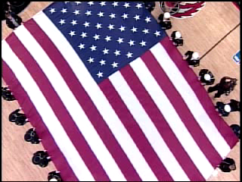
Audience Effect with Peer Coaching
Notes:
4

Slide 5
Presentation Three
Effective Instruction of CPS Certification Curriculum
Use of the 5 Chapter options provided.
Visual Aids
Participant interaction
Eight to ten minutes
Notes:
5

Slide 6
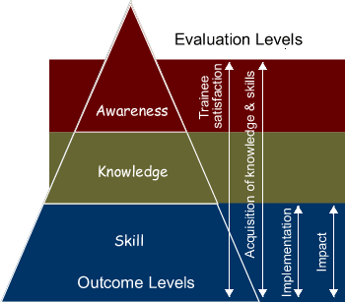
Evaluation
Definition:
Evaluation is a
continuous process
of assessing the
effectiveness and
efficiency of training

Slide 7
Steps to Evaluate Training
Select the evaluation levels(s) to be measured
Collect and analyze the data
Document the evaluation results and share with the appropriate instruction team members.
Determine the need for revision

Slide 8
Evaluation Methods
Course Evaluation
Pretest
Daily feedback
Observation
Work sessions
Course Quizzes
Post -Test
Follow up survey

Slide 9
Module 7 Summary
Describe evaluation methods used in CPS Certification courses
Demonstrate training techniques in 8-10 minute presentation

