Slide 1
MODULE 13
Using and Maintaining Your New Skills
Notes:
module 13 • using and maintaining your new skills
TOTAL TIME: 228 Minutes
Introduction – 1 minute
Next Steps: Be Active in Your Community – 5 minutes
Next Steps: Build Skills – 5 minutes
Next Steps: Recertification Process – 5 minutes
Next Steps: Organize an Inspection Station – 2 minutes
Next Steps: Get Engaged! – 5 minutes
How Far You’ve Come – 10 minutes
Learn • Practice • Explain—Review Installation Video
Skills Evaluation 4 – 180 minutes
Course Completion – 15 minutes
Activity—Checkup Event and Course Recap (indoor)
MEDIA, MATERIALS, AND RESOURCES
Recertification Flow Chart (cert.safekids.org)
CPST Recertification Personal Log (cert.safekids.org)
Course Roster
List of local/state CEU opportunities
List of local/state checkup events/inspection stations
List of local/state Safe Kids Coalitions and respective points of contact
State CPS Coordinator List (cpsboard.org)
Course evaluations
PREPARATION
Review CPS Inspections and Checkup Events (cpsboard.org).
Review the resources listed under Media, Materials, and Resources, and be prepared to hand out copies to the students.
Prepare to conduct the checkup event.
The Lead Instructor is responsible for ensuring that a checkup event is planned in advance and will allow all students the opportunity to participate.
The checkup event must be a minimum of 120 minutes.

Slide 2

Module Objectives
IDENTIFY next steps to strengthen new CPS Technician skills.
EXPLAIN the steps for recertification.
PARTICIPATE in course checkup event.
Notes:
MODULE OBJECTIVES
DO
Review the module objectives with the group.

Slide 3
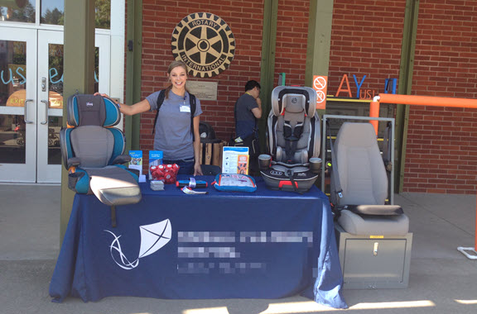
NEXT STEPS: Be Active in Your Community
Share Information
Participate
Notes:
Next Steps: Be Active In Your Community
DO
Use the TG to review ways students can be active in their community, and strengthen their technical and communication skills.
Reminder
As you use the TG to teach, take time to review this module’s Tech Tips with students.

Slide 4
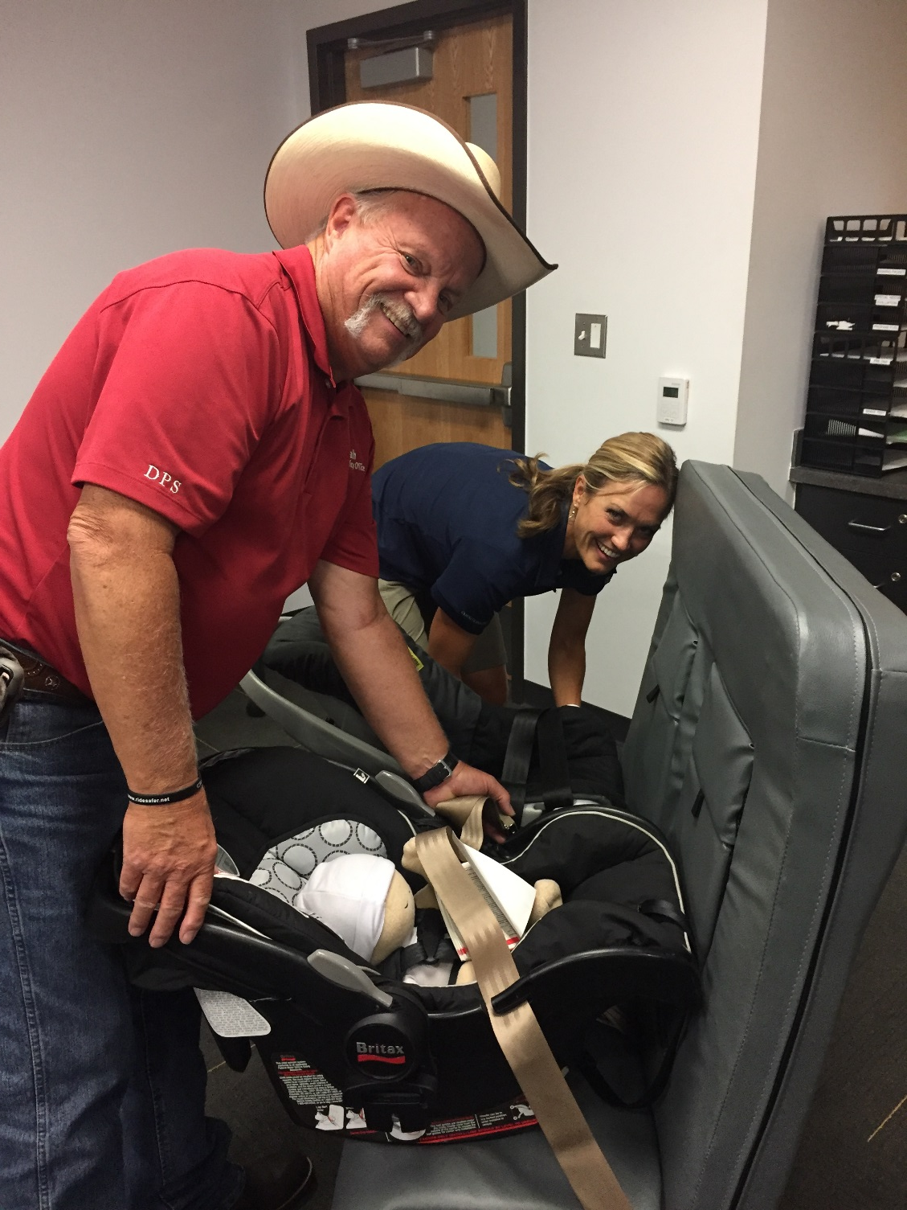
NEXT STEPS: Build Skills
Technical
Workshops/Webinars
Resource Review
Communication
Workshops/Webinars
Hands-on Experience
Partner with more experienced CPS Technicians
Notes:
Next Steps: BUILD SKILLS
DO
Since the National CPST Certification Training is an introductory course, encourage students to put their new knowledge and skills to use as soon as possible. Discuss ways to get involved in their communities.
Remind students that the CPST Code of Conduct details the expected conduct and commitment for CPS Technicians.
Direct students to view the copy of the CPST Code of Conduct (cpsboard.org) located on the inside back cover of the TG.
Remember the National CPST Certification Training is a beginning.
Work to expand your knowledge base by reviewing resources and completing continuing education unit (CEU) workshops/webinars.
Continue to build positive communication skills by completing community education workshops/webinars.
Seek out opportunities to work with more experienced CPS Technicians in the community to expand your skills.

Slide 5
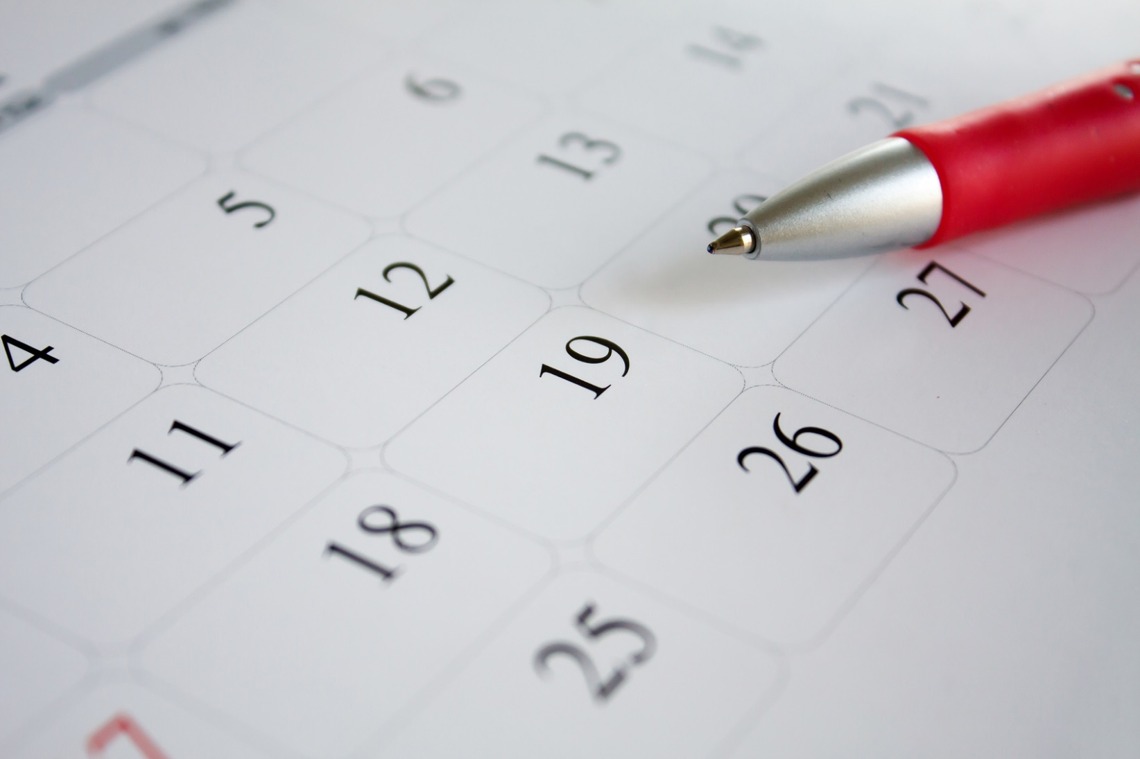
NEXT STEPS: Recertification Process
Two-year Cycle
Instructor/Technician Proxy verified seat checks
Community Education
Continuing Education Units (CEU)
Recertification Fee
Notes:
Next Steps: Recertification Process
It is never too early to begin working on the recertification requirements.
Keep email current with Safe Kids Certification to receive recertification updates.
Recertification information and program updates will be provided through the CPS Express, a newsletter emailed to all CPS Technicians and Instructors.
Keep proof of attendance for CEU workshops in case of an audit.
DO
Review the requirements for recertification.
Provide students with a Recertification Flow Chart and a CPST Recertification Personal Log, or project on the screen if the Internet is available.
If possible, review the Safe Kids Certification website at cert.safekids.org and log into a profile to show where to enter recertification information.

Slide 6

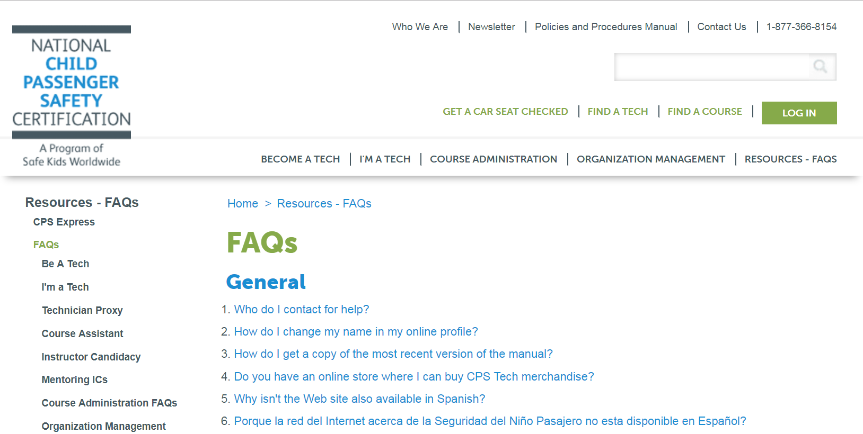
Recertification Questions
Notes:
Recertification Questions
DO
Review where to find answers on cert.safekids.org, including frequently asked questions and other helpful resources (e.g., I’m a Tech, Policies and Procedures, and Contact Us sections).
Project the cert.safekids.org website on the screen if an Internet connection is available.

Slide 7
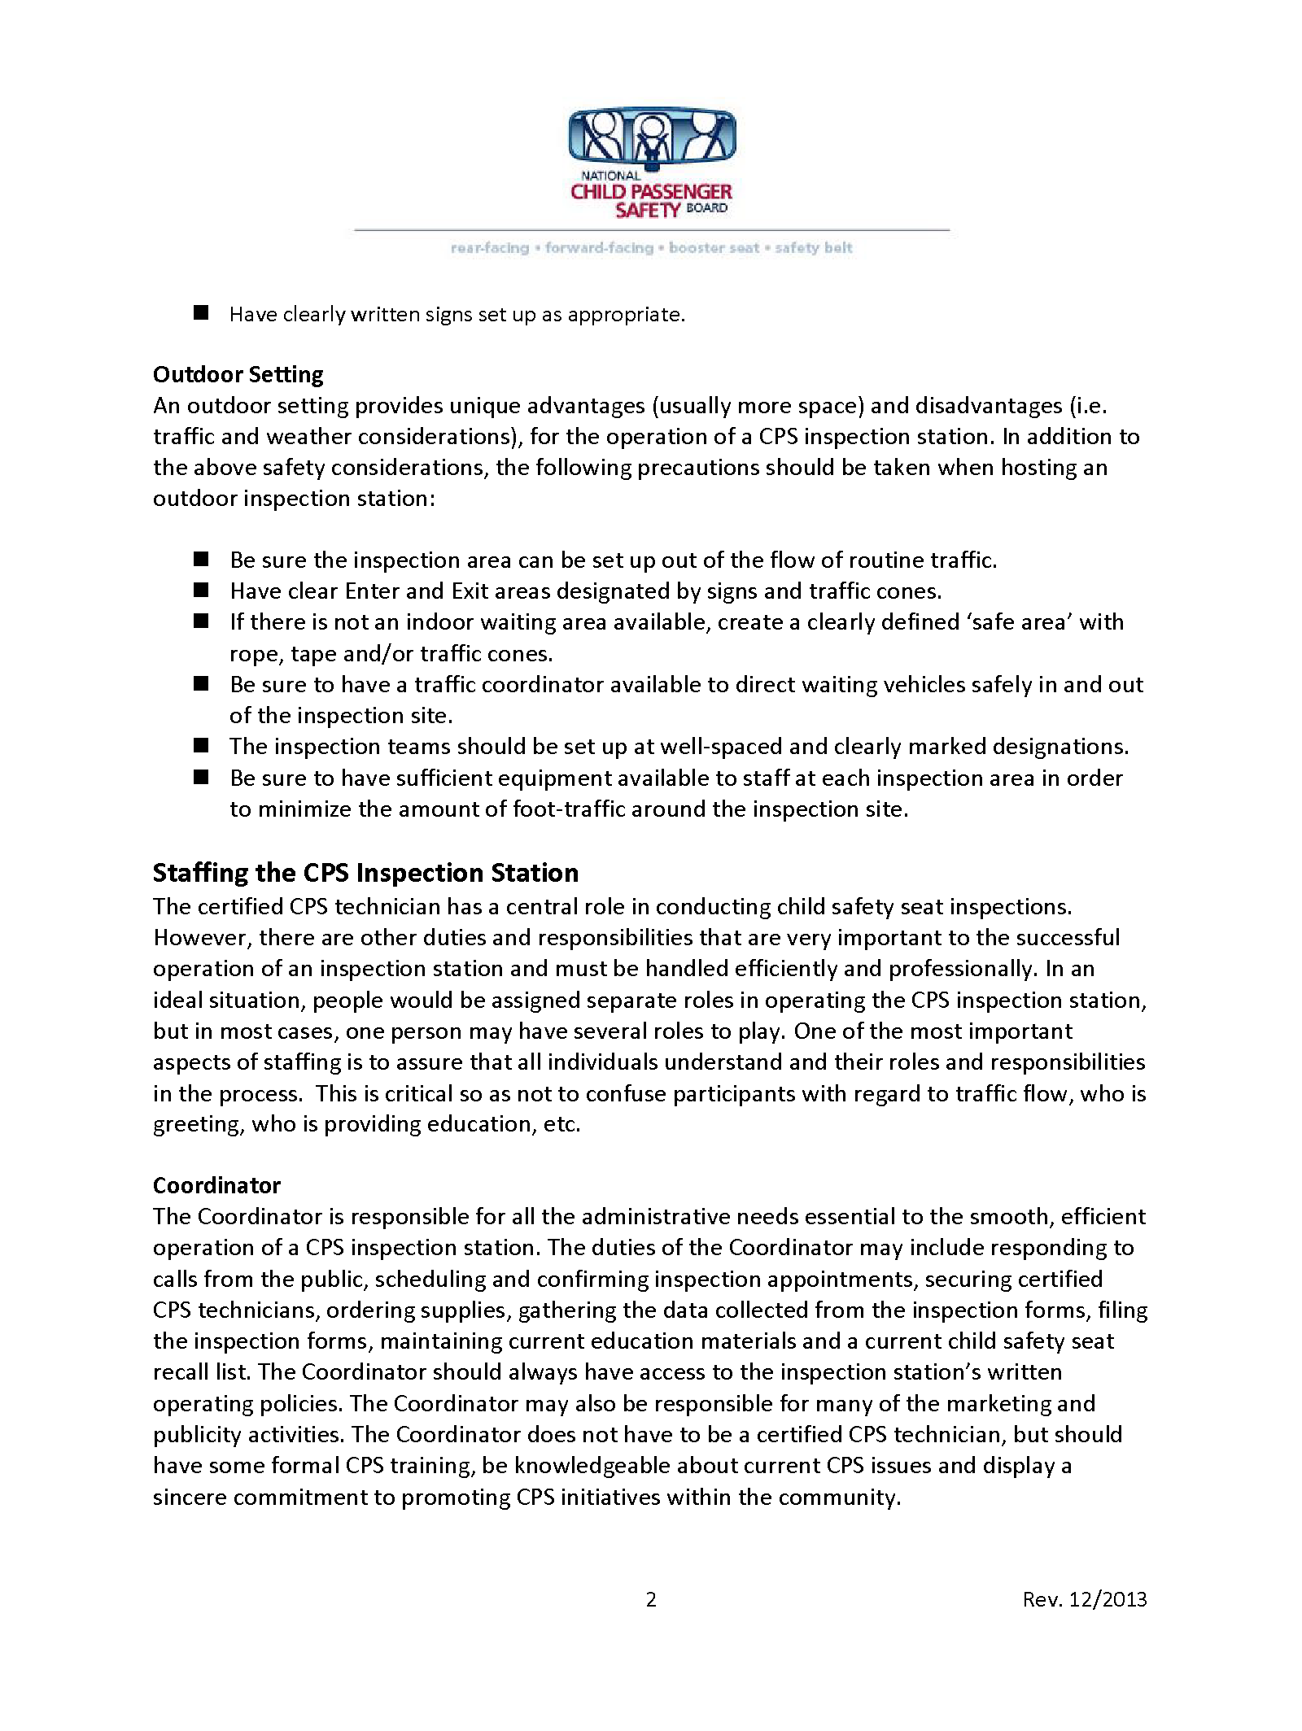
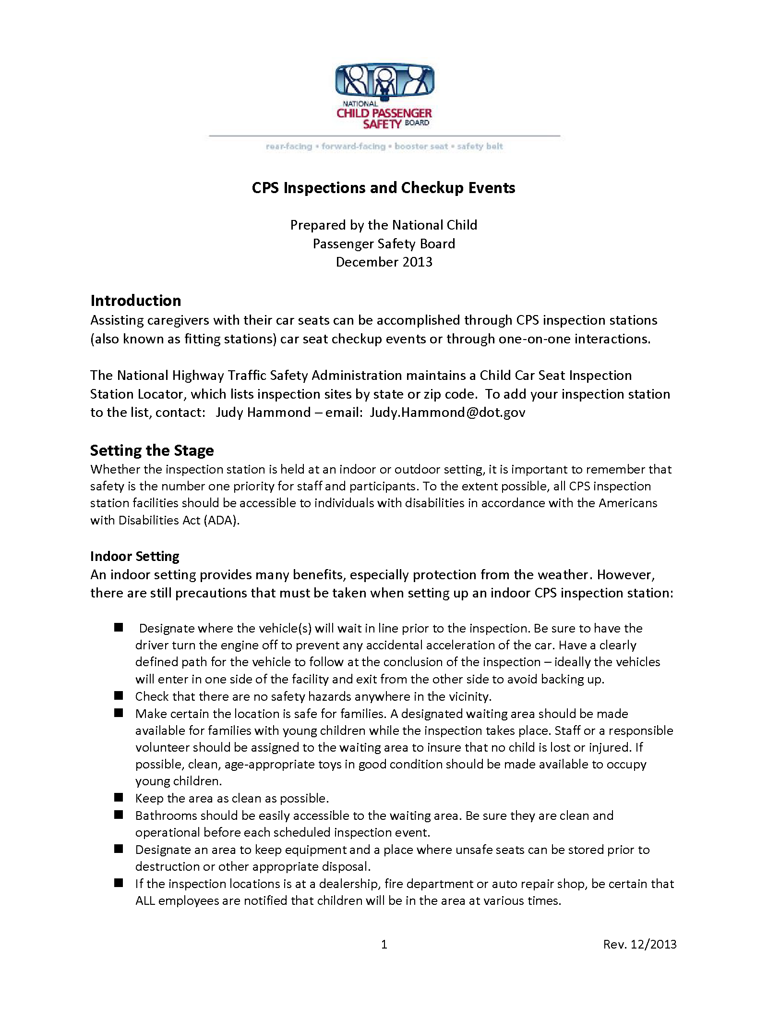
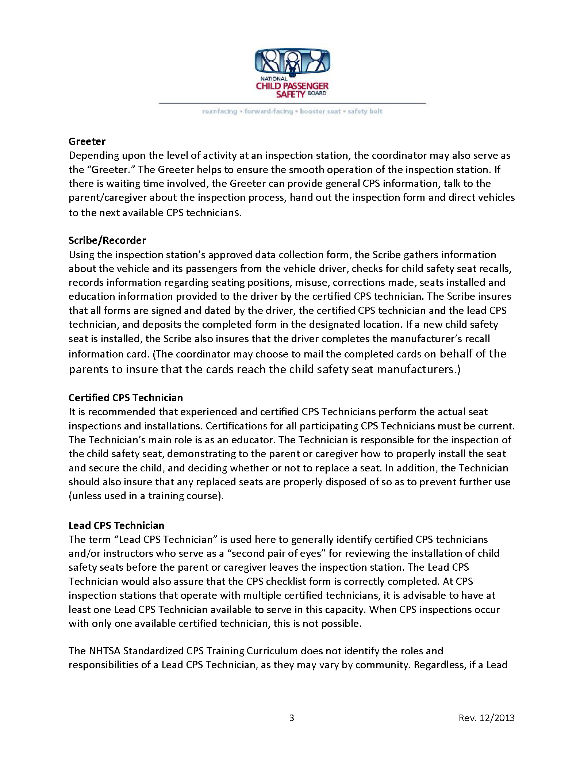
NEXT STEPS: Organize an Inspection Station
View the “CPS Inspections and Checkup Events” document to learn more about…
How to run a safe, quality inspection station or checkup event
Resources and information on liability
Notes:
Next Steps: Organize an Inspection Station
Refer to the CPS Inspections and Checkup Events document at cpsboard.org for information about the following topics.
How to run a safe, quality inspection station or checkup event
Resources and information on liability
DO
Review the information in the callout box in the TG, regarding the National Digital Car Seat Check Form.

Slide 8
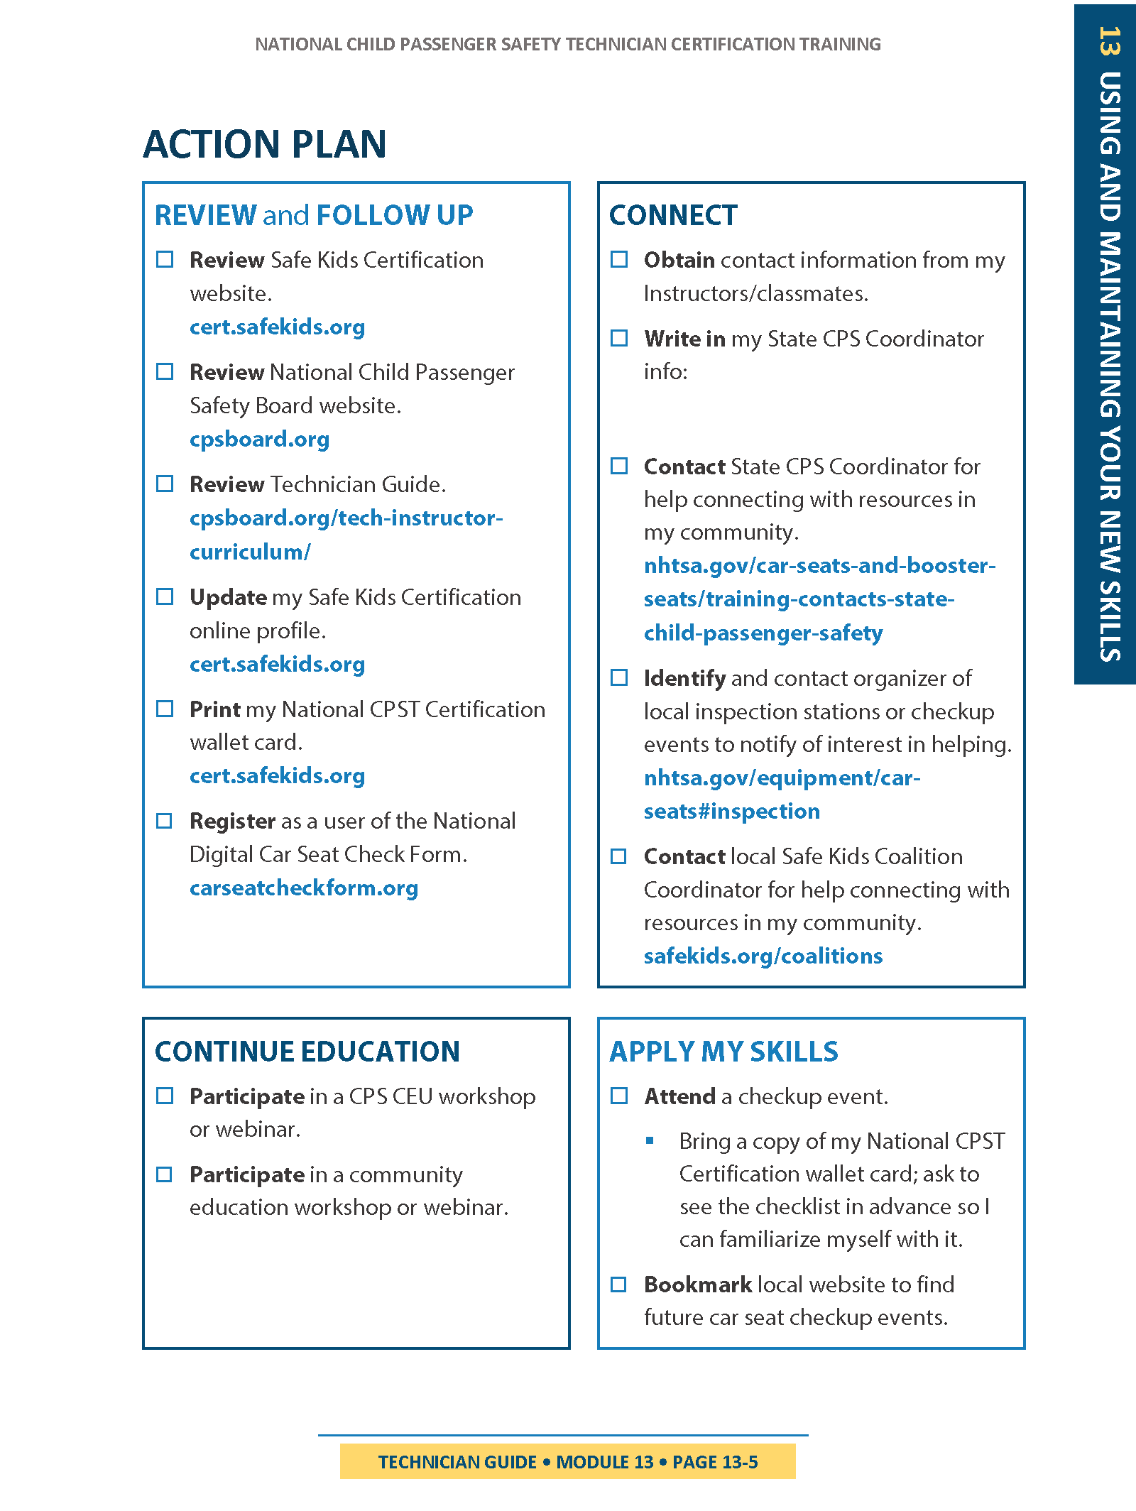
Action Plan
Develop an action plan to put your skills to work!
What resources will you review?
How will you work to improve your technical/communication skills?
How will you get involved in your community?
Notes:
action plan
DO
Allow students to identify ways to get involved in the CPS Community after the completion of the course.
Additionally, identify ways to expand their knowledge base through identifying educational opportunities.
Be prepared to share the following information with the students as appropriate.
Course Roster
List of local/state CEU opportunities
List of local/state checkup events/inspection stations
List of local/state Safe Kids Coalitions and respective points of contacts
State CPS Coordinator List (cpsboard.org)
NOTE
The Action Plan form in the TG is provided as a reference for suggested post-training activities.

Slide 9


Review Installation Video
Learn Practice Explain
Review the video you recorded earlier in the training, when you did your first car seat installation. Reflect on your progress, and share what you’ve learned.
Discuss the following questions.
Now that you’ve learned and practiced the skills for proper car seat installation, what guidance would you give yourself, based on your video recording?
How do you rate your progress based on your video recording, and how you feel now?
Notes:
LEARN • PRACTICE • EXPLAIN—Review Installation Video
Allow 10 minutes for this activity.
DO
Before continuing to the checkup event, remind students how far they’ve come in developing their skills.
Ask students to take a moment to review the video they recorded earlier in the training, when they did their first car seat installation.
Allow a few moments for students to review their recordings, then lead a discussion using the following questions.
ASK
Now that you’ve learned and practiced the skills for proper car seat installation, what guidance would you give yourself, based on your video recording?
How do you rate your progress based on your video recording, and how you feel now?
DO
Allow the students to reflect on their progress, and share what they’ve learned.

Slide 10
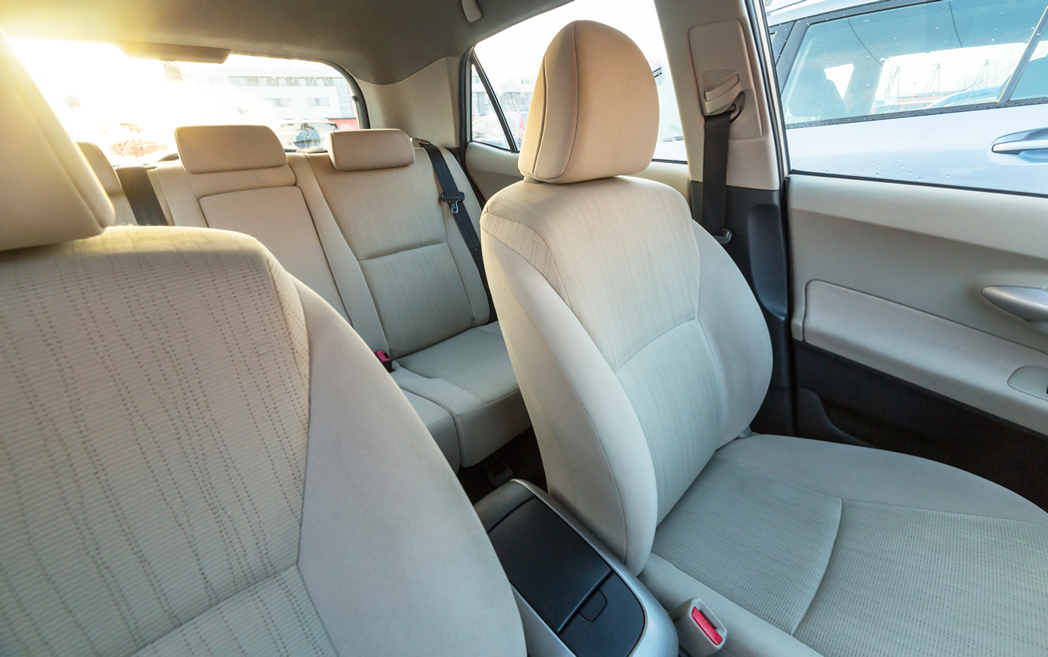
Skills Evaluation
SKILLS EVALUATION 4 Checkup Event
Notes:
DO
Explain how the skills evaluation will be conducted.
For complete instructions, refer to the Instructor Prep Guide, Instructor Guideline for Administering Skills Evaluations.
Note
Allow 30 minutes for event setup, 30 minutes for event tear-down, and two hours for the event itself.

Slide 11

Checkup Event and Course Recap
ACTIVITY
Let us know how we did: things you liked and any suggestions for improvement!
Notes:
Activity—Checkup Event and Course Recap
Allow 15 minutes for discussion and course closure.
DO
Discuss the checkup event with the students.
Ask them what worked well for them, and what didn’t.
DO
It is strongly encouraged that evaluations be provided to students.
Completed evaluations are for local use, and do not need to be provided to Safe Kids Certification.
A sample course evaluation is included in the instructor materials for this module.
Do
Thank everyone for their attention, hard work, and commitment to safe child transportation.

