Slide 1

New Results & Tools from the NDCF
Adele Polson, Westat and Casey Brennan, AAA
Notes:
Hello everyone, and thank you for having me back to present today.
We are going to review some new results from the NDCF.
Our partners at AAA Mountain West group have developed these results into an outreach campaign.
Casey is going to give you some highlights of the campaign and provide you with the materials that you can use in your own programs.

Slide 2
NDCF Program Partners
Subject Matter Experts
Data Analysis
Software Developer
Program Support
Program Manager Field Training
Program Support
Notes:
First, I’m just going to review some quick background on the NDCF.
As you all have probably heard before, the NDCF has been developed through a collaborative effort, managed by the National Safety Council, with support from the National Highway Traffic Safety Administration (NHTSA).
Tennessee Tech University iCube serves as the software developers, and data analysis is performed by Westat.
AAA Mountain West Group also provides program and financial support.
The National Child Passenger Safety Board serves as a body of subject matter experts providing insights for decision-making as feedback is received from the field.
These diverse program partners are a reflection of the collaborative nature of the NDCF program.
Each of these partners has a unique and important role in this collective initiative.

Slide 3
NDCF Overview
One national, standardized data collection tool
Collect, store, & access data
Monitor trends
Inform outreach & educational strategies
Notes:
This resource provides one national, standardized data collection tool, freely available to all U.S. certified child passenger safety technicians and instructors.
As we all know, CPS programs conduct car seat checks through a variety of settings.
And, the NDCF allows that seat check data to be collected, stored, and accessed by technicians as well as program managers.
The seat check data can also be used to monitor trends, seat distribution, and issues encountered in the field.
Then this data can be leveraged to enhance and change the way that we provide outreach and educational strategies to families.

Slide 4




Initiative to Leverage Data
New insights into car seat checks and child passenger safety
Notes:
This initiative that we are discussing today is an excellent example of the NDCF program the data into outreach campaigns.
Our program partners, AAA, NSC, and Westat all came together to use the NDCF data to show the program’s effectiveness and also to develop new data for an outreach campaign.

Slide 5
Today’s Agenda
1
Which data is better?
2
What new messages can we use to help encourage caregivers to visit Techs?
3
Materials you can use for your programs
Paper versus Digital Data (NDCF)
Further analysis of the NDCF data
AAA CPS Week Media Campaign
Notes:
So today, we are going to share the results of this initiative with you.
There were 3 components to this initiative:
First, using AAA data, we compared paper car seat check forms to digital data collected in the NDCF and analyzed which method is more efficient and produces better quality data.
Second, I’m going to review the analysis we conducted on the NDCF data.
With the support for AAA Mountain West Group we were able to deep dive into all of the NDCF data.
Finally, Casey is going to walk you through all of our results and how they have been packaged for marketing to caregivers.

Slide 6

Paper versus Digital
Paper Data
2,422 seats
Mostly from 2019
NDCF Data
1,381 seats
Mostly from 2020
Notes:
Of course, all of us on the NDCF program team believe that digital data collection is preferable to paper data collection.
And while feedback from the field has strongly indicated that the NDCF is more efficient than paper data collection
And although our data cleaning and analysis have shown the usefulness of consolidating the data into one, digital system,
We wanted to conduct an more scientific experiment to test our conclusions.
In order to compare paper data to digital data, AAA Mountain West provided us with their paper data files from 2019.
We compared that data to the AAA Mountain West data found in the NDCF, which was mostly from 2020.
So we have the same program, in the same geographic areas, with many of the same Techs.
In other words, we did our best to make the data as comparable as possible.

Slide 7

Data Quality - Comprehensive
Total Seat Checks in 2019 | 6,000
Total Seat Checks Not Scanned to PDF | 3,578
Total Seat Checks Missing a Page | 215
Total Seat Checks Lost | 3,793
Lost 63% of seat checks
Notes:
One of the reasons AAA has been such a strong supporter of the NDCF, is because they wanted to analyze their data.
They quickly realized, using the paper form system would make that challenging.
AAA Mountain West is disbursed across 7 states so simply compiling all of the information in a centralized location has issues.
Their solution was to have all of their Techs scan and email their forms.
Techs also reported on the number of total checks they conducted.
This table shows us that although AAA conducted about 6,000 checks in 2019,
They never received any data on approximately 3,578 of those checks.
Additionally, 215 checks for which they received a file, the files were incomplete and the PDFs only contained one of the two pages of the form.
So in total, 3,793 or a about 63% car seat checks were lost.

Slide 8
Data Quality - Comprehensive
More missing data on paper forms than on the NDCF
For example for vehicle make and model:
Paper Forms
0.7% missing
5.5% missing
NDCF
Notes:
Even when the seat check was properly scanned and submitted, there was still missing data in the forms.
In fact, because of built-in validity checks,, there is much less missing data in the NDCF.
For example, for vehicle make and model was missing for 5.5% of the paper form seats and missing for less than 1% of the NDCF seats.

Slide 9
Data Quality – Internal Consistency
Techs reporting there the lower anchor (LA) was not used on arrival but then report on it’s status
 | LA Used on Arrival | LA Not Used on Arrival | % of Inconsistent Records
Paper Forms | 1020 | 158 | 15%
NDCF | 776 | 20 | 2.6%
Notes:
By building in skip logic, the NDCF reduces the incidence of internal inconsistencies in the data.
We can see that the 153 paper form records where an LA was not recorded as being used on arrival still have an indication how whether they were used correctly.
If the lower anchors are not used on arrival, that field should be Not applicable or N/A.
However, it’s unclear on the paper forms whether the tech incorrectly failed to indicate that an LA was used on arrival, or whether the LA misuse was marked incorrectly (perhaps accidental marking of No instead of N/A, since those bubbles are next to each other).

Slide 10

Conclusions
Preliminary findings show NDCF is more comprehensive and more internally consistent
Continuing to compare paper forms to the NDCF
Will provide more details in future presentations
Notes:
Based on these preliminary findings, the NDCF provides more comprehensive and internally consistent data.
We are continuing with our analysis and will provide more details on the our conclusions in future presentations.

Slide 11
In-Depth Analysis
41,000+ records gathered since the launch of the NDCF, providing significant national data to inform the public
NDCF inspections between July 1, 2018, and June 1, 2021
Notes:
The second part of this initiative was to provide in-depth analysis of the entire NDCF dataset.
Westat’s team of statisticians and programmers is responsible for regularly cleaning, analyzing, and presenting all of the data.
For this work, we analyzed approximately 41,000 car seat checks to provide the findings presented in the following slides.
This analysis went above and beyond the regular analysis we conduct to produce the dashboards, focusing instead on useful educational messaging for caregivers.

Slide 12
Add-On Survey
NDCF captures data from caregivers who actively sought out a nationally certified Child Passenger Safety Technician, vs. an observational study
Supplemented NDCF with a nationally representative survey of Americans, fielded by Ipsos
Survey of 1,500 adults, including 805 with children 17 years of age or younger living at home
July 30-Aug. 2, 2021
Notes:
The NDCF represents a new type of dataset for child passenger safety.
It is the most robust, detailed dataset that has ever been compiled on car seat checks.
It is unique because it is immediately accessible to the car seat technicians, child passenger safety program leads, and car seat and vehicle manufactures.
It is also unique because it represents only caregivers who actively seek out help from Technicians.
So we quickly realized that if we were going to release NDCF results to the public, it would be important to provide context to these findings.
In order to clarify our messaging, we needed to understand the big picture of Americans’ perceptions of child passenger safety so we worked with AAA and Ipsos to field a nationally representative survey.
I’d now like to turn it over to Casey to review the part of our initiative that took these results and turned them into educational messaging and marketing materials.

Slide 13

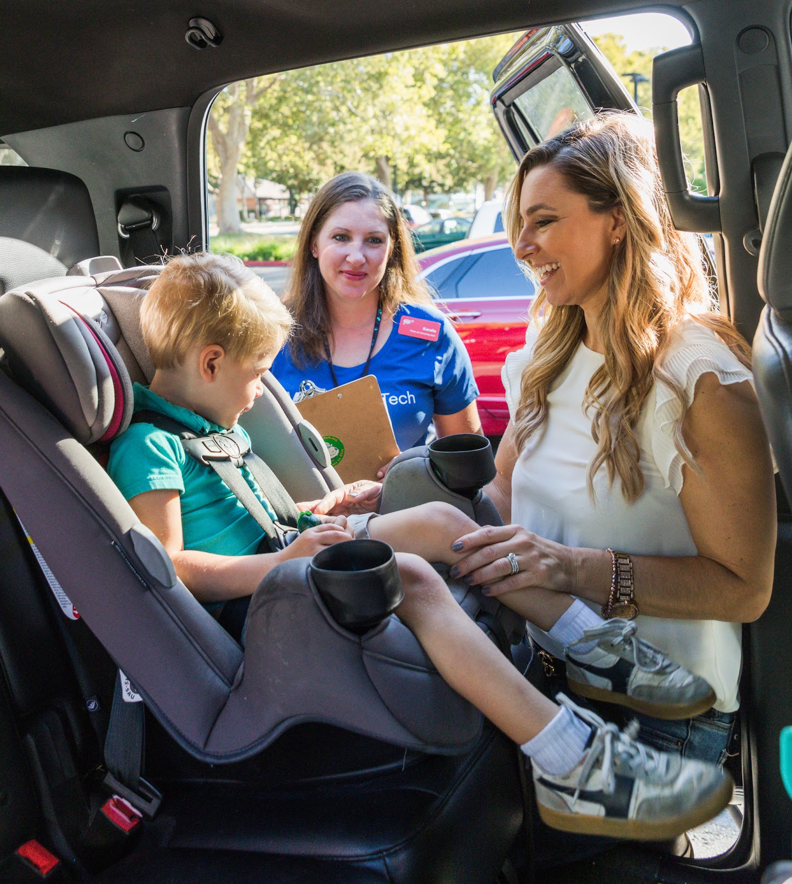
SURVEY FINDINGS
Most Americans are unaware that car crashes are the #1 safety issue for children.
Only 25% of Americans correctly chose car crash as the leading cause of death and injury for children in the Ipsos survey.
Approximately 183,000 children were injured in car crashes in 2018, or more than 500 injuries per day, according to NHTSA.

Slide 14
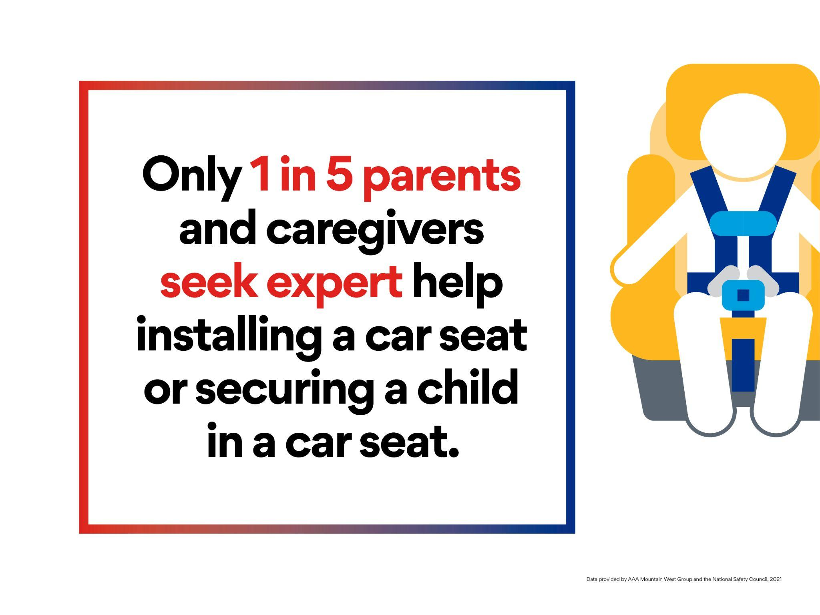
SURVEY FINDINGS
Only 1 in 5 caregivers has their car seat checked:
Only 21% caregivers seek expert help installing a car seat or securing a child in a car seat.
Most caregivers are confident that their car seat is properly installed.
"Car crashes are the leading cause of injuries and deaths among children. This safety risk can be mitigated by the correct use of car seats and booster seats.”
Mark Chung, National Safety Council, VP Roadway Practice

Slide 15
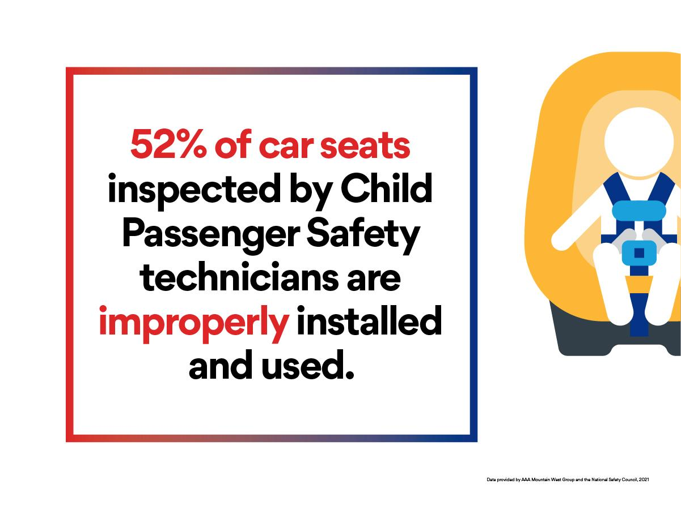
STUDY FINDINGS
More than half (52%) of all car seats inspected by CPSTs had at least one misuse.
Caregivers that attend car seat checks are more aware of the risk, and engaged in seeking support from an expert.
For all car seats in the U.S., the misuse could be even greater.

Slide 16
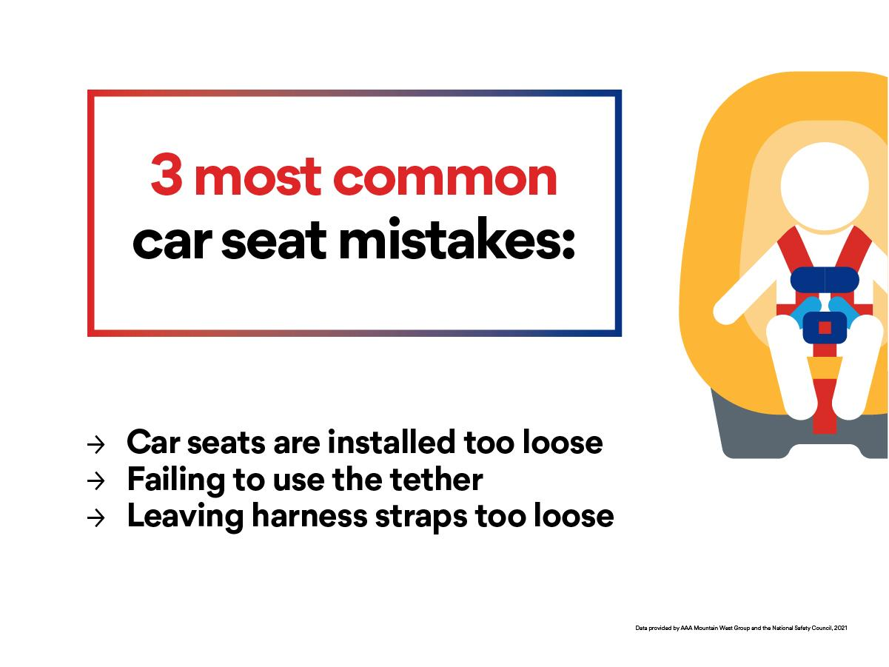
STUDY FINDINGS
The three most common errors identified by Child Passenger Safety Technicians:
Having the car seat installed too loosely.
Failing to use the tether when installing a forward-facing car seat with either the lower anchors or seat belt.
Leaving the harness straps too loose when securing the child in the seat.

Slide 17
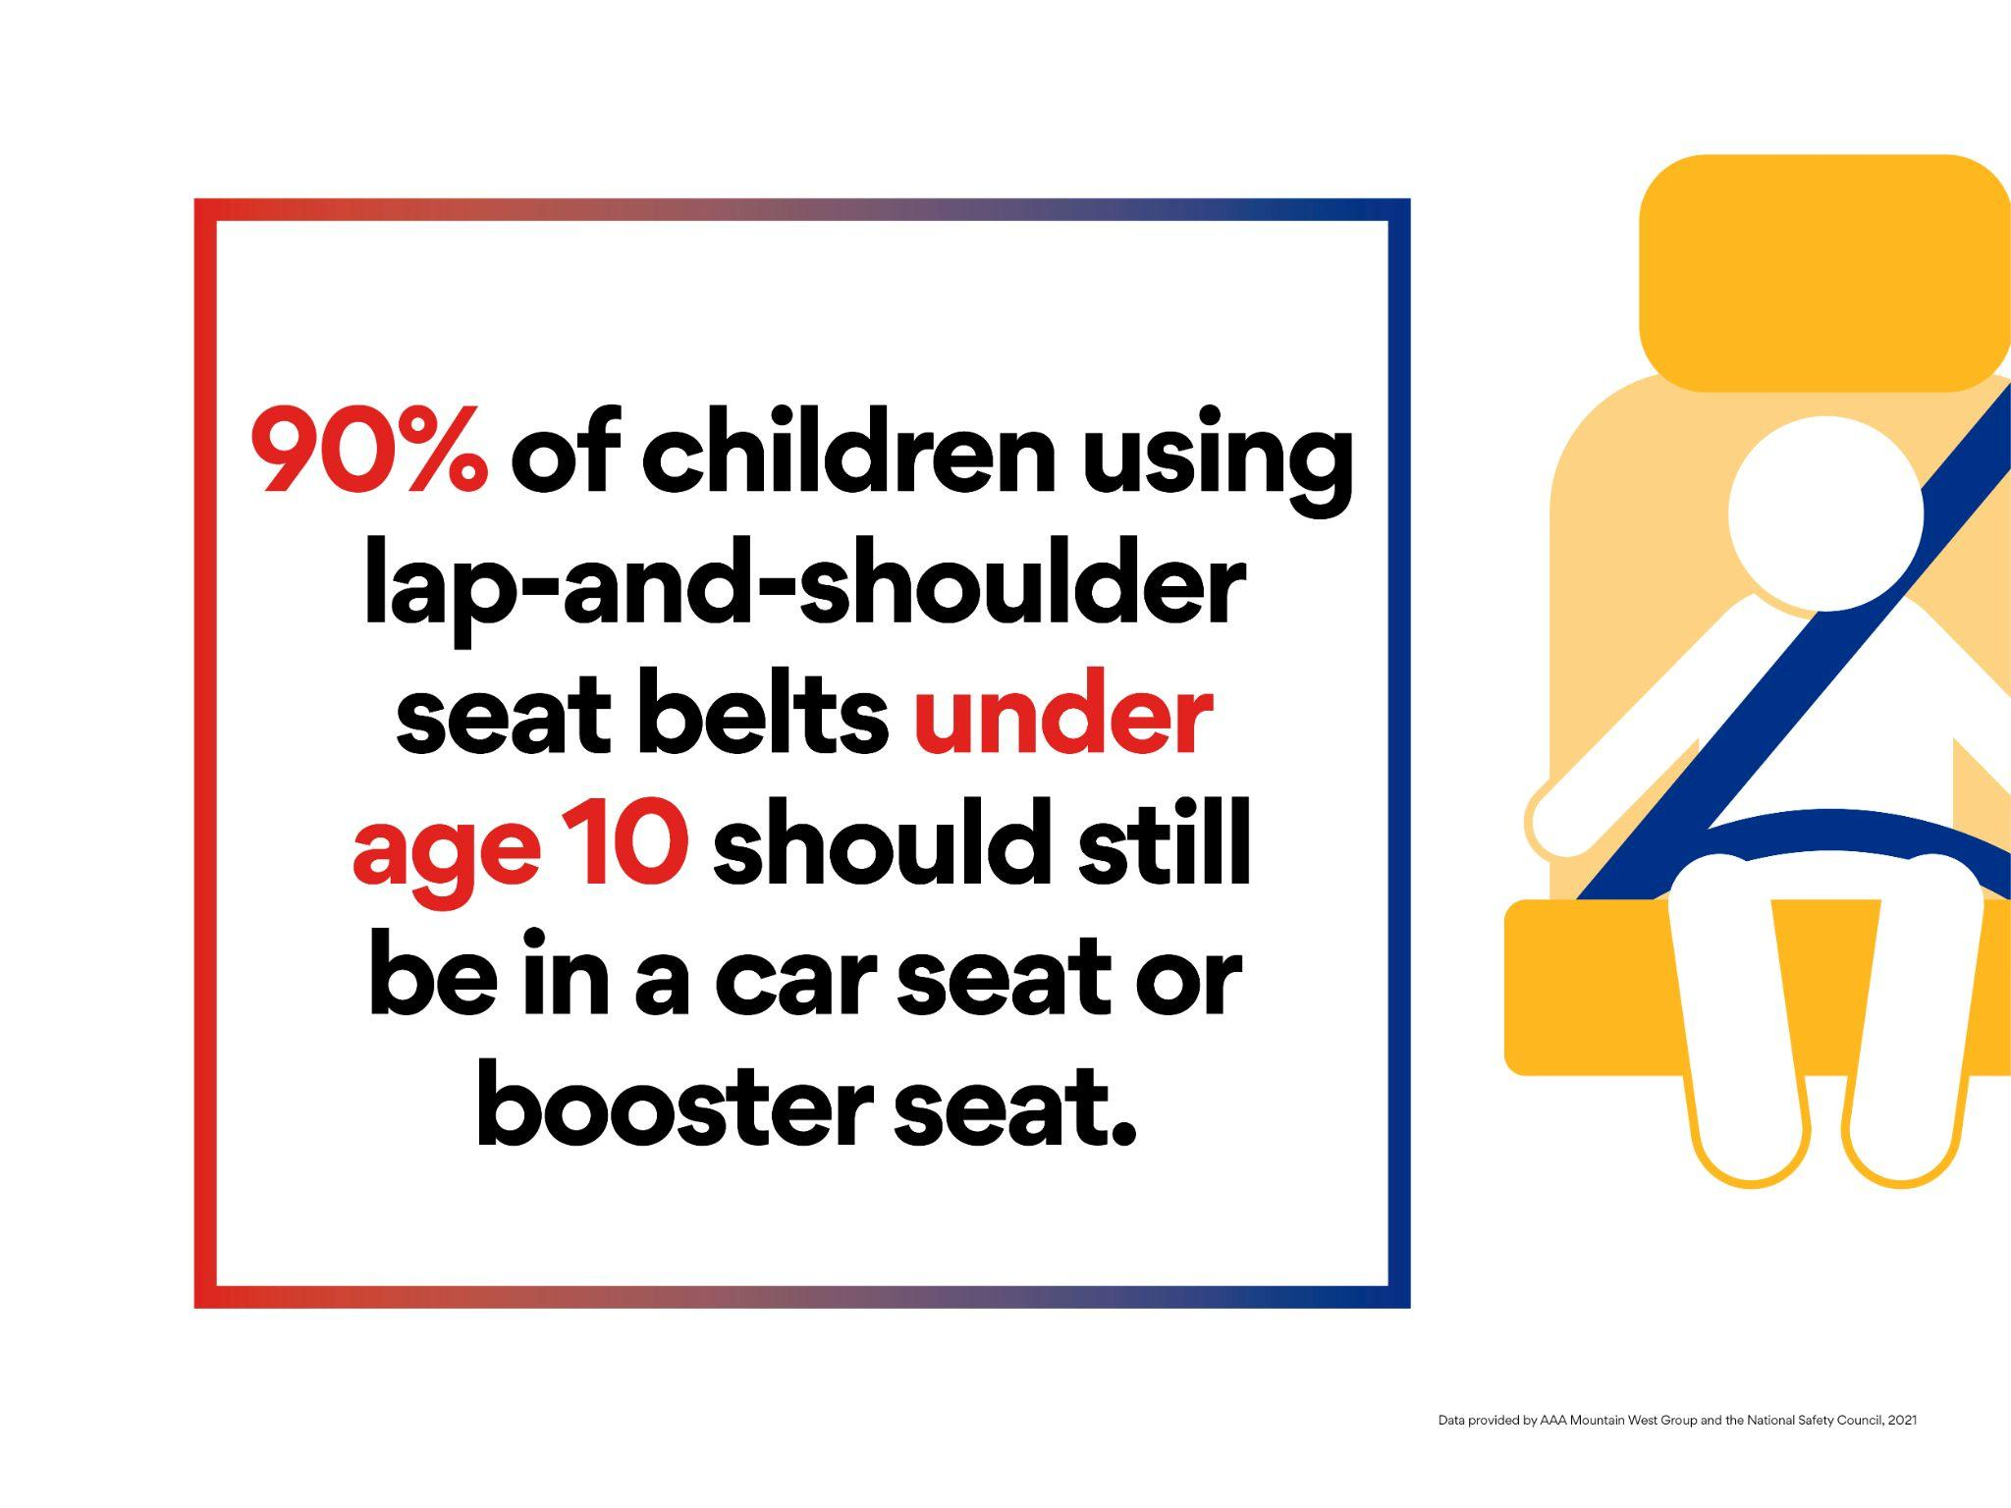
STUDY FINDINGS
Children are often transitioned out of the appropriate car seats before it is safe:
More than 25% of children are moved from forward-facing car seats to booster seats too soon.
More than 90% of children using lap-and-shoulder seat belts under the age of 10 should still be in a car seat or booster seat.

Slide 18
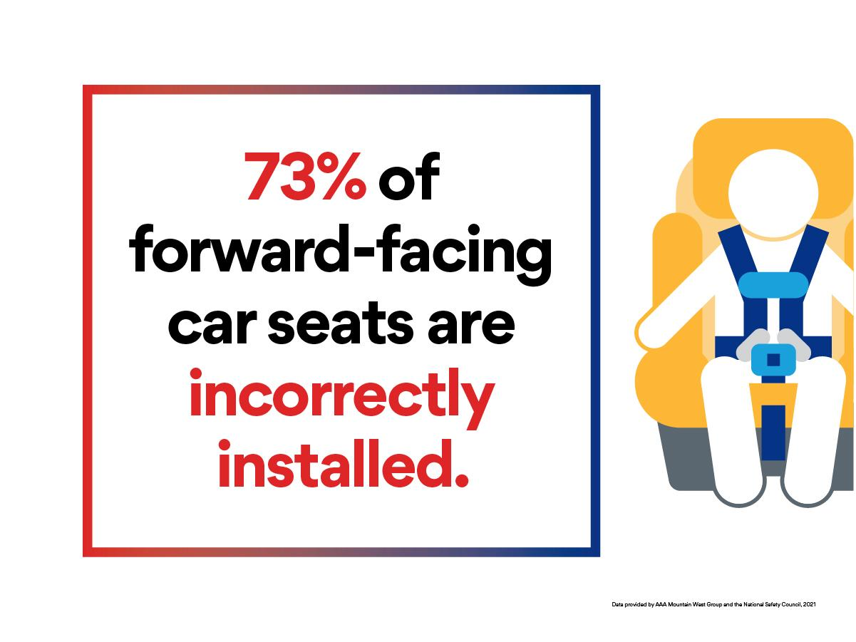
STUDY FINDINGS
Caregivers are less likely to seek car seat inspections as children grow:
Child passenger safety technicians inspect 4x the amount of rear-facing car seats than they do forward-facing car seats.
73% of forward-facing seats are not correctly installed.

Slide 19




CAMPAIGN CHANNELS
English + Spanish Content
Social media graphics + copy
Webinars - AAA and CPS Coordinators Forum
Editorial placement - online, print
Press release, blog post, AAA magazine article
Earned media - online, broadcast, print
Key messages
Radio media tour

