Slide 1
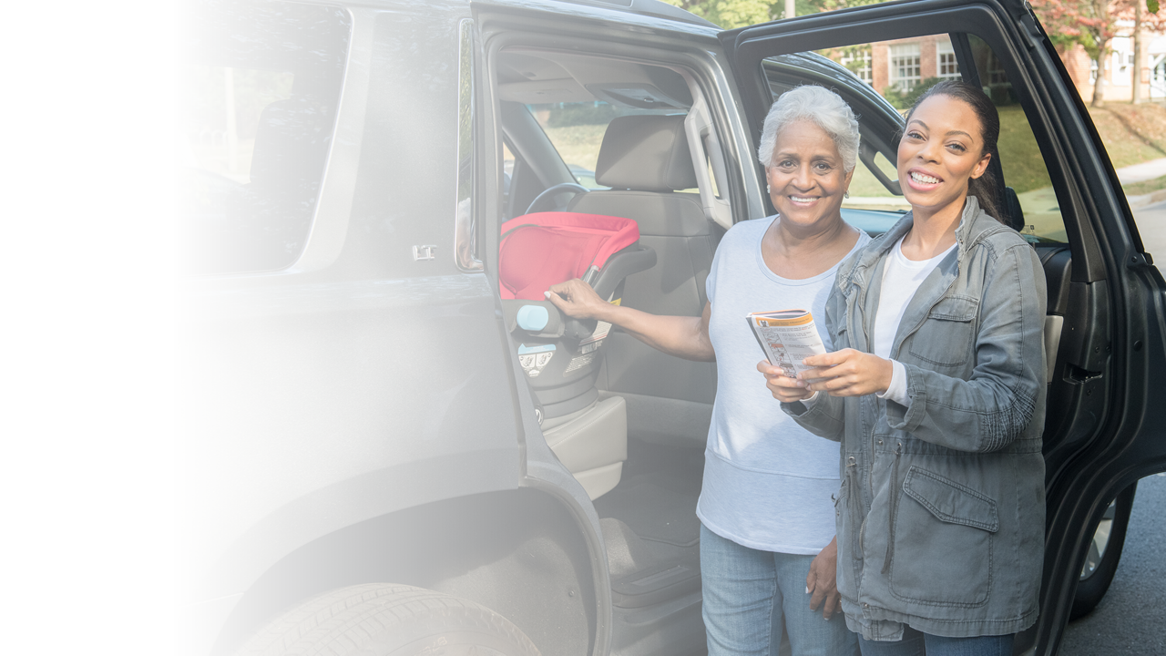
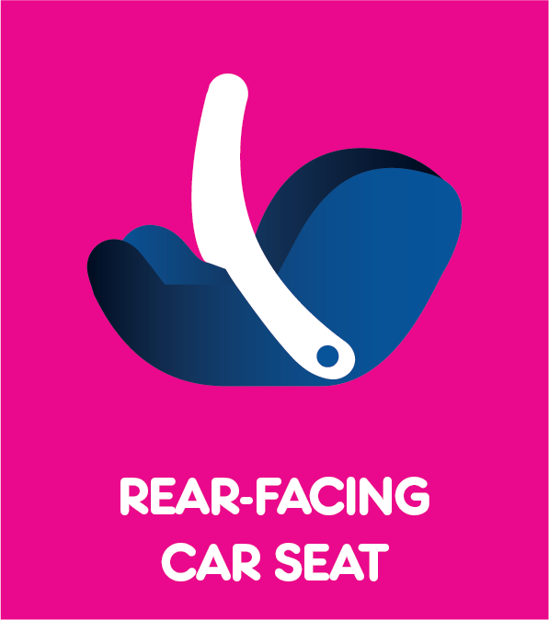
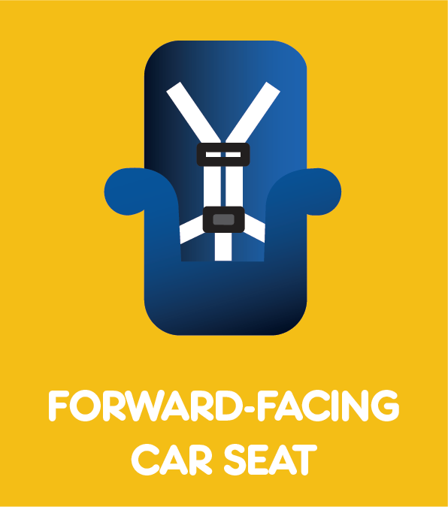
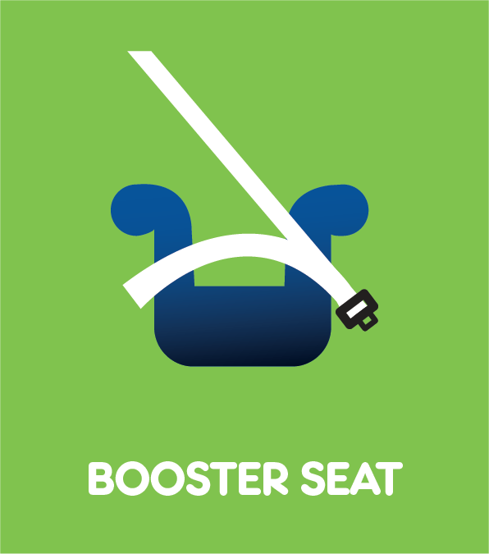
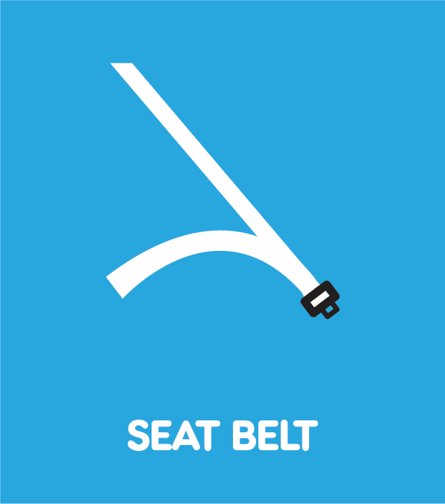

Checkpoint 1
National CPST Certification HYBRID Training
Notes:
This PowerPoint presentation supports CHECKPOINT 1 for The National cpst Certification hybrid Training.
INSTRUCTOR NOTE: The National CPST Certification HYBRID Training is a nationally standardized curriculum delivered in a cumulative manner with each successive module building on the preceding modules. The content must be delivered in its entirety, in modular order, and may not be altered in any way, including addition or deletion of content.

Slide 2
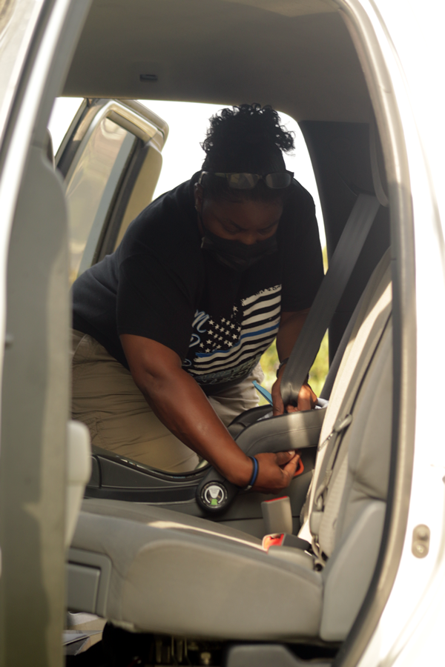
How did it go?
How do you think you did with your first installation?
What do you expect to learn in class to help you build your skills in car seat installation?
How does this exercise help you empathize with a caregiver?
Notes:
Car Seat Installation
Allow students to share their experiences, using the prompters on the slide as a guide.

Slide 3
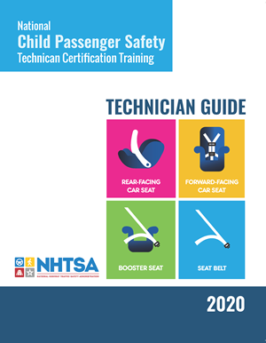
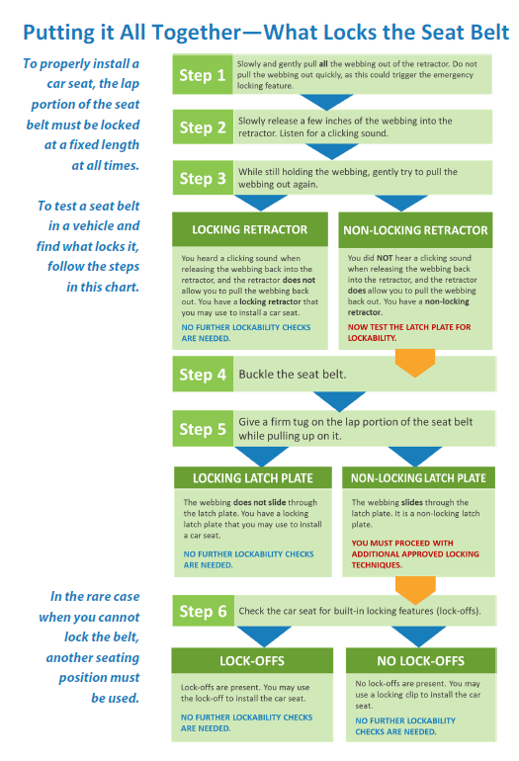
Putting it All Together –
What Locks the Seat Belt
TG 4-19
Learn to use this flow chart!
It guides you through the process of assessing lockability in a seating position in a vehicle.
Notes:
Putting it All Together – What locks a seat belt flowchart
(TG 4-19/IG 4-49)
Encourage students to refer to the What Locks the Seat Belt flow chart on page 4-19 of the TG for the upcoming discussion.

Slide 4
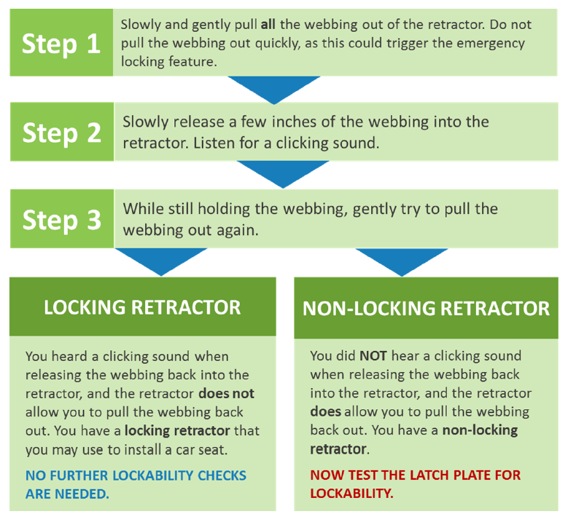
Learn Practice Explain
Using the What Locks the Seat Belt Flow Chart in the Technician Guide, Steps 1–3:
Practice explaining retractors.
Focus on how to test for lockability.
TG 4-6
Notes:
Learn • practice • explain (TG 4-6/IG 4-19)
Conduct the LPE activity, ensuring that everyone has an opportunity to contribute.

Slide 5
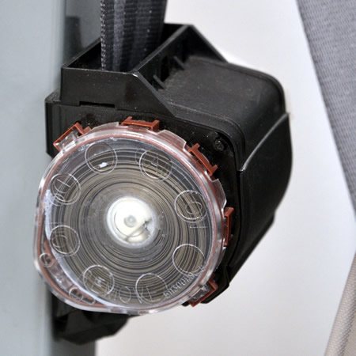
Emergency Locking Retractor (ELR)
Locks only in a sudden stop, acceleration, turn, or crash
Requires additional step to provide locking feature to secure a car seat
Found in lap-only, shoulder-only, or lap-and-shoulder belts
Must test to determine if a locking feature is present; cannot identify by looking
Notes:
Retractor review
Begin a review of retractor types, beginning with emergency locking retractor (ELR).

Slide 6
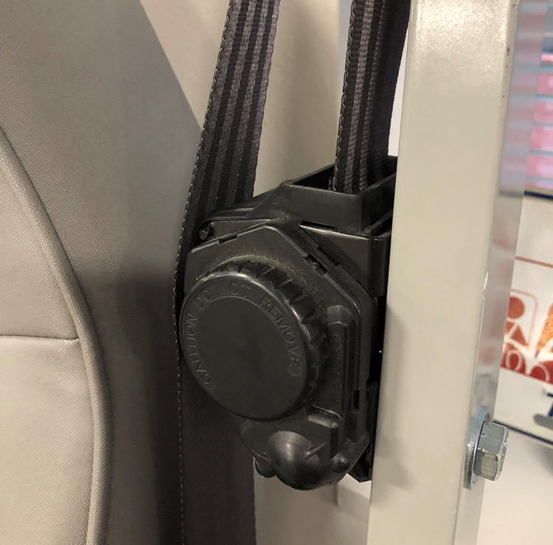
Automatic Locking Retractor (ALR)
Locks once the seat belt webbing has been pulled out approx. 12–18"
Does not require any additional steps to lock the retractor
Will stay locked until it is reset by allowing webbing to feed back in
Has a 12–18" dead-zone where the retractor does not lock
Almost never found in newer vehicles
Notes:
Retractor review
Continue reviewing retractor types with automatic locking retractor (ALR).

Slide 7
Switchable Retractor
WHEN FASTENING CHILD RESTRAINT SYSTEM
FULLY EXTEND BELT TO PUT IT IN THE LOCK MODE
-------------SEE OWNER’S MANUAL------------
Starts out in an unlocked ELR mode for adults
Can be switched to locked ALR mode for use with a car seat
POUR BOUCLER LE SYSTEME DE SECURITE POUR ENFANTS
TIRER A FOND SUR LASANGLE POUR LA METTRE EN MODE
------VOIR LE MANUEL DU CONDUCTEUR-----
Most common system encountered
Notes:
Retractor Review
Continue reviewing retractor types with switchable retractor.

Slide 8
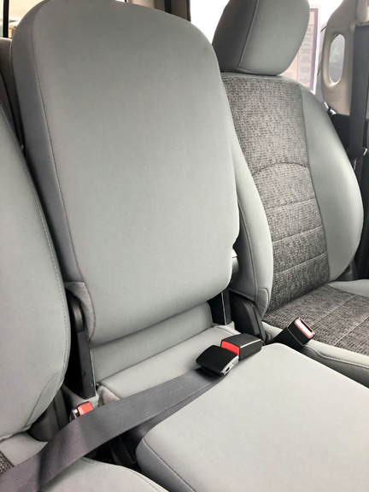
No Retractor
Some lap belts have no retractor to store the excess webbing.
This type of seat belt:
Is usually found in the front or rear center seat of some older vehicles
Always has a latch plate that provides the locking feature
Notes:
Retractor REVIEW
Review the “no retractor” scenario and what it means for car seat installation.

Slide 9
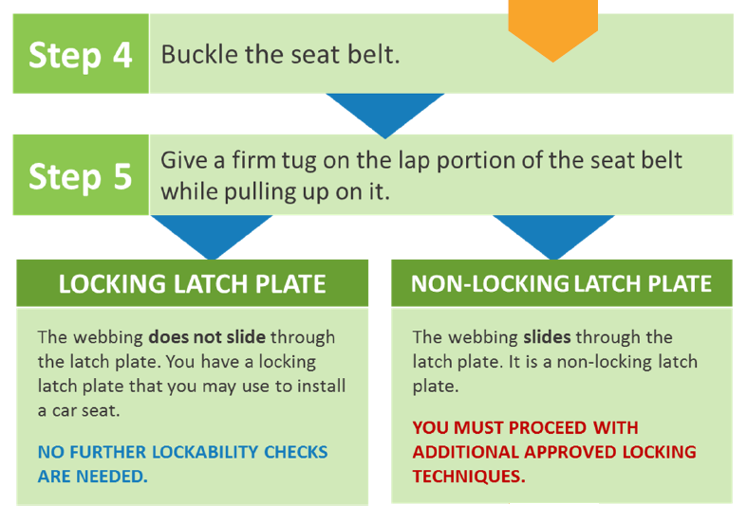
Learn Practice Explain
Using the What Locks the Seat Belt Flow Chart in the Technician Guide, Steps 4–5:
Practice explaining latch plates.
Focus on how to test latch plates for lockability.
TG 4-14
Notes:
Learn • practice • explain (TG 4-14/IG 4-35)
Conduct the LPE activity, ensuring that everyone has an opportunity to contribute.

Slide 10
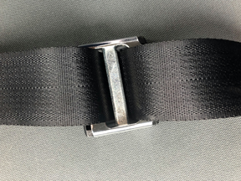
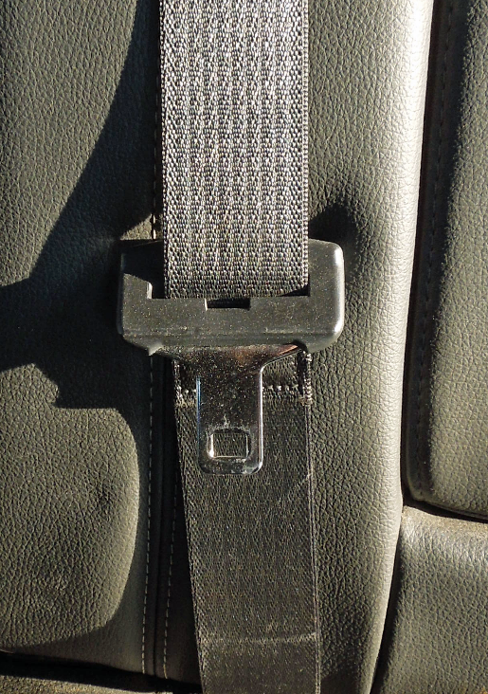
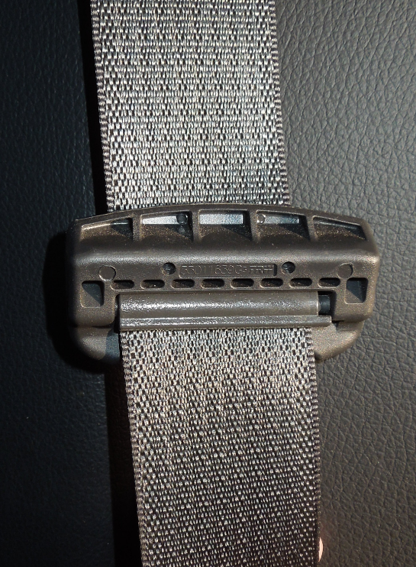
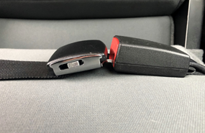
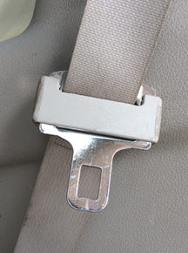
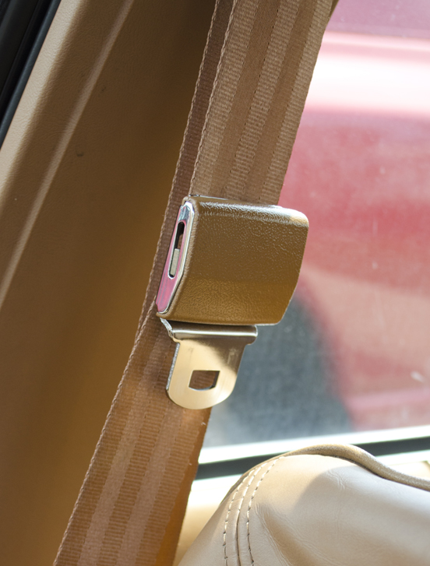
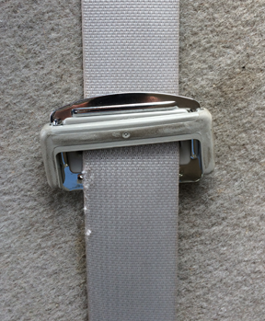
Locking Latch Plate
Some locking latch plates have a bar while others have a sliding metal or plastic piece.
ALL of these are examples of locking latch plates.
Notes:
LATCH PLATE Review
Begin a review of latch plate types, starting with locking latch plates.

Slide 11
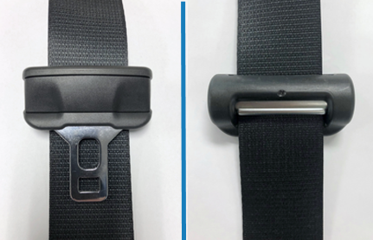
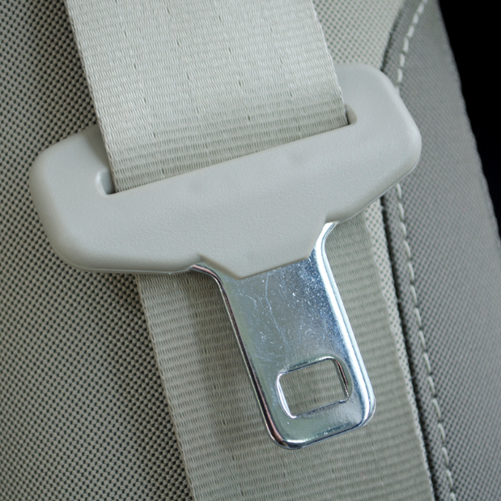
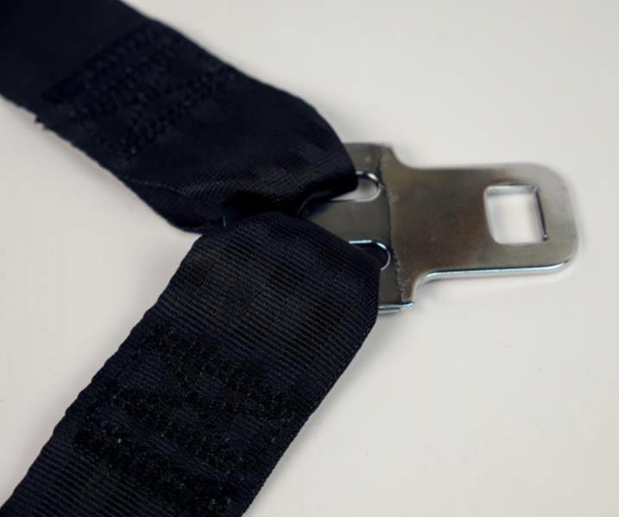
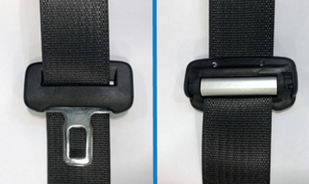
Non-Locking Latch Plate
SLIDING
SEWN-ON
DYNAMIC
Notes:
LATCH PLATE review
Continue reviewing latch plate types with non-locking latch plates.

Slide 12

Mystery hardware?
What types of seat belt systems did you find in your practice vehicle(s)?
Did you find any hardware in your practice vehicle that you were unable to identify?
Notes:
Discussion
Ask students share the types of seat belt systems, retractors, and latch plates they discovered in their practice vehicles.
Ask students if they found any retractors or latch plates that they were uncertain about categorizing.
Pull up any retractor/latch plate photos that students uploaded to the online student workspace that were tricky or problematic, and review them.
Allow the group to help identify any mystery vehicle hardware that was posted to the channel.

Slide 13

Quiz 1
Review
Covers content from Modules 1-5
Notes:
QUIZ review
Conduct a review for Quiz 1 using suggested review questions found in the Protected Instructor Materials on cpsboard.org.
Share the following quiz reminders with the students.
The quiz is timed at 45 minutes.
Students are able to exit and resume taking the quiz at a later point in time. The student’s progress and time remaining to complete the quiz will be saved.
An audio option is available at the top of each question if the student prefers having the quiz questions and answers read to them.
Any questions not completed at the end of the 45-minute time period are marked incorrect.
The quiz will be graded once the student clicks the “Submit Quiz” button and the results will be shared with the student.

Slide 14

Learning Block 2
AHEAD
Notes:
LEARNING BLOCK 2
Preview Learning Block 2 content.
Learning Block 2 e-learning material may require more time and effort than the Learning Block 1 e-learning material since the modules go into much more detail about vehicles and car seats.
In addition to completing the e-learning, there is practice time in vehicles during this learning block.
PREVIEW CONTINUED ON NEXT SLIDE.

Slide 15
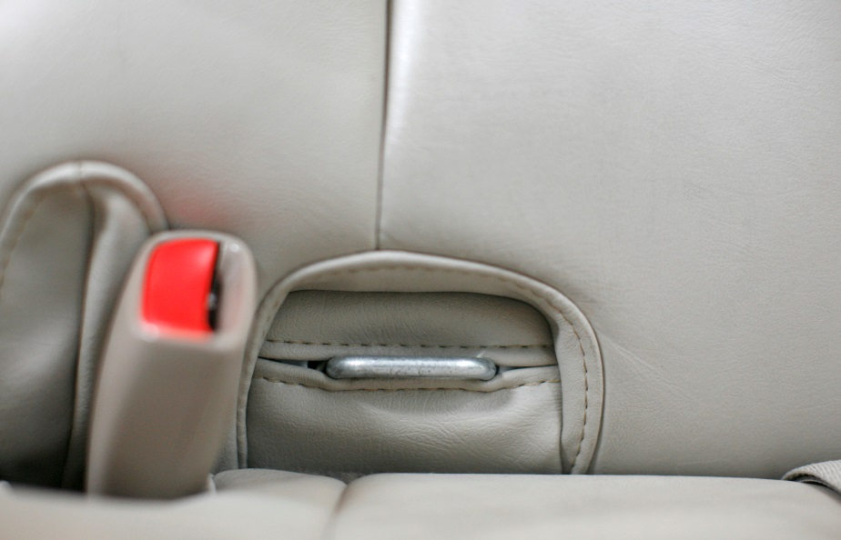
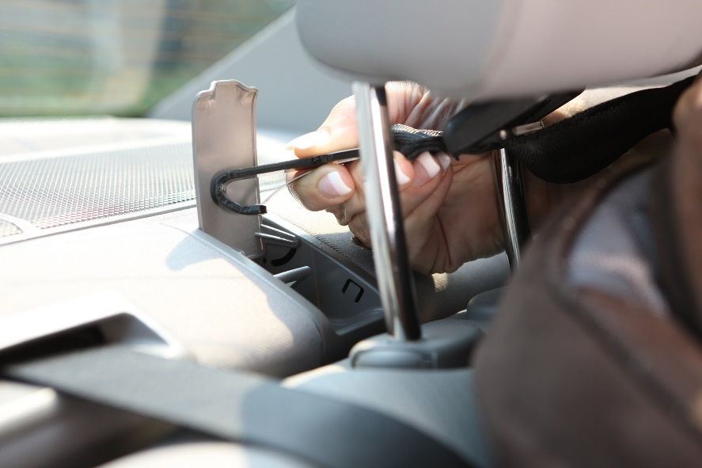
The LATCH System
L
OWER
A
NCHORS
T
for
CH
ILDREN
and
ETHERS
Notes:
PREVIEW LEARNING BLOCK 2
Review Learning Block 2 content.
LATCH: Lower Anchors and Tethers for Children will be introduced in Module 6.
Encourage students to ask questions in the online class workspace if they are finding the material challenging.
Remind students to identify the vehicles they’ll be using, and to post them in the online class workspace.
PREVIEW CONTINUED ON NEXT SLIDE.

Slide 16
STEPS for Rear-Facing Car Seat Use
SELECTION
Choose the right car seat.
DIRECTION
Face the car seat the right way.
LOCATION
Choose an appropriate location in the vehicle.
HARNESS
Adjust the harness to fit the child properly.
INSTALLATION
Secure the car seat to the vehicle seat.
Notes:
PREVIEW LEARNING BLOCK 2
Review Learning Block 2 content.
Module 7 requires learning the names of different parts of a car seat.
Module 8 begins a series of three modules that focus on specific car seat types: rear-facing, forward-facing, and booster.
Briefly review the five steps for rear-facing car seat use: selection, direction, location, harness adjustment and fit, and installation.
Point out that the steps on the slide apply to rear-facing and forward-facing car seats, and that booster seat steps are very similar.
Learning the steps helps in all car seat and booster seat scenarios.
Remind students to work with their social networks to find as many different car seat types as possible for their own practice identifying the parts on a car seat.

Slide 17

Questions?
Notes:
Q&A
Answer any questions that students may have.

Slide 18




Next steps…
Complete the Checkpoint 1 Assignment as soon as possible following this session so you can be approved to move on in the e-learning!
It is strongly recommended to complete all of the Learning Block 2 e-learning segments and assignments BEFORE the virtual Checkpoint 2 session.
Remember to use your Learning Block 2 Checklist to help you stay on track.
Notes:
NEXT STEPS
Review the next steps for the students as listed on the slide.

