Slide 1


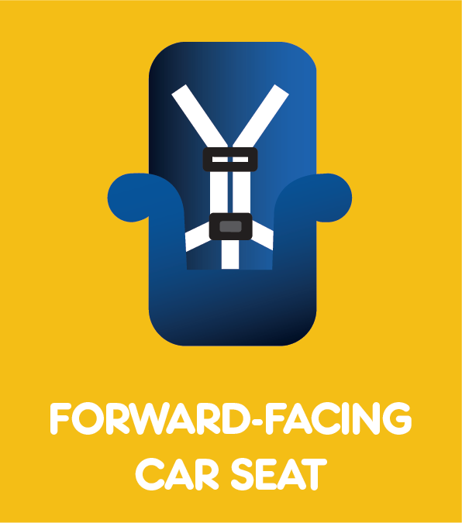
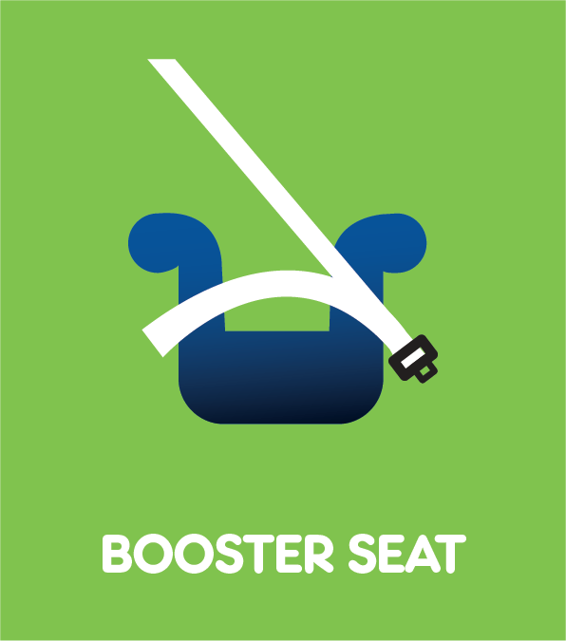
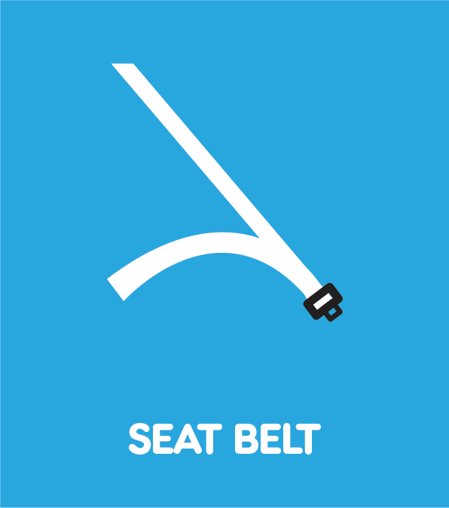

Checkpoint 2
National CPST Certification HYBRID Training
Notes:
This PowerPoint presentation supports CHECKPOINT 2 for The National cpst Certification hybrid Training.
INSTRUCTOR NOTE: The National CPST Certification HYBRID Training is a nationally standardized curriculum delivered in a cumulative manner with each successive module building on the preceding modules. The content must be delivered in its entirety, in modular order, and may not be altered in any way, including addition or deletion of content.

Slide 2
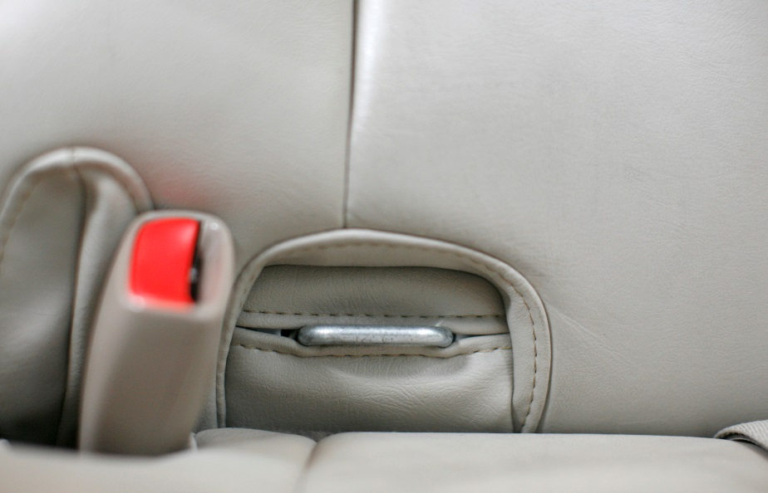
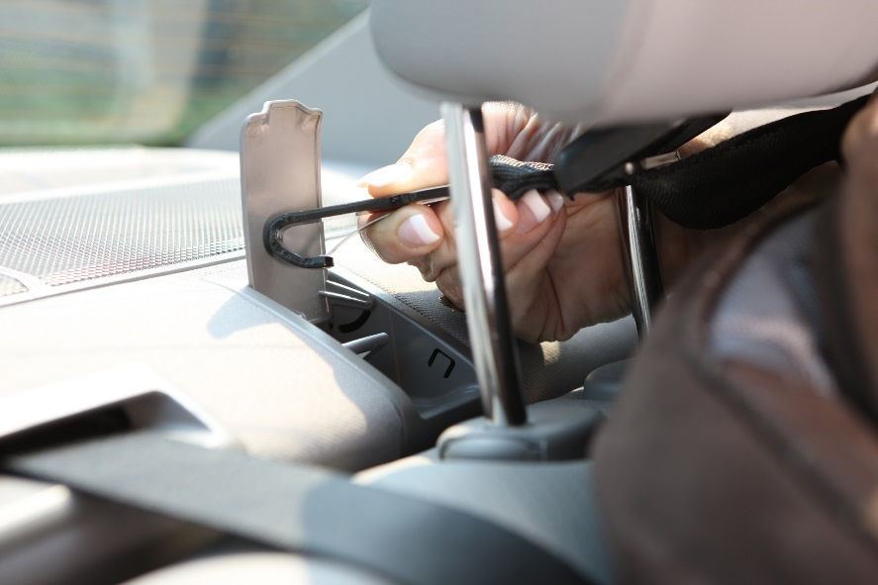
The LATCH System
L
OWER
A
NCHORS
T
for
CH
ILDREN
and
ETHERS
Tell us about your experience locating LATCH systems in your practice vehicles.
Notes:
LATCH review
Begin a review of LATCH systems in the vehicles.
Have students share their experiences finding LATCH systems in their practice vehicles.

Slide 3
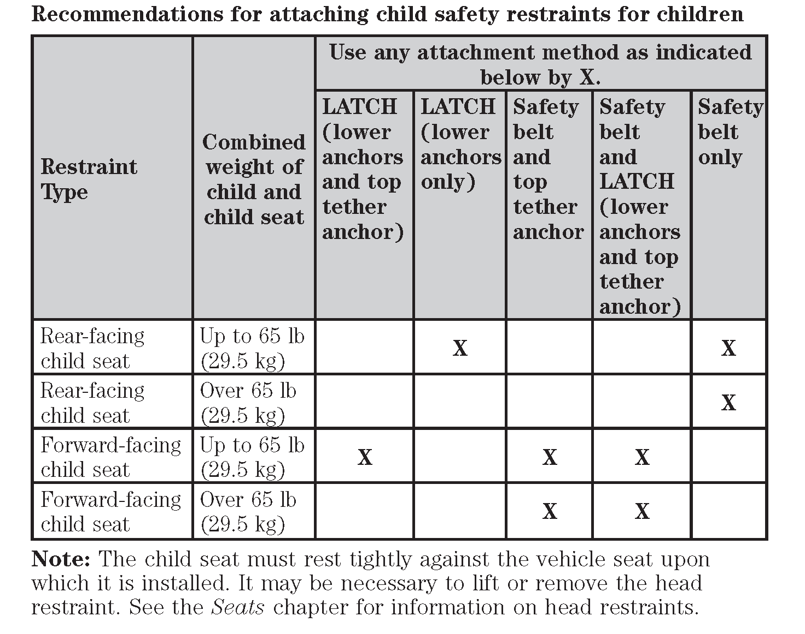
Learn Practice Explain
Practice explaining how to determine lower anchor and tether weight limits.
Where do you find this information?
What do you do when the car seat manufacturer and the vehicle manufacturer have different weight limits?
TG 6-14
Notes:
Learn • practice • explain (TG 6-14/IG 6-35)
Conduct the LPE activity, ensuring that everyone has an opportunity to contribute.

Slide 4
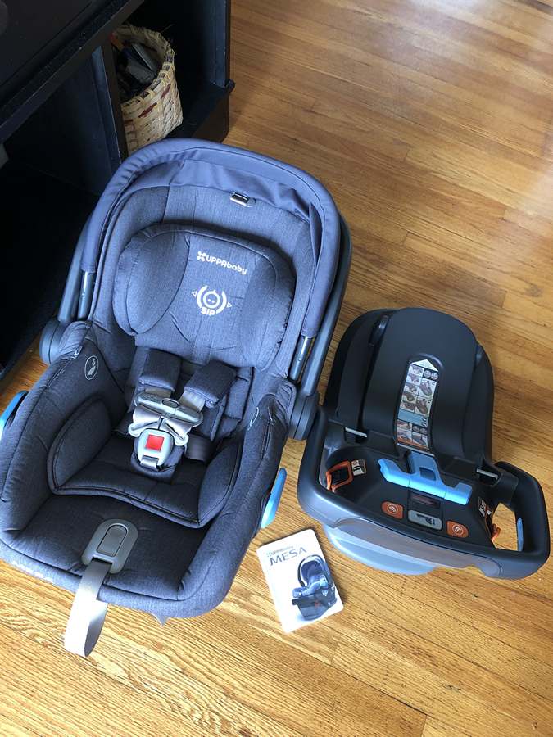
How did it go?
How was your experience exploring car seat parts?
  What was difficult?
  What was easy?
  What did you find surprising?
Notes:
Car Seat Parts
Allow students to share their experiences with the Car Seats and Booster Seats – Hands-on Parts Identification (E-Learning Segment 7-12).
What was difficult?
Easy?
Surprising?

Slide 5
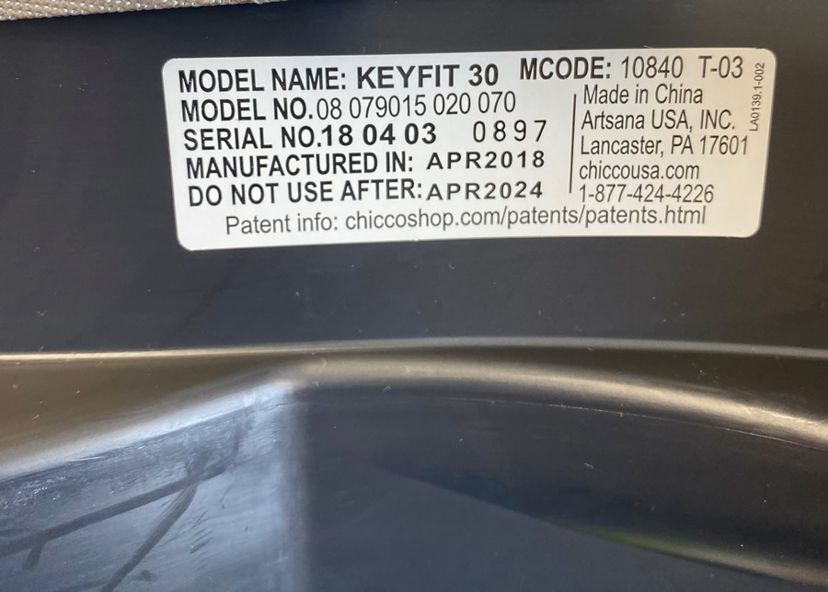
Recalls and Expiration Dates
Did you find recall information on any of the car seats you worked with during this learning block?
Where did you locate the expiration date on your practice car seat(s)?
Notes:
Discussion
Lead a brief discussion on recalls and expiration dates using the prompters on the slide.
Remind students to check that they are using the most current recall list.

Slide 6

DEMONSTRATION
Locate Recline Indicator
Notes:
DEMONSTRATION
Demonstrate how to locate the recline indicator on a car seat. If possible, use a variety of car seats with different types of recline indicators.
Remind students that images of recline indicators are found on TG 8-13/IG 8-47.
Demonstrate how to make sure the car seat is set at the appropriate recline angle and how to fix it if it is at the wrong recline angle.
Students located the recline indicators on their practice car seat type and posted them in the online class workspace before the Checkpoint. If unusual types were posted to the workspace, consider sharing them after your demonstration.

Slide 7
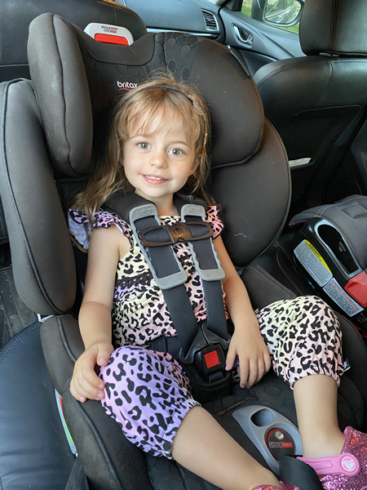
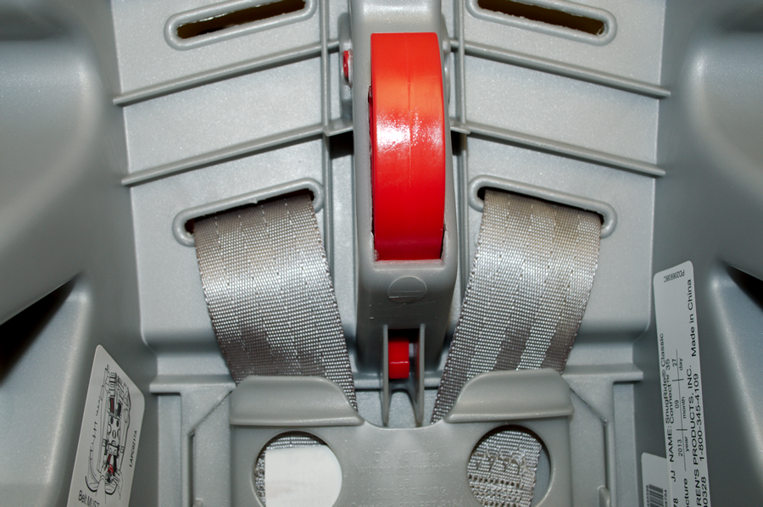
Learn Practice Explain
Adjust Harness Height and Buckle Strap
Practice explaining how to change the harness height and how to adjust the buckle strap for use rear-facing.
Harness Practice
Practice explaining how to properly harness a child in a rear-facing car seat.
TG 8-9
TG 8-10
Notes:
Learn • practice • explain (TG 8-9/IG 8-37 AND TG 8/10/IG 8-41)
Conduct the LPE activities, ensuring that everyone has an opportunity to contribute.

Slide 8
DEMONSTRATION
Adjust Harness Height and Buckle Strap
Notes:
DEMONSTRATION
Demonstrate how to adjust harness height and the buckle strap.

Slide 9
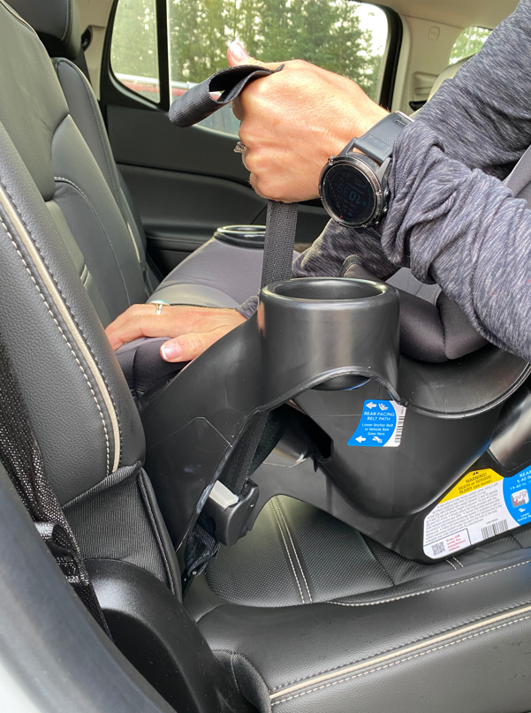
How did it go?
How was your experience installing a rear-facing car seat?
  What was difficult?
  What was easy?
  What did you find surprising?
Notes:
Rear-facing car seat installation
Lead a discussion on students’ experiences installing a car seat rear-facing.
What was difficult?
Easy?
Surprising?
Address any questions.
INSTRUCTOR NOTE: Ideally, have one or more car seats available for demonstration if needed.
Remind students during the in-person session, they will have an opportunity to install rear-facing car seats with an Instructor’s feedback.

Slide 10
Learn Practice Explain
Communication Skills
Practice explaining best practice recommendations for transporting children rear-facing in the following scenarios.
The child is 18 months old and 30 lbs., the same weight as the three-year-old sibling. The caregiver is wondering how to transport both children.
The child is 13 months old and 26 lbs. The caregiver would like to see the child while driving and was told by the pediatrician that the child can ride forward-facing.
The caregiver says, “The state law says my son can turn forward at age 2. Now that he is two, I want to turn him around.” (Child is within height and limits to remain rear-facing.)
TG 8-3
Notes:
Learn • practice • explain (TG 8-3/IG 8-13)
Conduct the LPE activity, ensuring that everyone has an opportunity to contribute.

Slide 11
Learn Practice Explain
Common Caregiver Questions
Practice answering the following common caregiver questions.
I have two children. Which child should go in the middle of the back seat?
Can I leave the carry handle up and dangle toys from the car seat to keep my child happy?
Should I use the lower anchors or the seat belt to install my car seat? Which is safer?
TG 8-18
Notes:
Learn • practice • explain (TG 8-18/IG 8-59)
Conduct the LPE activity, ensuring that everyone has an opportunity to contribute.

Slide 12

Quiz 2
Review
Covers content from Modules 6-8
Notes:
QUIZ review
Conduct a review for Quiz 2 using suggested review questions found in the Protected Instructor Materials on cpsboard.org.
Share the following quiz reminders with the students.
The quiz is timed at 45 minutes.
Students are able to exit and resume taking the quiz at a later point in time. The student’s progress and time remaining to complete the quiz will be saved.
An audio option is available at the top of each question if the student prefers having the quiz questions and answers read to them.
Any questions not completed at the end of the 45-minute time period are marked incorrect.
The quiz will be graded once the student clicks the “Submit Quiz” button and the results will be shared with the student.

Slide 13

Learning Block 3
AHEAD
Notes:
LEARNING BLOCK 3
Preview Learning Block 3 content.
The e-learning content will be completed in learning block 3.
In addition to completing the e-learning, there is practice time in vehicles during this learning block.
PREVIEW CONTINUED ON NEXT SLIDE.

Slide 14
STEPS for Forward-Facing Car Seat Use
SELECTION
Choose the right car seat.
DIRECTION
Face the car seat the right way.
LOCATION
Choose an appropriate location in the vehicle.
HARNESS
Adjust the harness to fit the child properly.
INSTALLATION
Secure the car seat to the vehicle seat.
Notes:
PREVIEW LEARNING BLOCK 3
Review Learning Block 3 content.
Briefly review the five steps for forward-facing car seat use: selection, direction, location, harness adjustment and fit, and installation.
Point out that the steps on the slide apply to rear-facing and forward-facing car seats, and that booster seat steps are very similar.
Learning the steps helps in all car seat and booster seat scenarios.
PREVIEW CONTINUED ON NEXT SLIDE.

Slide 15
STEPS for Booster Seat Use
SELECTION
Choose the right booster seat.
DIRECTION
Face the booster seat the right way.
LOCATION
Choose an appropriate location in the vehicle.
ADJUST
Adjust the booster height to fit the child properly.
SECURE
Secure the booster seat to the vehicle seat.
Notes:
PREVIEW LEARNING BLOCK 3
Review Learning Block 2 content.
Briefly review the five steps for booster seat use: selection, direction, location, adjust, and secure.
Point out that the steps on the slide apply to booster seats, and that the rear-facing and forward-facing car seat steps are very similar.
Learning the steps helps in all car seat and booster seat scenarios.
Module 11 provides information on school buses, airplanes, and emergency vehicles, and how to transport children safely in these other types of vehicles.
Module 12 is about communication skills. It presents many helpful tips and techniques for communicating with caregivers.
Module 13 is about how you can continue learning about child passenger safety, and provides some resources for additional education.
PREVIEW CONTINUED ON NEXT SLIDE.

Slide 16
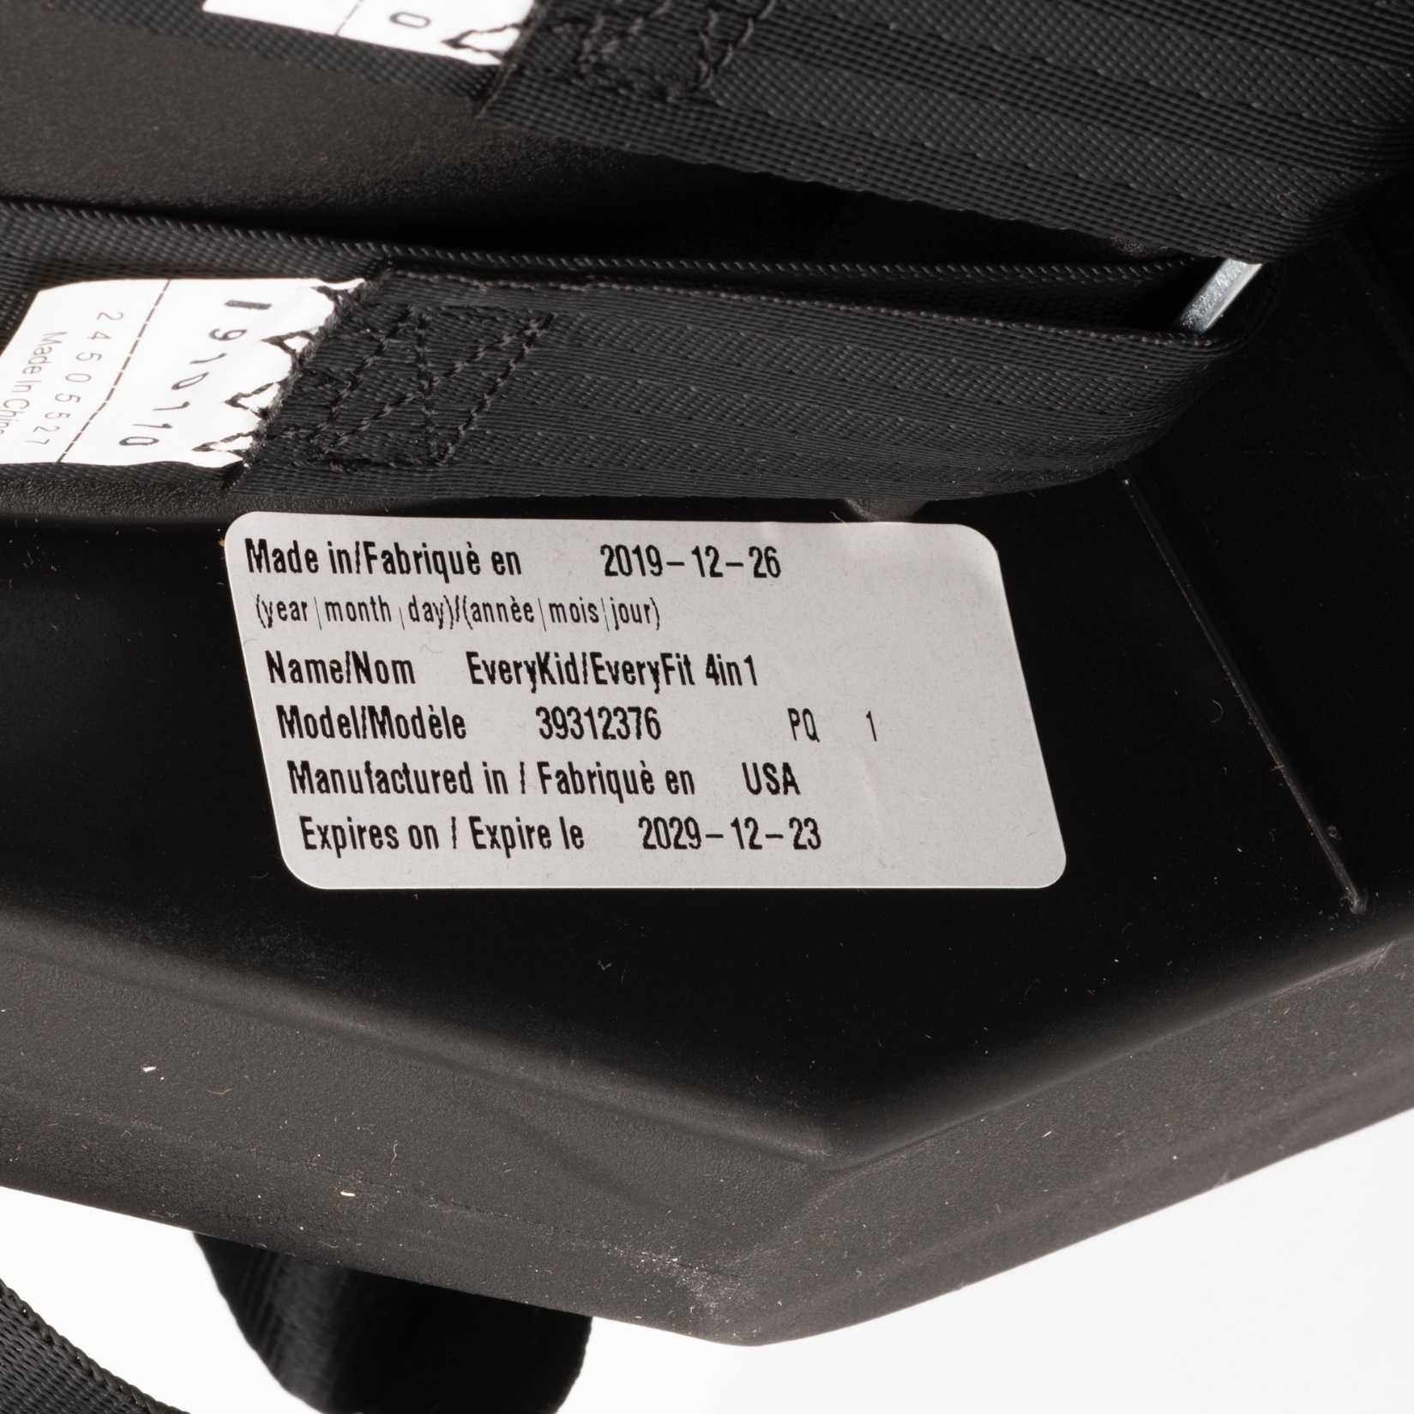
Skills Evaluation:
Putting It All Together
Covers content from Modules 1-10
Notes:
Skills Evaluation: Putting It All Together
Share the following skills evaluation reminders with the students.
The Skills Evaluation is delivered at the end of the Module 10. There is a “Coming Next” segment after the Module 10 Progress Check notifying you of the upcoming Skills Evaluation in the next segment.
The skills evaluation is timed at 45 minutes.
Students are able to exit and resume taking the skills evaluation at a later point in time. The student’s progress and time remaining to complete the skills evaluation will be saved.
No audio option is available for the skills evaluation questions.
Any questions not completed at the end of the 45-minute time period are marked incorrect.
The skills evaluation will be graded once the student clicks the “Submit Quiz” button and the results will be shared with the student.

Slide 17

Questions?
Notes:
Q&A
Answer any questions that students may have.

Slide 18




Next steps…
Complete the Checkpoint 2 Assignment as soon as possible following this session so you can be approved to move on in the e-learning!
It is strongly recommended to complete all of the Learning Block 3 e-learning segments and assignments BEFORE the virtual Checkpoint 3 session.
Remember to use your Learning Block 3 Checklist to help you stay on track.
Notes:
NEXT STEPS
Review the next steps for the students as listed on the slide.

