Slide 1
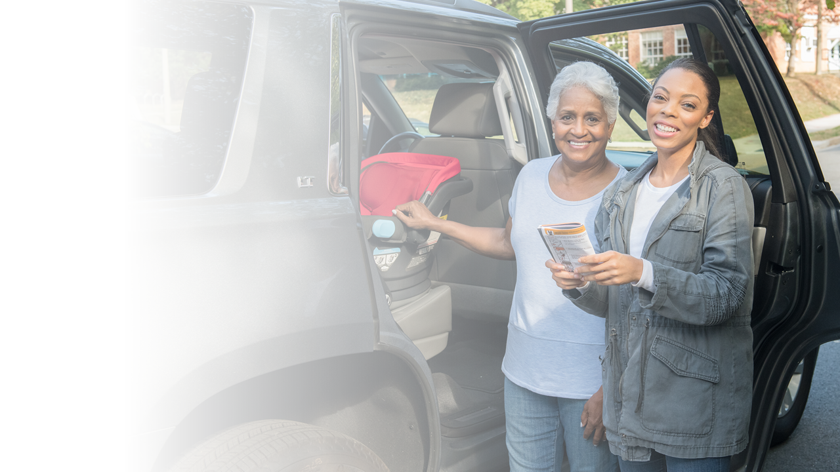

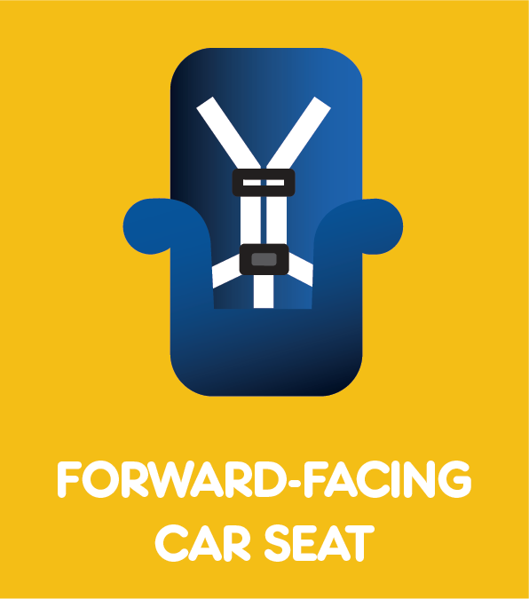
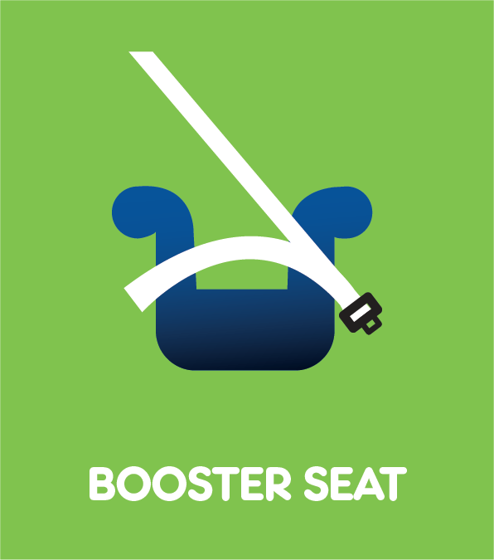
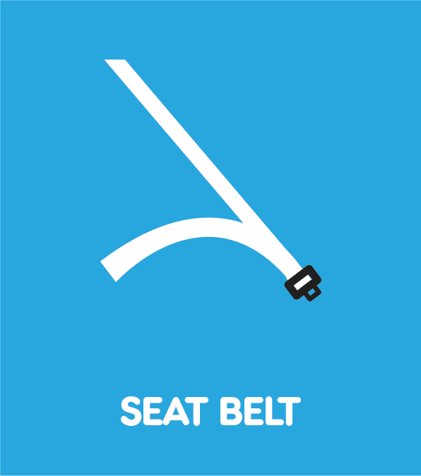

Kick-off Session
National CPST Certification HYBRID Training
Notes:
This PowerPoint presentation supports the Kick-off session for The national cpst Certification hybrid Training.
INSTRUCTOR NOTE: The National CPST Certification HYBRID Training is a nationally standardized curriculum delivered in a cumulative manner with each successive module building on the preceding modules. The content must be delivered in its entirety, in modular order, and may not be altered in any way, including addition or deletion of content.

Slide 2
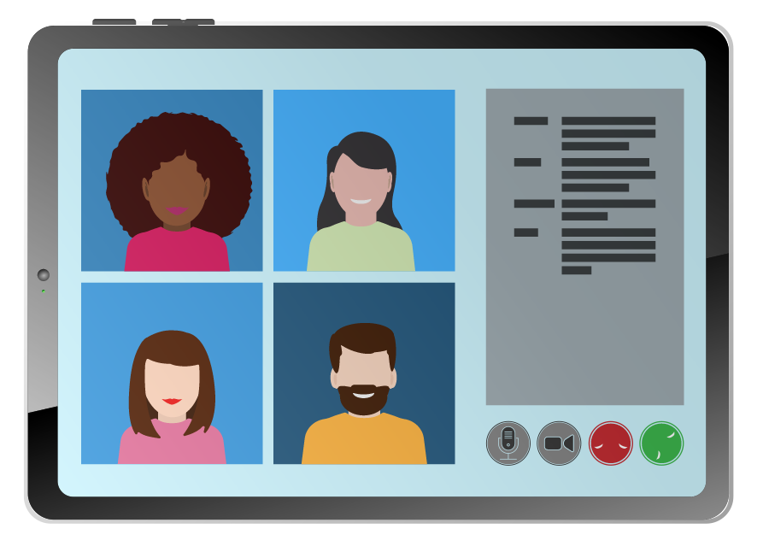
Getting to know you (and you, us)!
When called on, introduce yourself.
If possible, please turn on your camera.
Notes:
Welcome and INTRODUCTIONS
Welcome the students.
Explain that students’ web cameras should be on for this session and all virtual sessions, so that we can all work “face to face.”
Have the Instructor Team and students briefly introduce themselves.
Ask Instructors to share their name, agency and for how long they have been involved in the child passenger safety field.
Ask students to share their name, agency, why they are taking the training and what experience they have with car seats.
Share the Coach assignments with the students.

Slide 3
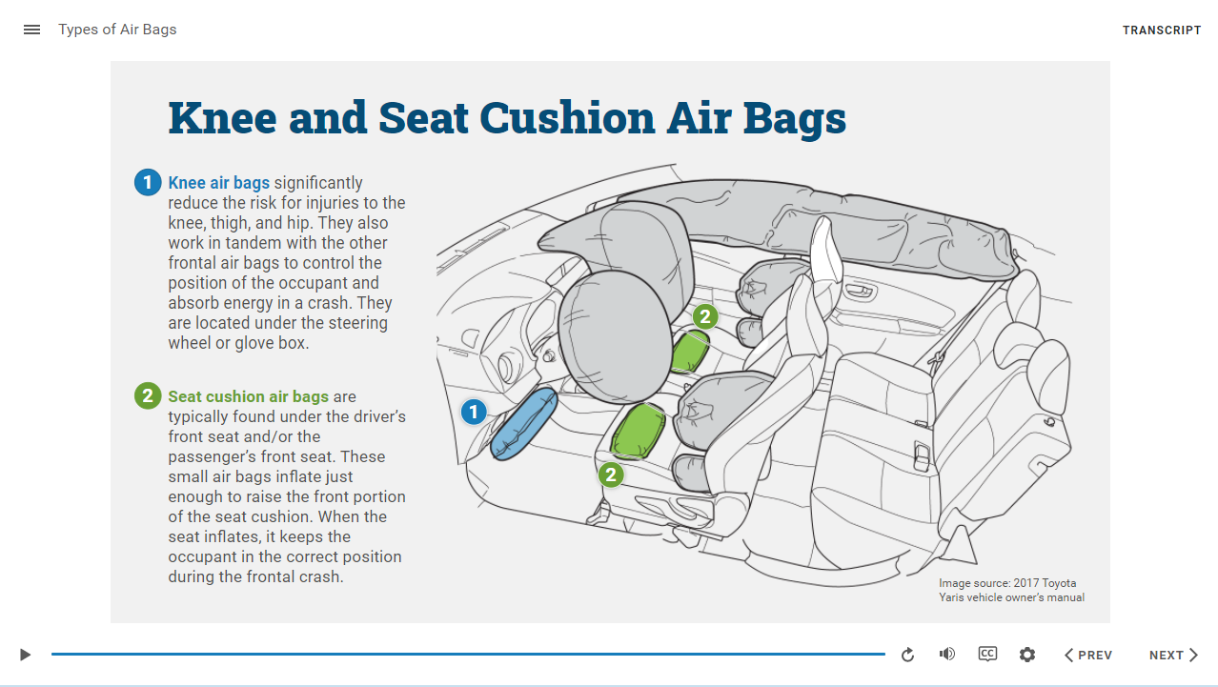
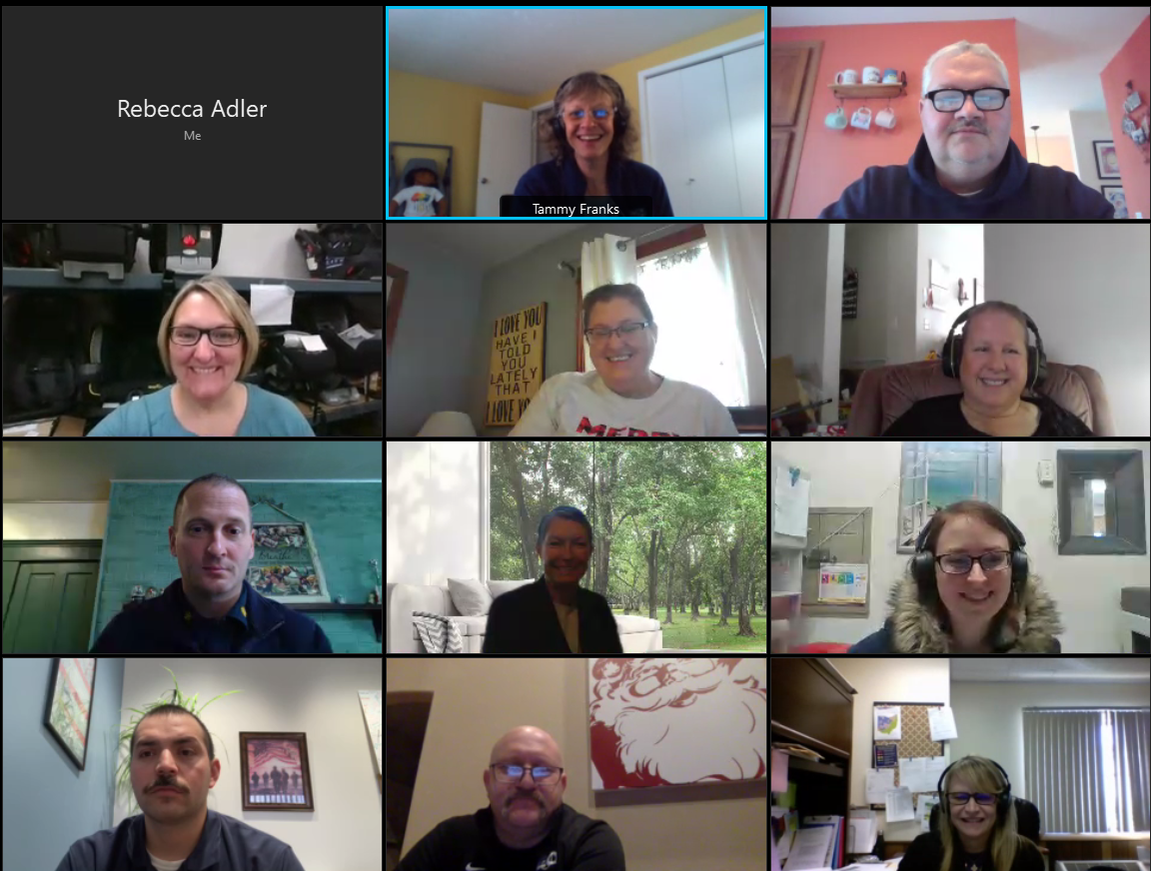
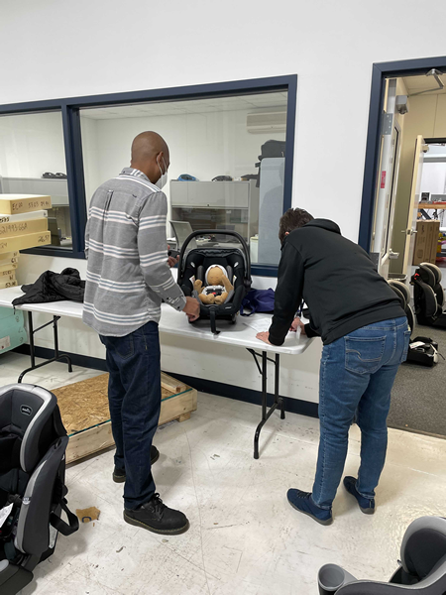
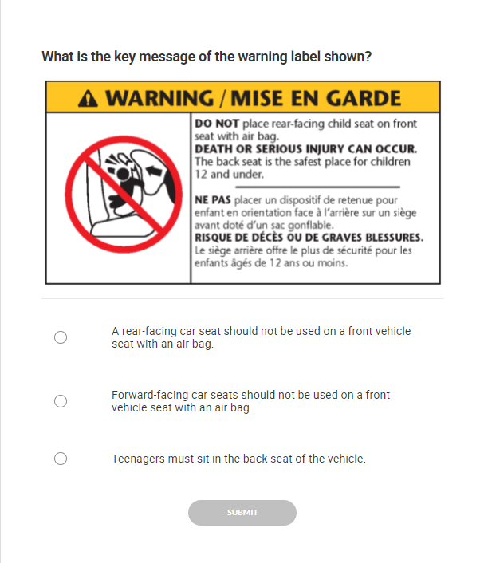
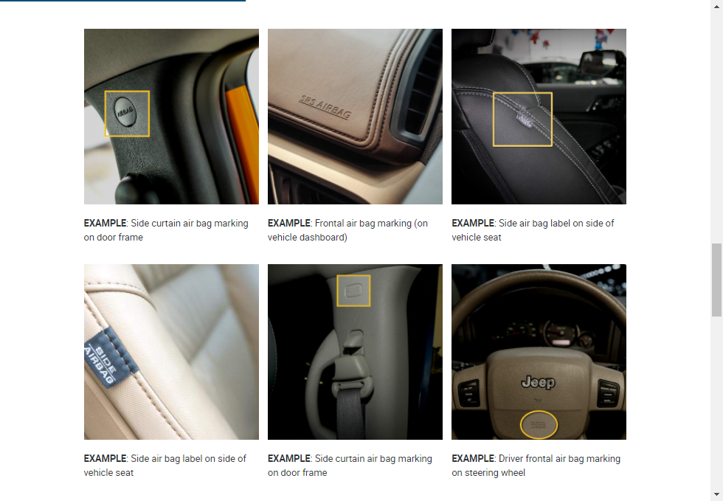
Hybrid Course Components
SELF-PACED E-LEARNINGS
VIRTUAL SESSIONS
IN-PERSON SESSIONS
Images from Canton, Ohio pilot course
Notes:
Hybrid course components
Briefly review the three learning components that comprise the hybrid learning experience. Learning block specifics and course completion requirements will be covered later in the presentation.
Self-paced e-learnings
Virtual sessions
In-person sessions

Slide 4
E-learning and Device Types
Device Type | Device Examples | Notes
Mobile | Smart Phone iPad Tablet | These devices use a mobile operating system. Only mobile operating systems support the full range of touch screen gestures. A tablet is defined as “a mobile device, typically with a mobile operating system and touchscreen display processing circuitry.”
“Convertible” Devices | Laptop-like devices that fold to enable a tablet-like experience Examples: Lenovo Yoga Dell XPS | These devices use a desktop PC operating system that typically does not have the full circuitry for processing all touch screen gestures. Most convertible devices include minimal touch screen gestures such as tapping or zooming in/out.
Desktop/ Laptop PC | Desktop unit with keyboard, monitor, and mouse attached Laptop with built-in full function keyboard and touch pad for navigating the screen. | Uses a desktop operating system. Touch screen capability is typically not a part of desktop and laptop PC function. Laptop devices typically include USB ports to attach an external mouse.
Notes:
E-LEARNING AND DEVICE TYPES
Review the types of devices to be used to complete the e-learning.
Explain that the best experience for the e-learning is a tablet, laptop, or PC. This is because the curriculum is heavily based on photographs with details that need to be seen easily.
While most segments are easy to complete via a mobile device, it is not recommended to complete more complex segments via a small mobile phone screen. Mobile phone screens may be too small to see some of the images.
Be sure that students understand that “convertible” devices may not have full touchscreen capabilities.
INSTRUCTOR NOTE: This information is included in the Navigating the Learning Management System – Students JOB AID which the students will receive via email from training@cpsboard.org, so don’t spend a lot of time going over it. If a student has not received the Navigating the Learning Management System – Students JOB AID, it is available for Instructor download in the Protected Instructor Materials on cpsboard.org.

Slide 5
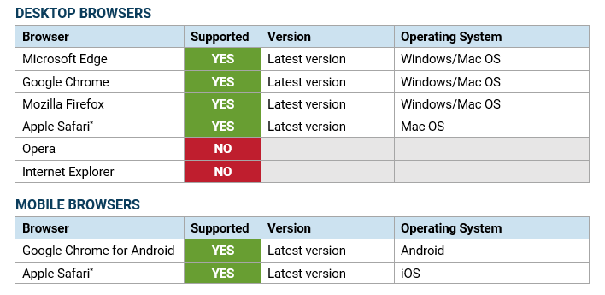
E-Learning and Supported Browsers
Notes:
E-Learning and SupportED Browers
Review the supported browers.
Students are able to check if they have the latest version of their browser by visiting whatismybrowser.com.
Older browsers such as Internet Explorer will NOT work.
IMPORTANT. Safari’s default settings prevent media from playing automatically. Change the settings to allow media to autoplay. Refer to the JOB AID for more information.
INSTRUCTOR NOTE: This information is included in the Navigating the Learning Management System – Students JOB AID which the students will receive via email from training@cpsboard.org, so don’t spend a lot of time going over it. If a student has not received the Navigating the Learning Management System – Students JOB AID, it is available for Instructor download in the Protected Instructor Materials on cpsboard.org.

Slide 6
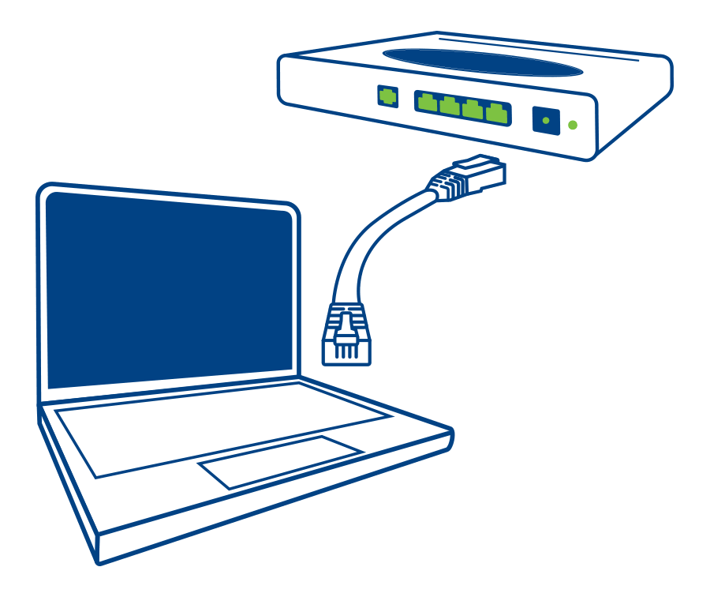


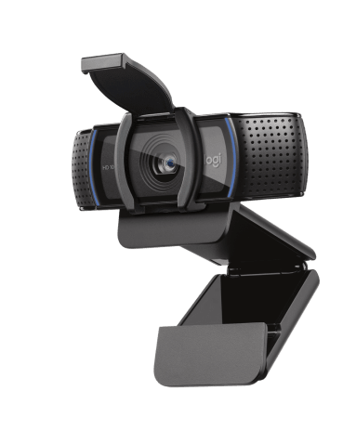


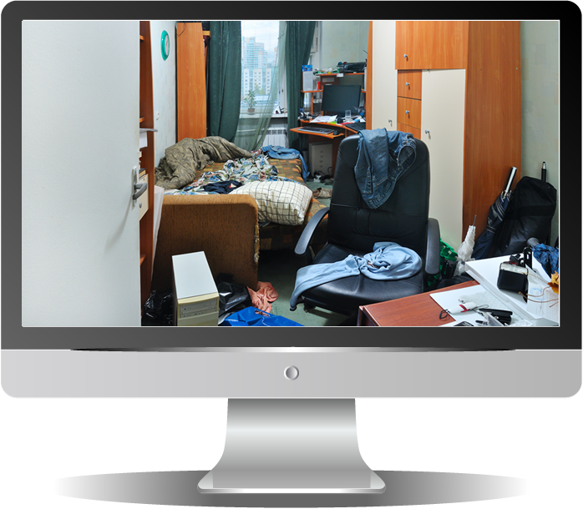

Are you ready for virtual sessions?
AVOID WiFi connections
Use a hard-wired Internet connection if possible*
Webcam
Light yourself so you can be seen
Find a quiet area. Alert others that you will be live online.
CLEAR away distractions
*Image: sse.co.uk/help/phone-and-broadband/internet-speed-extension-cables-ethernet
Notes:
TECHNOLOGY REQUIREMENTS FOR VIRTUAL SESSIONS
Confirm with students that they have the technology available to support participating in the virtual sessions including reliable Internet access, a web camera and good audio quality.
Connection. Encourage students to use a hard-wired internet connection if possible.
“Hard-wired” means that the PC or device is connected to an Ethernet cable that also connects to the Internet router.
If the student MUST use Wi-Fi, ensure that the connection is stable and fast.
Camera. Encourage students to use their webcam, either a built-in or an external one. It is important to be able to see and hear another during the virtual sessions.
If someone cannot be on camera, discover the reason. If it is due to low bandwidth, that student may have difficulty completing the hybrid course since much of it is completed online. Stress to students struggling with technology that today is the last day they can transfer their registration to an in-person offering of the certification course.
Lighting. Remind students that natural light is great. If possible, encourage them to avoid sitting in front of a window as they are not backlight and shadowed.
Distractions. Remind students to be aware of what their camera is capturing, and tidy up and clear away accordingly.
Quiet. Remind students to locate a quiet space for the virtual sessions.
Encourage them to alert others that they will be live online.
Silence Notifications. Remind students to silence all notifications that could become a distraction before going live.

Slide 7
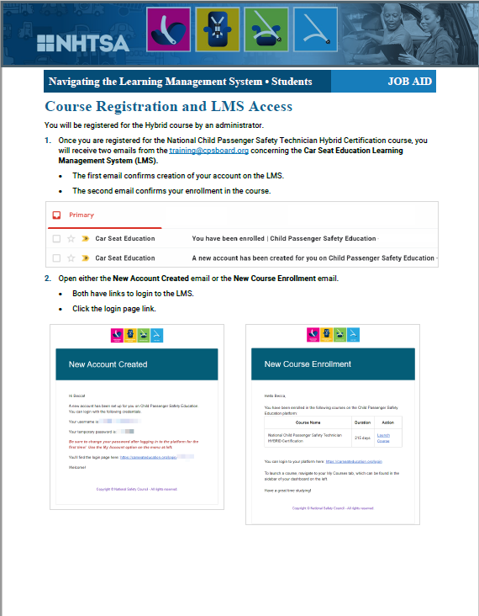
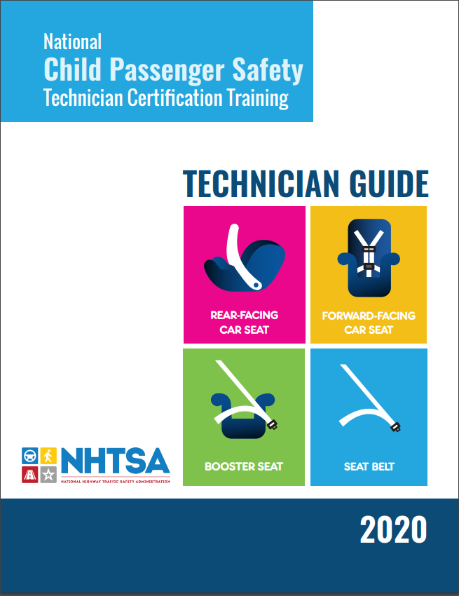
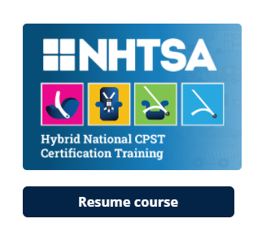

Materials and Resources
1
2
3
LMS Access
carseateducation.org
4
Slack Access
Job Aid
CPST Technician Guide (TG)
Notes:
Materials and Resources
Review the materials and resources that the students will use during the hybrid course.
1. JOB AID The Navigating the Learning Management System – Students JOB AID includes login instructions and other information about navigating in the learning management system (LMS) as well as information about supported devices and browsers.
Encourage students to read the entire job aid.
2. 2020 National Child Passenger Safety Technician Certification Training Technician Guide
Confirm with students that they have received their print copy of the TG.
3. LMS The Car Seat Education learning management system (LMS) is where all of the self-paced e-learning modules are administered.
Students should have received 2 emails from training@cpsboard.org: one confirming creation of their account on the LMS and another confirming enrollment in the course.
Confirm with students that they are able to log in to carseateducation.org and have the Hybrid National CPST Certification Training course listed in their courses.
There is no cost to the students for use of the Car Seat Education learning management system.
4. Slack Slack is communication tool for the class online workspace. The group will have its own private channel for communicating during the course.
Students should have received an email invite to join the group.
Confirm with students that they are able to access the group’s slack channel.
Slack can be accessed via a web browser. Students do not have to download an app to use Slack.
There is no cost to the students for use of Slack.

Slide 8
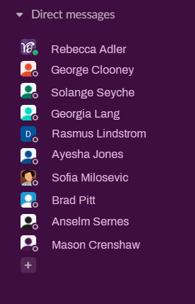

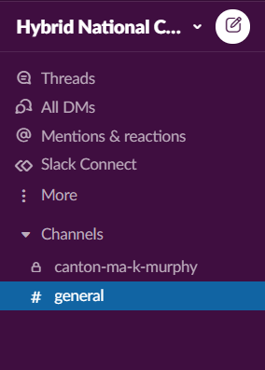
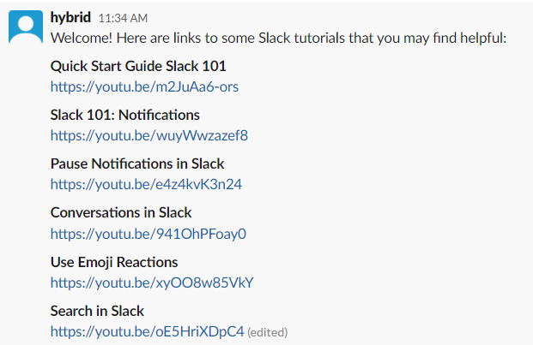
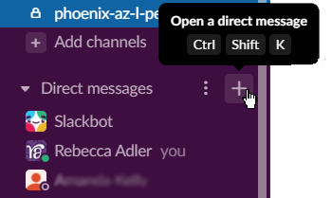

Using Slack
Direct Messages (Private)
Slack Tutorials
Create Direct Message
PRIVATE CHANNEL
OPEN CHANNEL
Notes:
Using Slack
Review the use of Slack.
The class will use their group’s own channel to post questions, certain assignments and for general communication regarding the course.
The group’s channel will have a small lock icon next to it, indicating that it is a private channel for the group alone.
The “general” channel is open to all members of the workspace, including other students who are taking the hybrid course in different areas and with different instructors.
The #general channel is used to communicate with all CPST students.
The Direct Messaging function will be used to submit assigned videos to coaches.
The Direct Messaging function can be used to contact the assigned Coach with questions. Messages sent via Direct Message are private.
To begin a direct message, hover over the Direct Messages heading and clicking the + sign. Then, type the name of the person you want to message.
OR, right-click a person’s name from one of their posts in the group channel, and choose Message [Name].
Consider using the group’s channel to post issues or questions. Anything posted to the group’s channel can be seen by all members of the group.

Slide 9
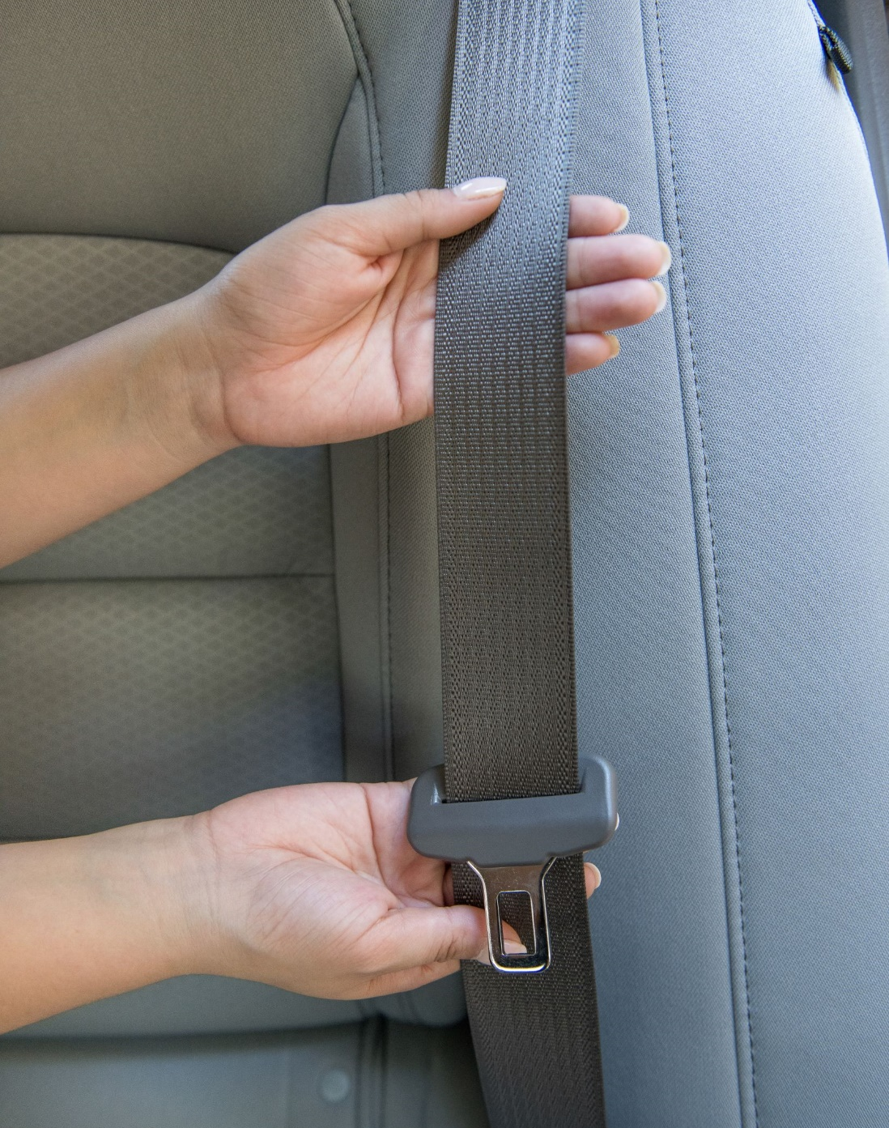
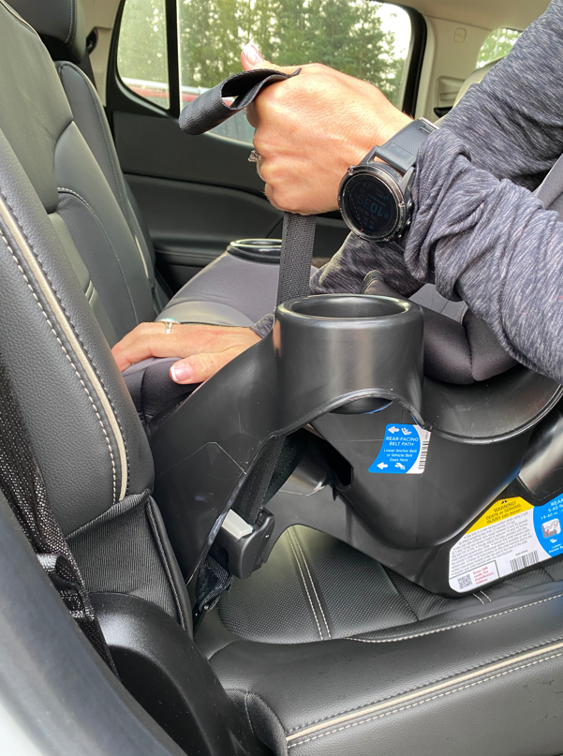
Equipment You Will Need
1
2
Notes:
Equipment
Review the equipment that the students will need for hands-on practice prior to attending the in-person sessions.
Vehicles
Students will need access to at least one vehicle for hands-on practice prior to the in-person sessions.
It is strongly suggested that students gain access to a variety of vehicles to help familiarize themselves with different types of seat belts and airbags.
2. Car Seats
Students will need access to car seats for hands-on practice prior to the in-person sessions.
Minimally, students will a car seat that can be used in the rear-facing mode, a car seat that can be used in the forward-facing mode and a booster seat.
It is strongly suggested that students gain access to a variety of car seats to help familiarize themselves with different features.
Remind students that most car seat instruction manuals can be found on the car seat manufacturer’s website.
If the Instructor Team is providing training car seats to students, confirm that the students have received the car seats.

Slide 10
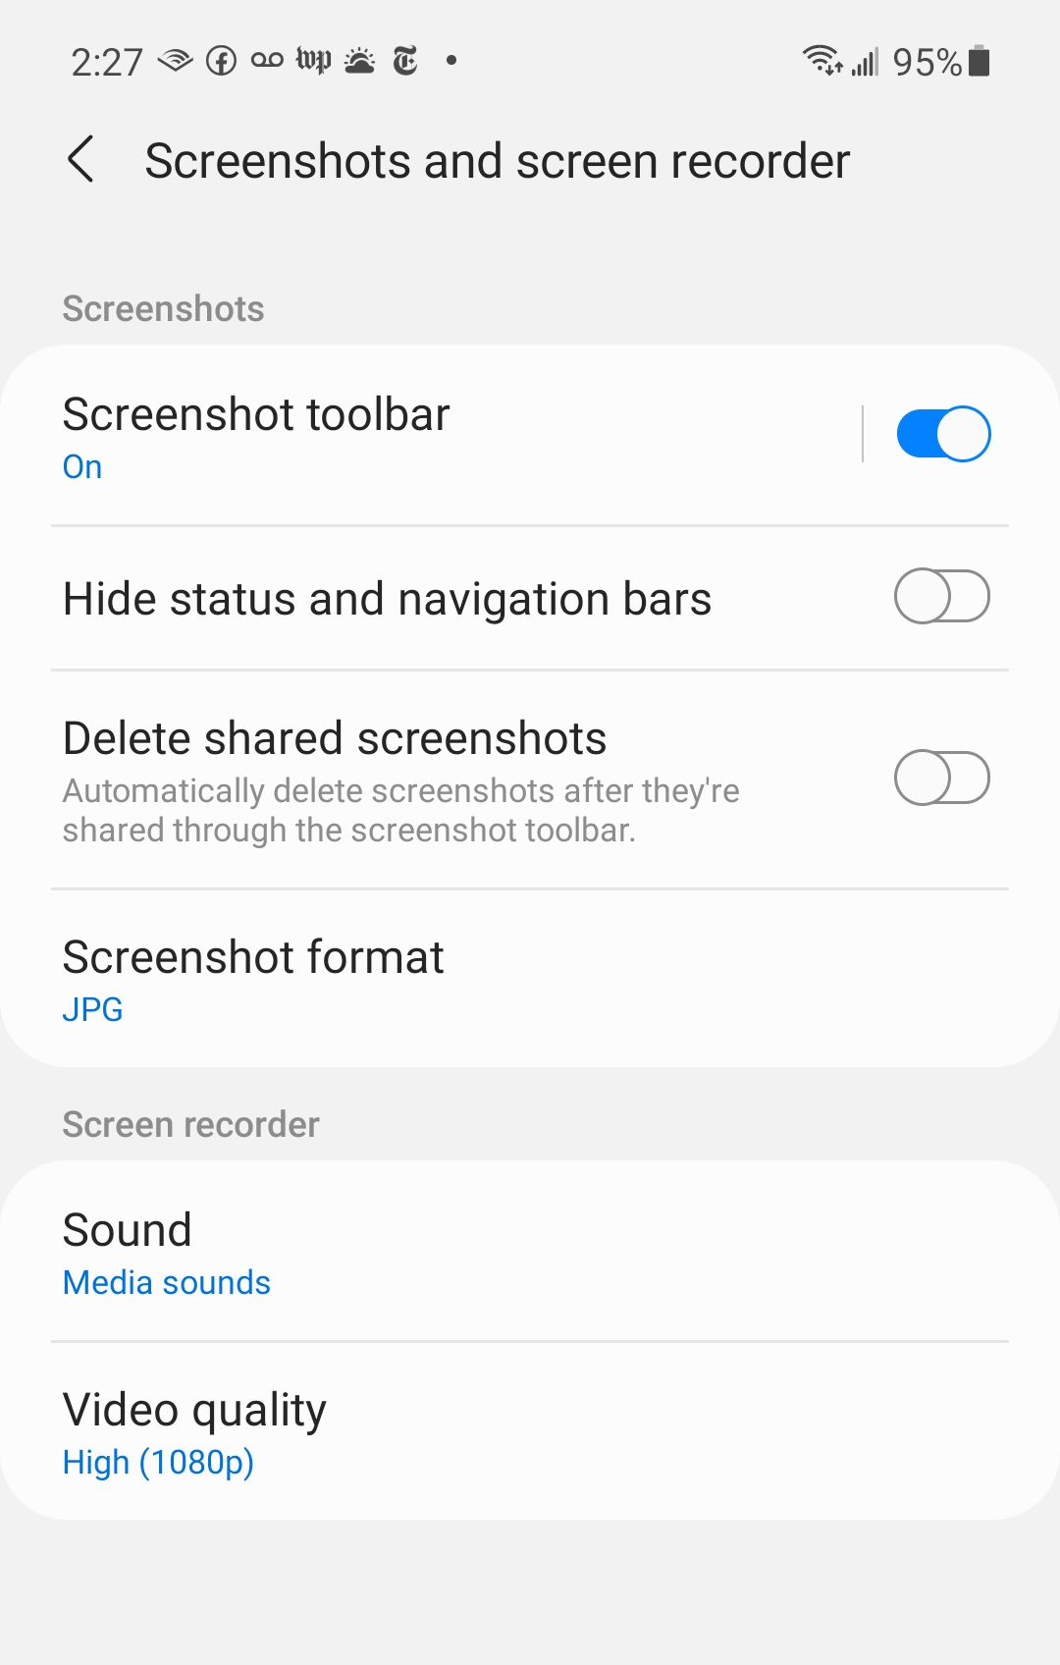


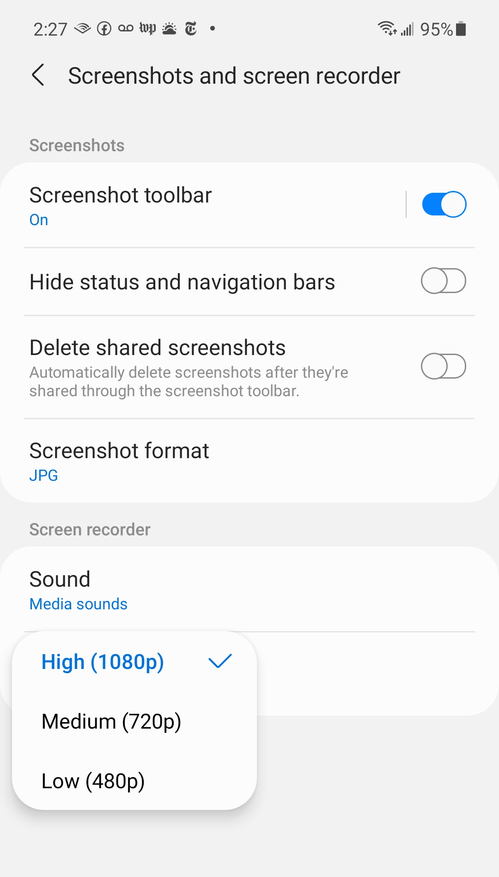

Are you ready to record simple videos?
1920 by 1080
1280 by 720
Recording at a resolution of 1280x720 pixels is best. This is web video.
854 by 480
Notes:
TECHNOLOGY REQUIREMENTS FOR VIDEO Learn-Practice-Explain Activities
Review with the students the use of video submissions during the course.
A key competency for Technicians is the ability to teach caregivers and to talk to caregivers in plain language. Students need to practice teaching others. For this reason, there are several assignments that require the students to record very brief videos and send them to their assigned Coach.
Students may record on any device that they are comfortable with, as long as they can access the video file and submit it to their Coach.
Encourage students to search their phone or device settings to change the video resolution to a lower setting so they don’t use up all of the storage space on their device, and so that the video is quick to upload.
On the slide is an example of how to change video resolution on a Samsung phone using Android. Most devices will have similar options for changing this setting.
The default video resolution on a device will likely be high, as shown in the example (1920 pixels wide by 1080 pixels tall in landscape mode).
A video resolution of 1280 pixels wide by 720 pixels tall in landscape mode is good quality but still a reasonable size when stored or uploaded.
Low resolution can be used if needed; however, don’t go too small so that the Coach cannot see the video.
A sample video is available in the #general channel of Slack.
NOTE: If students don’t understand the term “landscape” mode, explain that it is the mode for photos and videos when the device is held so that the widest dimension is horizontal to the ground. Portrait mode is when the device is held with the shorter dimensions horizontal to the ground.

Slide 11
Hybrid Course Structure
1
2
3
4
Learning Block 1: Modules 1–5
Virtual Kick-off Session
E-learning
E-learning Modules 1–5
Check-in with Instructor
Virtual Checkpoint 1
LPEs and Activities
Preview Learning Block 2
Quiz 1
Learning Block 2: Modules 6–8
E-learning
E-learning Modules 6–8
Virtual Checkpoint 2
LPEs and Activities
Preview Learning Block 3
Quiz 2
Learning Block 3: Modules 9–13
E-learning
E-learning Modules 9–13
Virtual Checkpoint 3
LPEs and Activities
Preview Learning Block 4
Skills Evaluation
Putting It All Together
Quiz 3
Learning Block 4: In-person Sessions
Practice Activities
Module 8: Install Rear-facing Car Seat
Module 9: Install Forward-facing Car Seats
Module 9: Examine Car Seat Misuse
Module 10: Secure A Booster Seat
Module 12: LPE: Conduct a Seat Check
Skills Evaluations
Vehicle Systems
Select and Install Car Seats
Checkup Event
Course Completion and Recap
Notes:
Course Structure
Review the course structure. Explain that it is strongly encouraged that all e-learning content and activities in each learning block be completed prior to the Checkpoint for that learning block. Stress that all e-learning content must be completed to 100% prior to attending the first in-person session.
The hybrid course is divided into four learning blocks.
The Learning Blocks, modules and segments must be completed in sequence.
All 3 quizzes and 1 skills evaluation are completed on the LMS.
The quizzes and skills evaluations are timed at 45 minutes each.
Students may pause a quiz/skills evaluation and return to complete it at a later point in time. The progress will be retained including time remaining.
Questions not completed at the end of the 45-minute time period are marked incorrect.
Virtual sessions are mandatory for students.
Students will be stopped in the LMS immediately prior to each virtual session.
At the conclusion of each checkpoint, students return to the LMS to complete a very quick assignment. Once an Instructor grades the assignment, the next e-learning segment will be available for the student.
In-person sessions are mandatory for students.
Students will completing hands-on activities and skills evaluations, including a checkup event, during the in-person sessions.
Review the course schedule and ensure everyone knows the dates for the virtual and in-person sessions.

Slide 12



Completion Requirements
TG 1-6
Pass three quizzes with total of 42/50 correct.
Quizzes are administered on the learning management system.
Pass four skills evaluations.
One skills evaluation is administered on the learning management system and the other three are conducted in-person.
Attend entire training.
This includes all virtual and in-person sessions.
Complete all e-learning segments.
All e-learning segments must be completed prior to the in-person sessions.
Participate in class discussions and practice activities.
This includes submission of all Learn • Practice • Explain videos prior to the in-person sessions.
Notes:
COMPLETION REQUIREMENTS
Review the completion requirements as shown on the slide. Refer the students to Course Completion Requirements in the Student Orientation Materials on the Car Seat Education Learning Management System as well as Technician Guide 1-6 for this information.
Stress again that attendance at all virtual and in-person sessions is mandatory for students.
Strongly encourage students to complete the e-learning segments in each learning block during that learning block.
Stress that all online learning content, Learning Blocks 1-3, must be completed prior to Day 1 of Learning Block 4, the in-person sessions. Share the deadline for submissions determined by the Instructor Team.
Stress that all Learn • Practice • Explain videos must be submitted prior to Day 1 of Learning Block 4, the in-person sessions. Share the deadline for submissions determined by the Instructor Team.

Slide 13
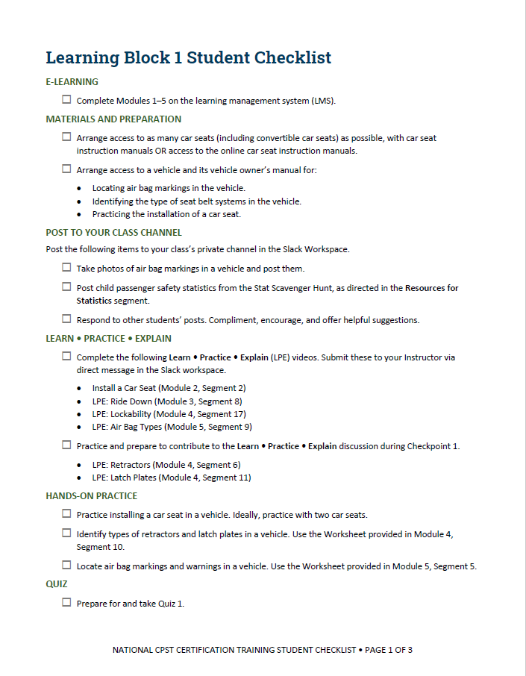
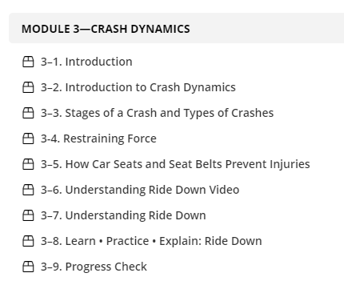

Student Checklists
The sequence of the learning activities is purposeful. Practice activities are provided at the appropriate time.
Do practice activities on the checklist when prompted to do so in the associated online learning segment. Then, check them off your checklist!
Notes:
STUDENT CHECKLISTS
Remind students that the checklist document is one of the first documents available for download in the LMS. It’s designed to help students keep track of their work for each learning block in the course.
There is a checklist for each learning block.
The checklist is a companion to the e-learning segments.
IMPORTANT: All content in the LMS is sequenced for learning development.
All activities should be completed when prompted to do so in the associated e-learning segment.

Slide 14



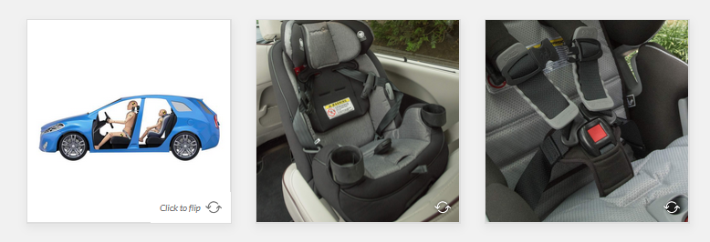
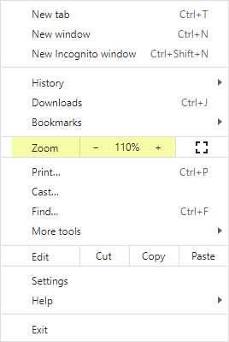
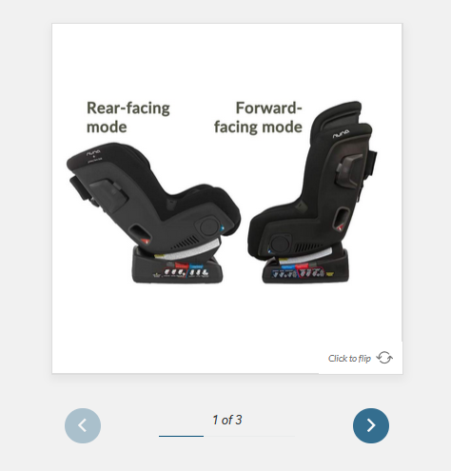
Tips!
Most images in online segments can be enlarged by clicking on them.
Your browser also has a zoom in/zoom out feature if needed!
EXAMPLE: On Chrome browser, press Ctrl and the plus key (on the keyboard’s numeric keypad) to zoom in and Ctrl and the minus key to zoom out.
OR, use the browser’s menu to zoom in or out.
FLASHCARD grid: click to flip each card
FLASHCARD stack: click to flip, then use > to advance to next card
Notes:
Tips
Review the following tips for the e-learning segments.
Zooming. The e-learning segments of the course feature many detailed photographs and images, such as pages from car seat instruction manuals. Most of these can be enlarged by clicking on them.
All browsers have zoom in/zoom out capability as well to enlarge content or shrink content to fit on the screen.
Flashcards. Some e-learning segments feature flashcard stacks and flashcard grids. Just click a flash card to turn it over! Icons in the bottom right-hand corner serve as reminders to do so.

Slide 15

Learning Block 1
AHEAD
Notes:
LEARNING BLOCK 1
Preview Learning Block 1 content.
Learning Block 1 sets the foundation for the course.
In addition to completing the e-learning for Modules 1-5, there is practice time in vehicles during this learning block.
Remind students to identify the vehicles they’ll be using, and to post them in the online class workspace.
PREVIEW CONTINUED ON NEXT SLIDE.

Slide 16



 | Partners | WEBSITE
 | National Child Passenger Safety Board | cpsboard.org
 | National Highway Traffic Safety Administration (NHTSA) | nhtsa.gov
 | Safe Kids Worldwide | safekids.org
Partnerships
Notes:
PREVIEW LEARNING BLOCK 1
Review Learning Block 1 content.
The National Child Passenger Safety Technician Certification training is a partnership between three organizations. Students will be introduced to the partners and their respective roles in Module 1.
PREVIEW CONTINUED ON NEXT SLIDE.
16

Slide 17

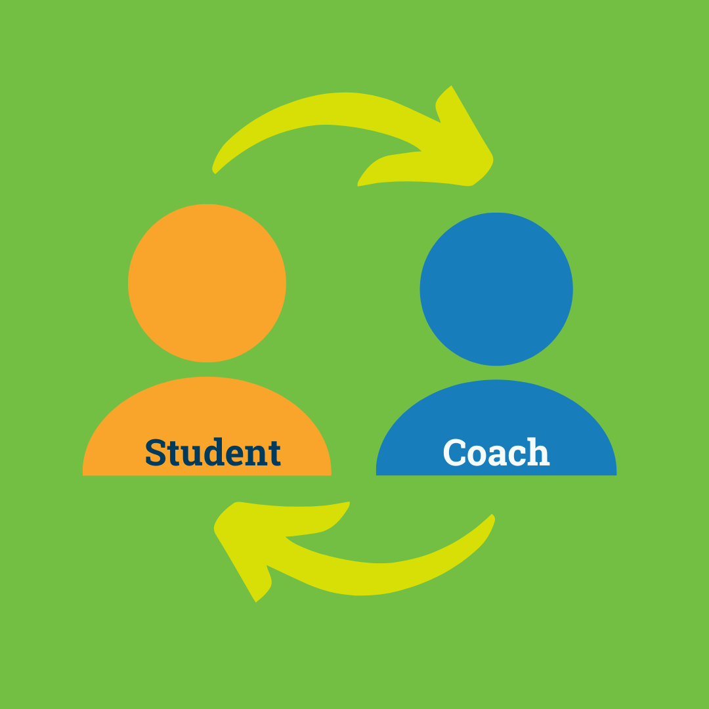
Hands-on Activity: Install a Car Seat
Notes:
PREVIEW LEARNING BLOCK 1
Review Learning Block 1 content.
In Module 2, students will be introduced to the role of a Child Passenger Safety Technician.
At the start of Module 2, student will record and submit a video of themselves installing a car seat.
After submitting the video to their Coach, students must have a 1:1 meeting with their Coach.
In order to advance to Module 3, students must enter the date of the 1:1 meeting with their Coach.
Encourage students to plan ahead and schedule a meeting with their Coach as soon as possible so they don’t get delayed in Learning Block 1.
Ask students if they have access to a car seat to complete the activity. If not, work with the student to get access to a car seat.
PREVIEW CONTINUED ON NEXT SLIDE.

Slide 18
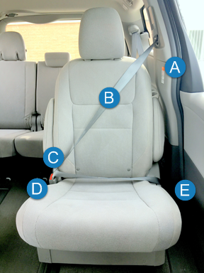
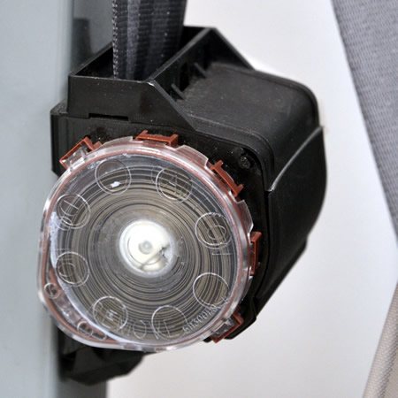
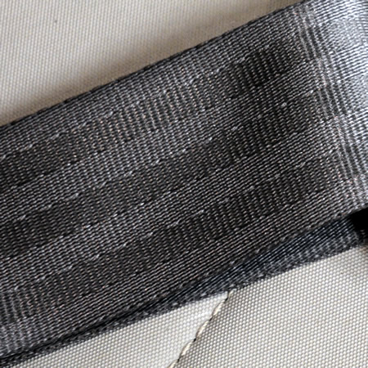
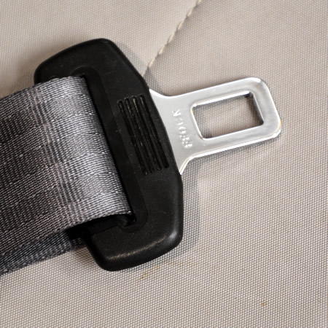
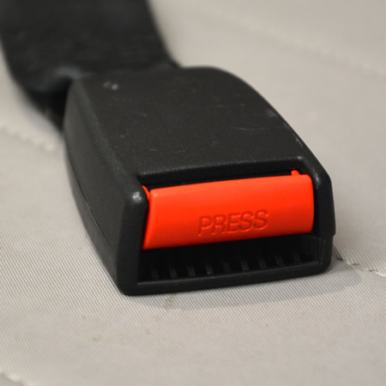
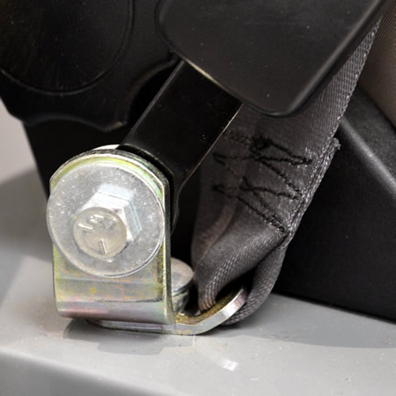
Seat Belt Parts
A. Retractor
B. Webbing
C. Latch Plate
D. Buckle
E. Anchor
Notes:
PREVIEW LEARNING BLOCK 1
Review Learning Block 1 content.
Module 3 will provide a short introduction to Crash Dynamics.
Modules 4 and 5 will begin exploring vehicle systems including seat belt systems and airbags.
Remind students that it will be helpful to have access to a variety of vehicles for Modules 4 and 5.
Encourage students to make ask questions as needed in Module 4, Seat Belt Systems, as this a foundational module in the training.
PREVIEW CONTINUED ON NEXT SLIDE.

Slide 19

Questions?
Notes:
Q&A
Answer any questions that students may have.

Slide 20




Next steps…
Complete the Kick-off Assignment as soon as possible following this session so you can be approved to move on in the e-learning!
It is strongly recommended to complete all of the Learning Block 1 e-learning segments and assignments BEFORE the virtual Checkpoint 1 session.
Remember to use your Learning Block 1 Checklist to help you stay on track.
Notes:
NEXT STEPS
Review the next steps for the students as listed on the slide.

