Slide 1






Checkpoint 3
National CPST Certification HYBRID Training
Notes:
This PowerPoint presentation supports CHECKPOINT 3 for the National cpst Certification hybrid Training.
INSTRUCTOR NOTE: The National CPST Certification HYBRID Training is a nationally standardized curriculum delivered in a cumulative manner with each successive module building on the preceding modules. The content must be delivered in its entirety, in modular order, and may not be altered in any way, including addition or deletion of content.

Slide 2
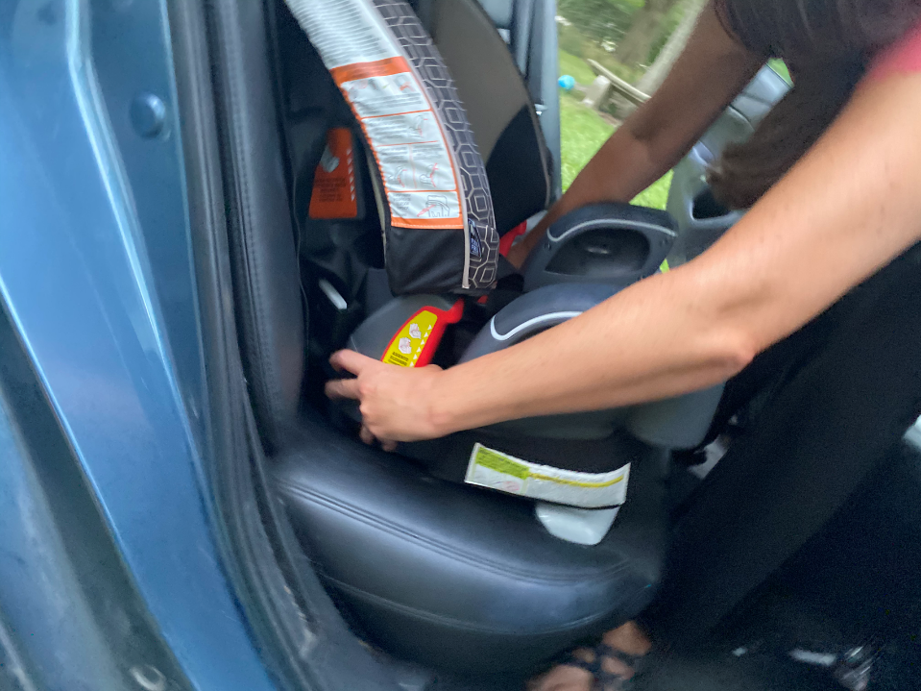
How did it go?
How was your experience installing a forward-facing car seat?
What was difficult?
What was easy?
What did you find surprising?
Notes:
INSTALLING A FORWARD-FACING CAR SEAT
Lead a discussion on students’ experiences installing a car seat rear-facing.
What was difficult?
Easy?
Surprising?
Address any questions.
INSTRUCTOR NOTE: Ideally, have one or more car seats available for demonstration if needed.
Remind students during the in-person session, they will have an opportunity to install forward-facing car seats with an Instructor’s feedback.

Slide 3
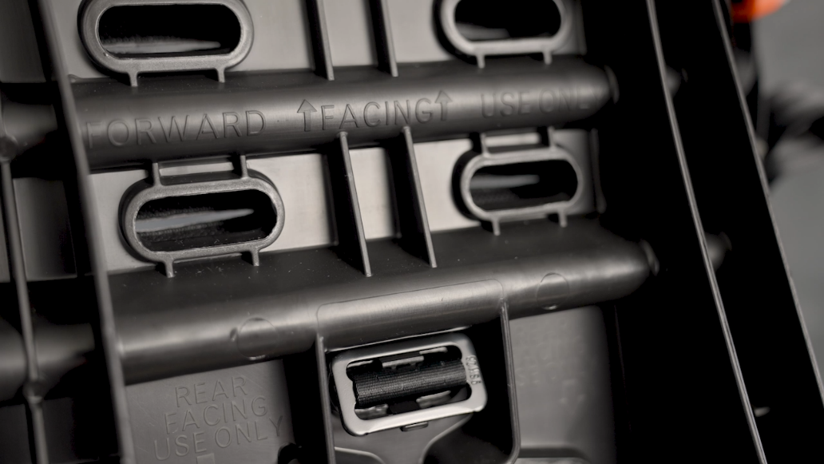
Learn Practice Explain
Adjust Harness Height and Buckle Strap
Practice explaining how to change the harness height and how to adjust the buckle strap for use forward-facing.
TG 9-6
Notes:
Learn • practice • explain (TG 9-6/IG 9-21)
Conduct the LPE activity, ensuring that everyone has an opportunity to contribute.

Slide 4
Learn Practice Explain
Communication Skills
Practice answering the following questions.
Where is the harness adjuster?
How do you adjust, tighten, and release the harness strap?
Where are the lower anchor connectors and tether stored when not in use?
How do you find the forward-facing weight and height limits on this car seat label?
TG 9-10
Notes:
Learn • practice • explain (TG 9-10/IG 9-31)
Conduct the LPE activity, ensuring that everyone has an opportunity to contribute.

Slide 5
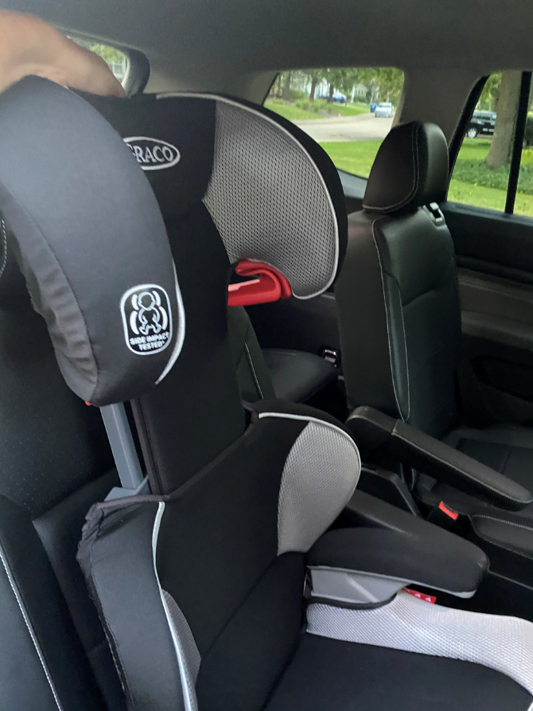
How did it go?
How was your experience securing a booster seat?
Did you practice with a booster seat, or all-in-one or combination car seat in booster mode?
What was difficult?
What was easy?
What did you find surprising?
Notes:
SECURING A BOOSTER SEAT
Lead a discussion on students’ experiences securing a booster seat.
Find out who practiced with booster seats and who practiced with all-in-ones or combination car seats in booster mode.
Compare the different types.
What was difficult?
Easy?
Surprising?
Address any questions.
INSTRUCTOR NOTE: Ideally, have one or more booster seats available for demonstration if needed.
Remind students that during the in-person session, they will have an opportunity to secure booster seats with an Instructor’s feedback.

Slide 6
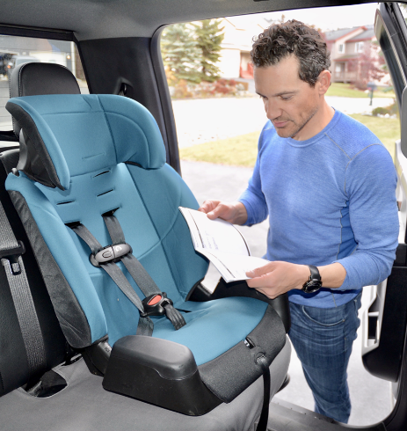
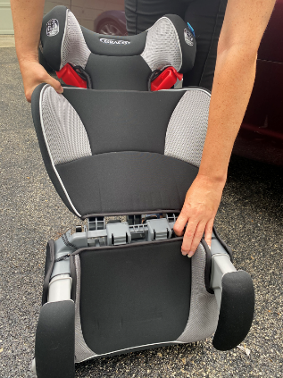
Learn Practice Explain
Booster Seat Conversions
Review the car seat instruction manual(s) for the car seat(s) you are using. Then:
Practice explaining how to convert a combination car seat to a booster and back again.
Practice explaining converting a high back booster to a backless booster.
TG 10-12
Notes:
Learn • practice • explain (TG 10-12/IG 10-37)
Conduct the LPE activity, ensuring that everyone has an opportunity to contribute.

Slide 7




Education Opportunities • Engages Caregivers • Easily Shared
Notes:
Social media
Discuss how social media can provide opportunities for community education, and help engage caregivers in a format that can be easily shared.
Emphasize the importance of vocal tone and non-verbal body language—these elements cannot be seen through social media communication.

Slide 8
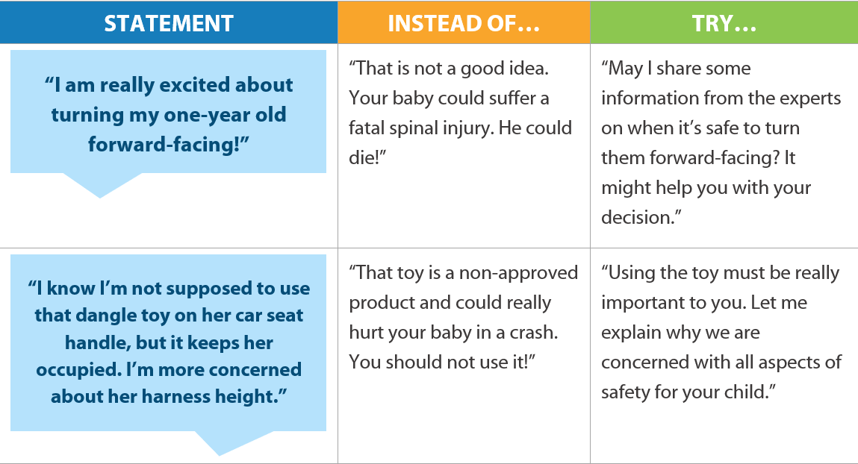
Fear-Based Messaging
TG 12-6
If a caregiver feels judged, they may not engage with the CPS Technician.
Notes:
FEAR-BASED MESSAGING
Discuss fear-based messaging, whether used in person or in a social media post.
Review the examples on TG 12-6/IG 12-21 and provide additional examples if desired.

Slide 9
Learn Practice Explain
Social Media Scenarios
Prepare to discuss the following social media scenarios.
A friend posts a picture of her child in her car seat. You notice the harness straps are loose and the chest clip is too low.
You notice a photo in a social media group where a young child is riding in a forward-facing car seat.
A caregiver who knows that you are a CPS Technician asks for your feedback on the installation and use of a new car seat.
A caregiver posts a picture in a social media group, generally asking for feedback on the installation and use of their car seat or booster seat.
TG 12-6
Notes:
Learn • practice • explain (TG 12-6/12-19)
Conduct the LPE activity, ensuring that everyone has an opportunity to contribute.

Slide 10
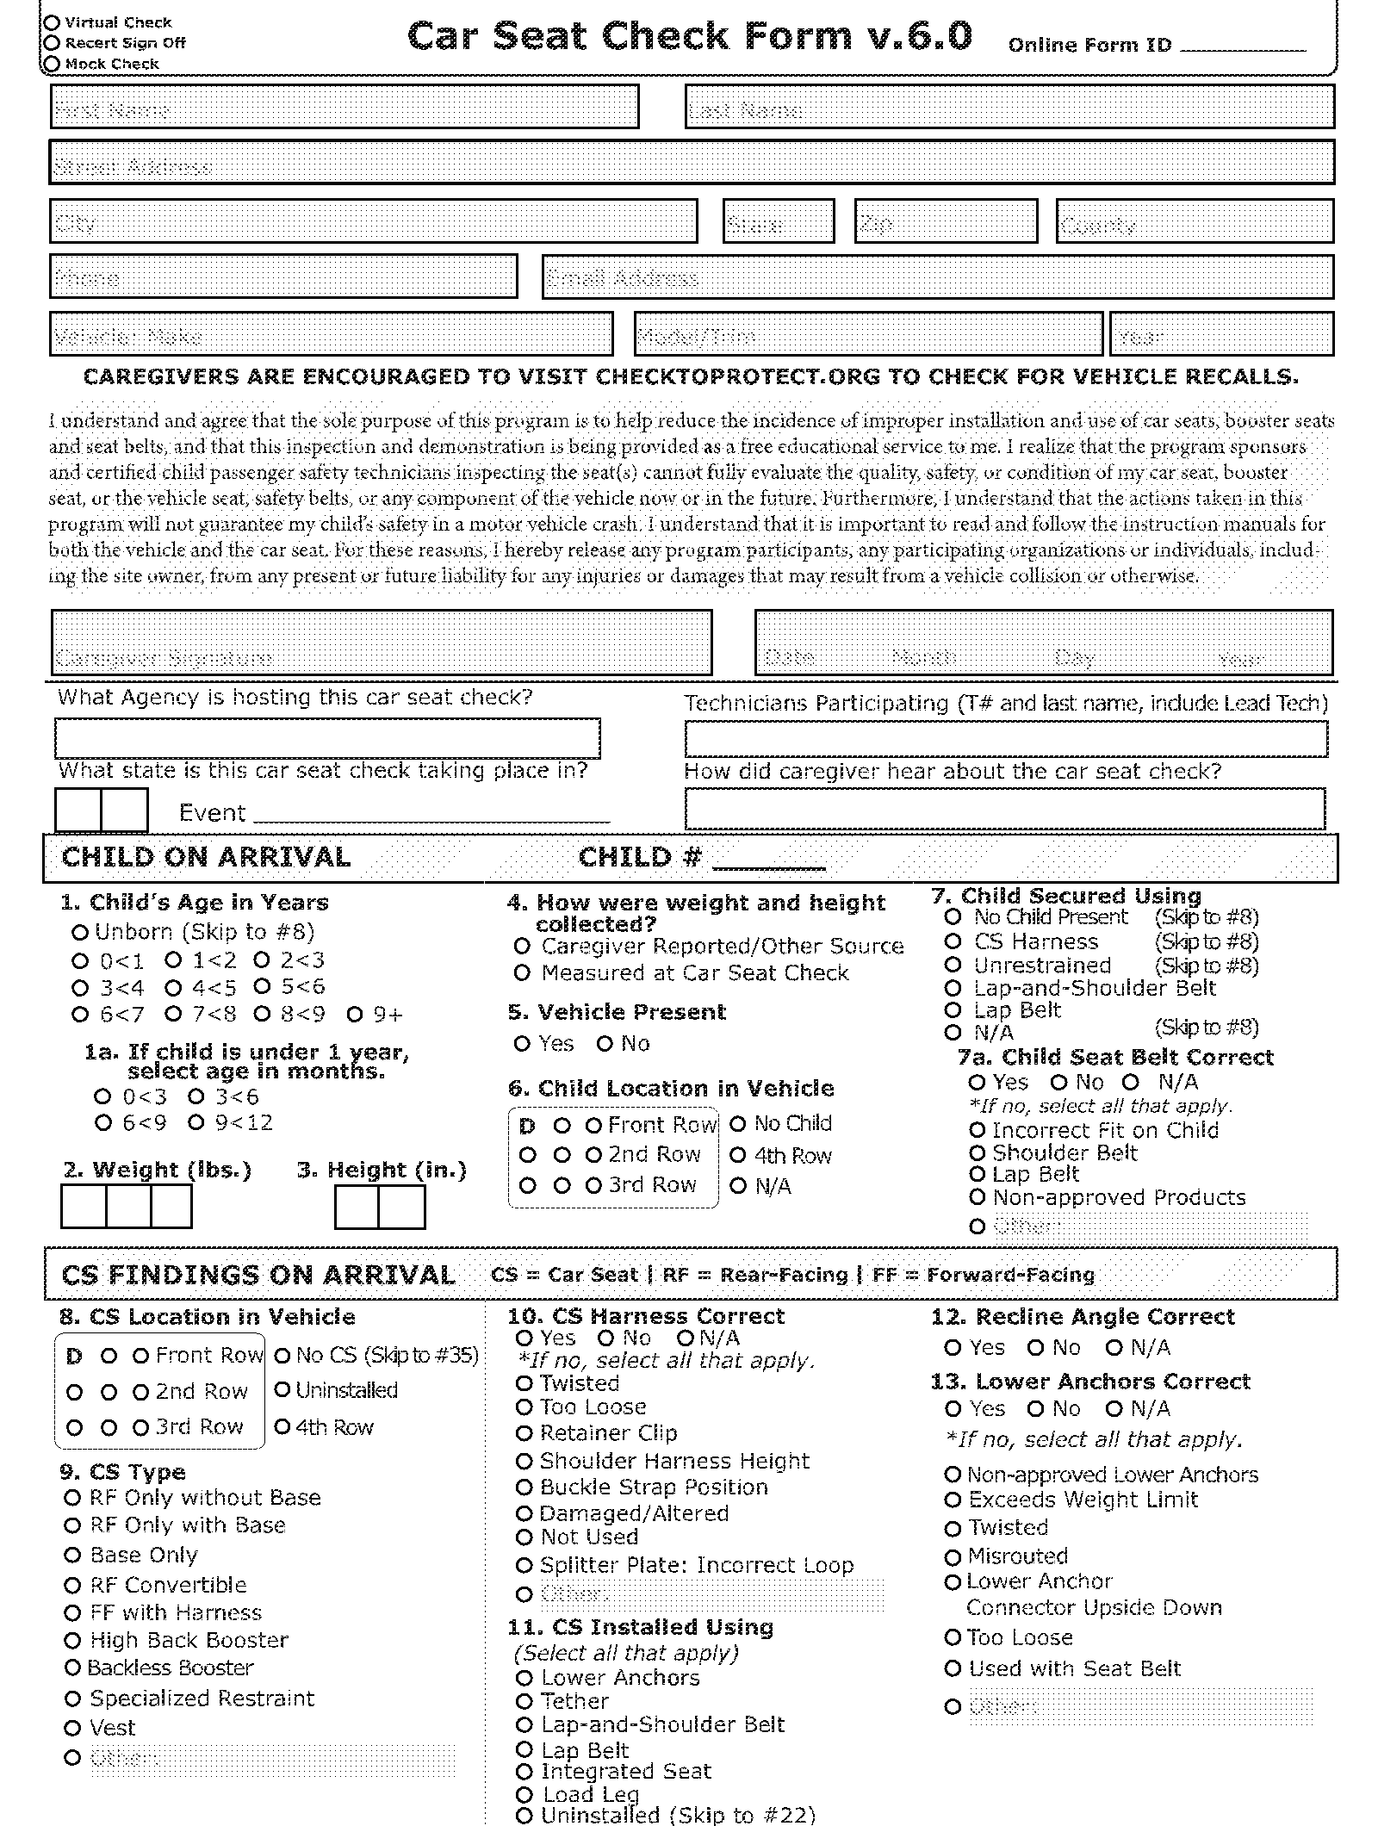
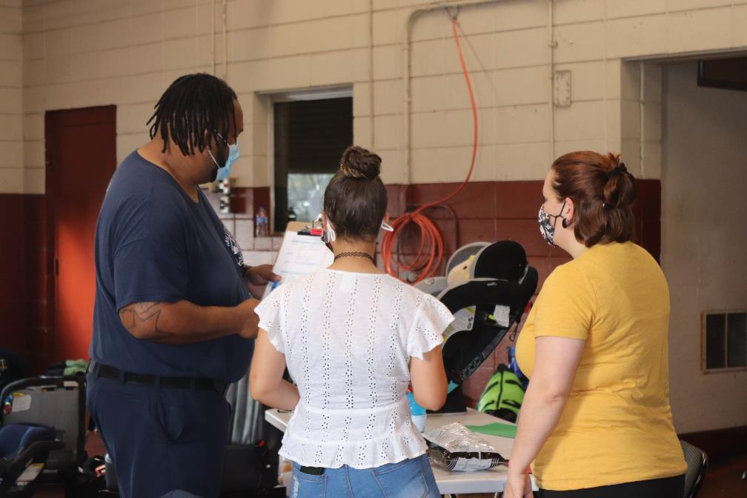
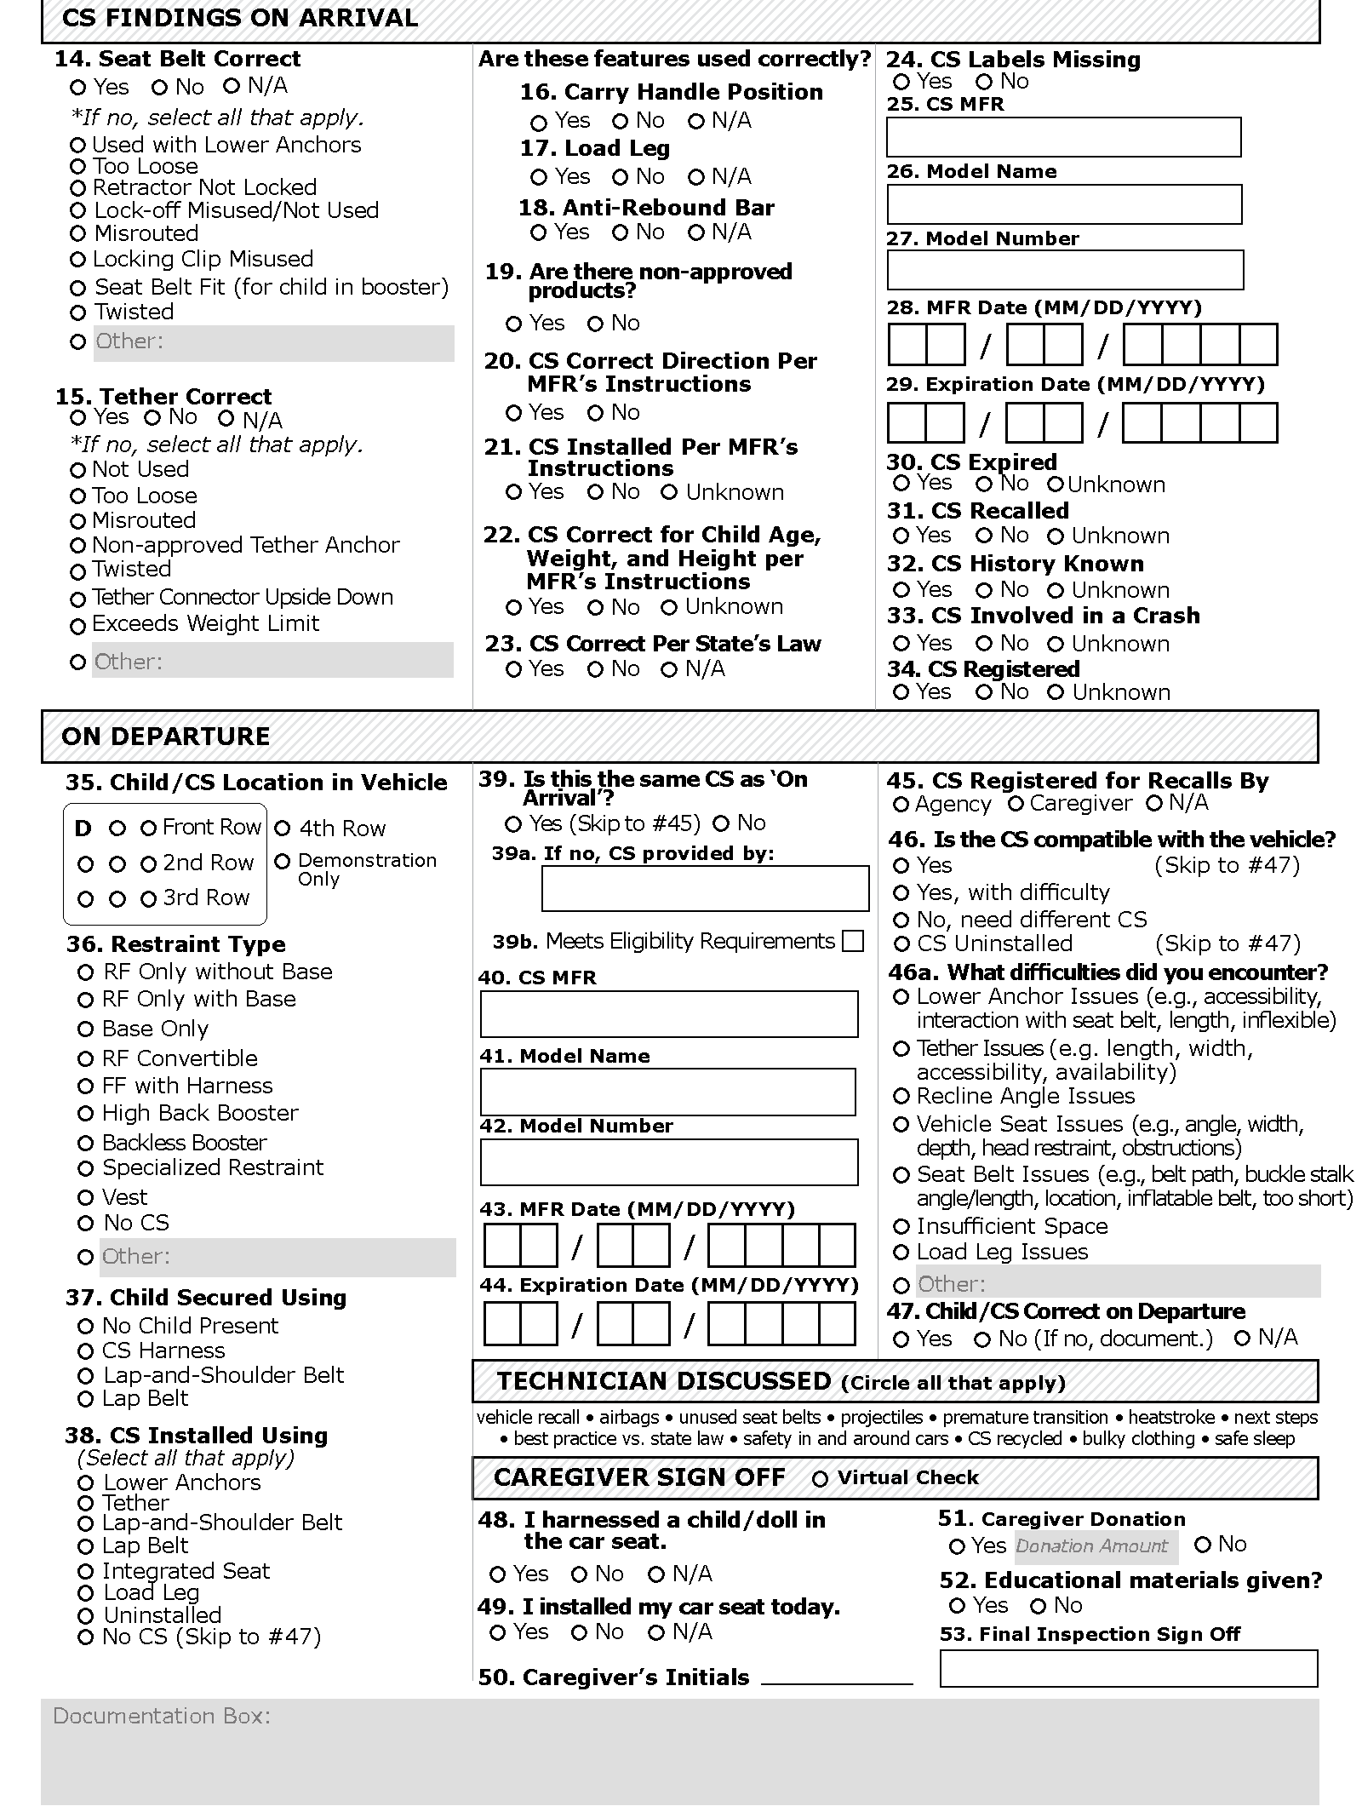
Document Actions
Notes:
Document actions
Discuss the importance of documenting actions in cases where the caregiver does not make a safe choice.
Share a few examples.

Slide 11
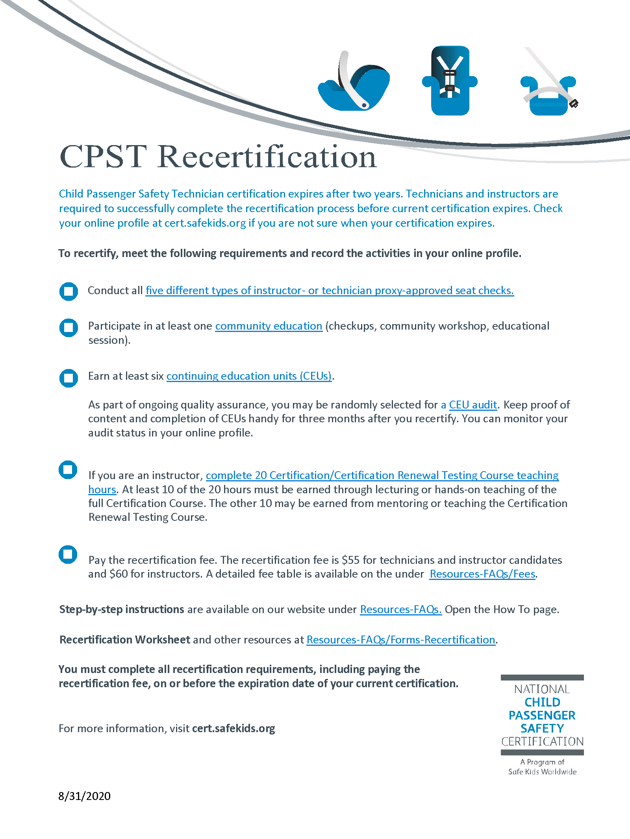
Recertification Process
CPS certification expires after two years.
Technicians and Instructors are required to successfully complete the recertification process before current certification expires.
To recertify:
Meet the requirements and record the activities in your online profile.
Pay the recertification fee.
https://cert.safekids.org/i-am-a-tech/recertification
Notes:
Recertification Process
Briefly review the re-certification process.
Remind students more information is available at https://cert.safekids.org/i-am-a-tech/recertification.
INSTRUCTOR NOTE: Slides 11-13 of Checkpoint 3 may be covered during the in-person sessions if a filler is needed while the Instructor Team sets up an activity.

Slide 12
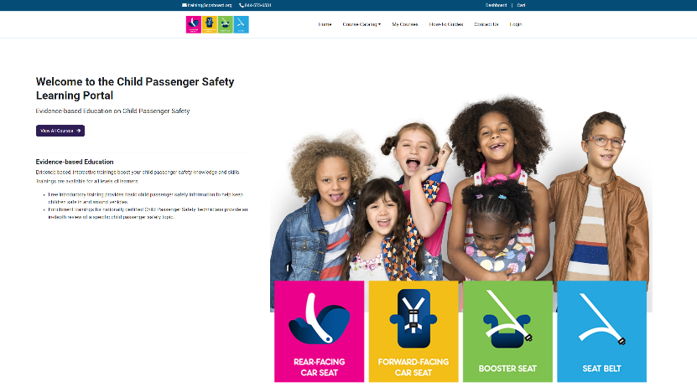
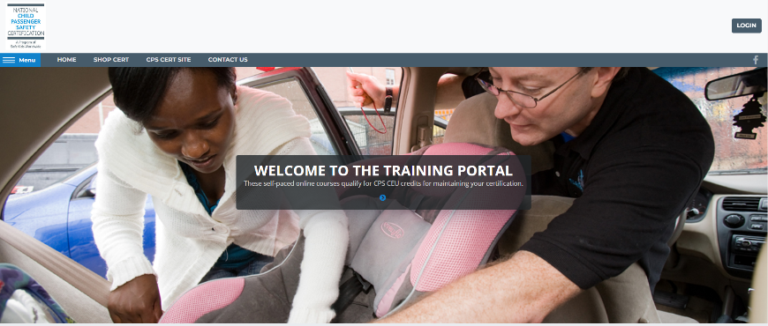
Educational Opportunities for CPSTs
CPS CEU webinars and trainings
Community Education webinars and trainings
carseateducation.org
training.safekids.org
Notes:
Educational opportunities for CPSTs
Discuss different development and educational opportunities for CPSTs, based on current offerings.
INSTRUCTOR NOTE: Slides 11-13 of Checkpoint 3 may be covered during the in-person sessions if a filler is needed while the Instructor Team sets up an activity.
Revision Note: Slide updated 20230519 – Changed cpsboard.org/recertification to carseateducation.org

Slide 13
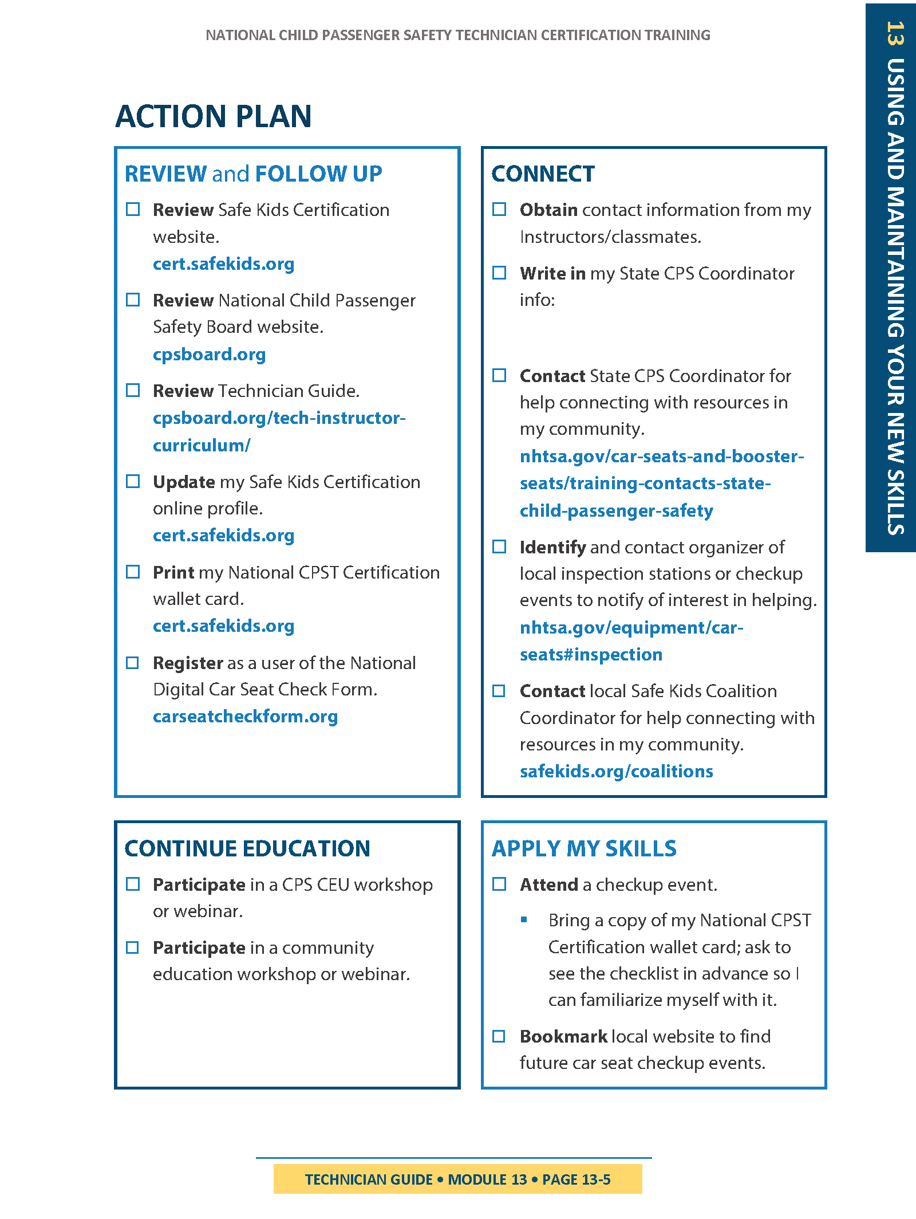
Action Plan
Q&A
TG 13-5
Notes:
ACTION PLAN 9TG 13-5/IG 13-15)
Briefly discuss the Action Plan, and ask if anyone has questions about it.
Confirm that the students were able to identify their state CPS Coordinator.
Help connect students to the organizer of local inspection stations or checkup events.
If applicable, share the local Safe Kids Coalition Coordinator with students.
INSTRUCTOR NOTE: Slides 11-13 of Checkpoint 3 may be covered during the in-person sessions if a filler is needed while the Instructor Team sets up an activity.

Slide 14

Quiz 3
Review
Covers content from Modules 9–12
Notes:
QUIZ review
Conduct a review for Quiz 3 using suggested review questions found in the Protected Instructor Materials on cpsboard.org.
Share the following quiz reminders with the students.
The quiz is timed at 45 minutes.
Students are able to exit and resume taking the quiz at a later point in time. The student’s progress and time remaining to complete the quiz will be saved.
An audio option is available at the top of each question if the student prefers having the quiz questions and answers read to them.
Any questions not completed at the end of the 45-minute time period are marked incorrect.
The quiz will be graded once the student clicks the “Submit Quiz” button and the results will be shared with the student.

Slide 15

Notes:
LEARNING BLOCK 4
Preview Learning Block 4 content.
Review specific details for the in-person sessions (e.g., times, location, parking, etc.) so that everyone is clear about the experience and expectations.
PREVIEW CONTINUED ON NEXT SLIDE.

Slide 16
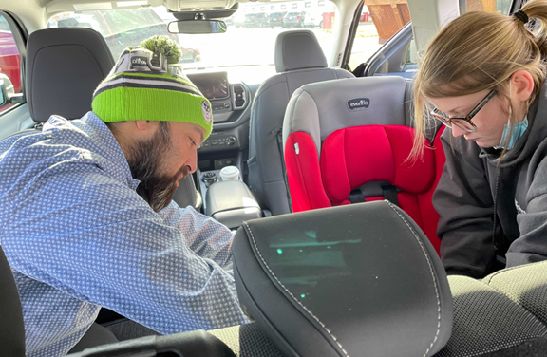
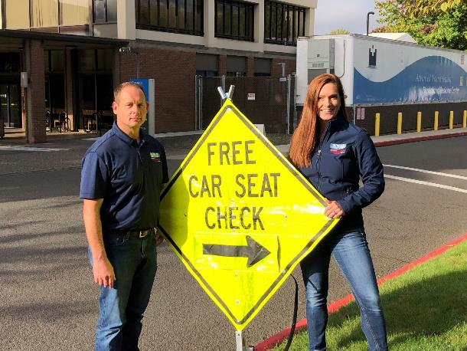
IN-PERSON SESSIONS • PREVIEW
Practice Activities:
Module 8—Install Rear-facing Car Seats
Module 9—Install Forward-facing Car Seats
Module 9—Examine Car Seat Misuse
Module 10—Secure a Booster Seat
Module 12—LPE: Conduct a Seat Check
Skills Evaluation: Vehicle Systems
Skills Evaluation: Select and Install Car Seats
Skills Evaluation: Checkup Event
Course Completion and Recap
Notes:
LEARNING BLOCK 4
Preview Learning Block 4 content.
Share with students that Learning Block 4 includes hands-on activities and 3 skills evaluations.
Share the specifics of the checkup event with the students (e.g. date, time, location, parking, etc.)

Slide 17

Reminder
Bring the PRINT COPY of your Technician Guide to the in-person sessions.
Notes:
REMINDER
Remind students to bring their print copy of the Technician Guide to the in-person sessions.

Slide 18

Questions?
Notes:
Q&A
Answer any questions that students may have.

Slide 19



Next steps…
Complete the Checkpoint 3 Assignment as soon as possible following this session so you can be approved to move on to Quiz 3!
Complete the remainder of Learning Block 3 e-learning segments and assignments BEFORE the in-person sessions.
All e-learning segments must be completed BEFORE the in-person sessions.
Notes:
NEXT STEPS
Review the next steps for the students as listed on the slide.
Stress that the e-learning content must be completed to 100% before the start of the first in-person session.
Stress that all Learn Practice Explain videos must be submitted to the Coaches before the start of the first in-person session.

