Slide 1
Checkpoint 2
Modules 5-8
Child Passenger Safety Technician Certification Training
Notes:
Checkpoint 2
This PowerPoint presentation supports Checkpoint 2 for a 2024 Child Passenger Safety Technician Hybrid Certification Training course.
INSTRUCTOR NOTE: The CPST Hybrid Certification Training is a standardized curriculum delivered in a cumulative manner with each successive module building on the preceding modules. Use of the PowerPoint presentation for Checkpoint 2 is required. The slides must be delivered in order, and may not be altered in any way, including addition or deletion of content.
MEDIA, MATERIALS AND RESOURCES
2024 Instructor Guide
Current paper version of the National Digital Car Seat Check Form
NDCF Training app, optional
PREPARATION
Based on the students in the training, review the state/territory child passenger safety and seat belt laws at ghsa.org/state-law.
Prior to the start of the checkpoint, remind students in the group Slack channel that it will be helpful to have access to the Technician Guide (print or digital copy) and the NDCF (paper version or training app).
TOTAL TIME: 75 Minutes
-DO-
Welcome the students.
-Say-
Today we will be covering Modules 5-8 of the online learning modules.

Slide 2
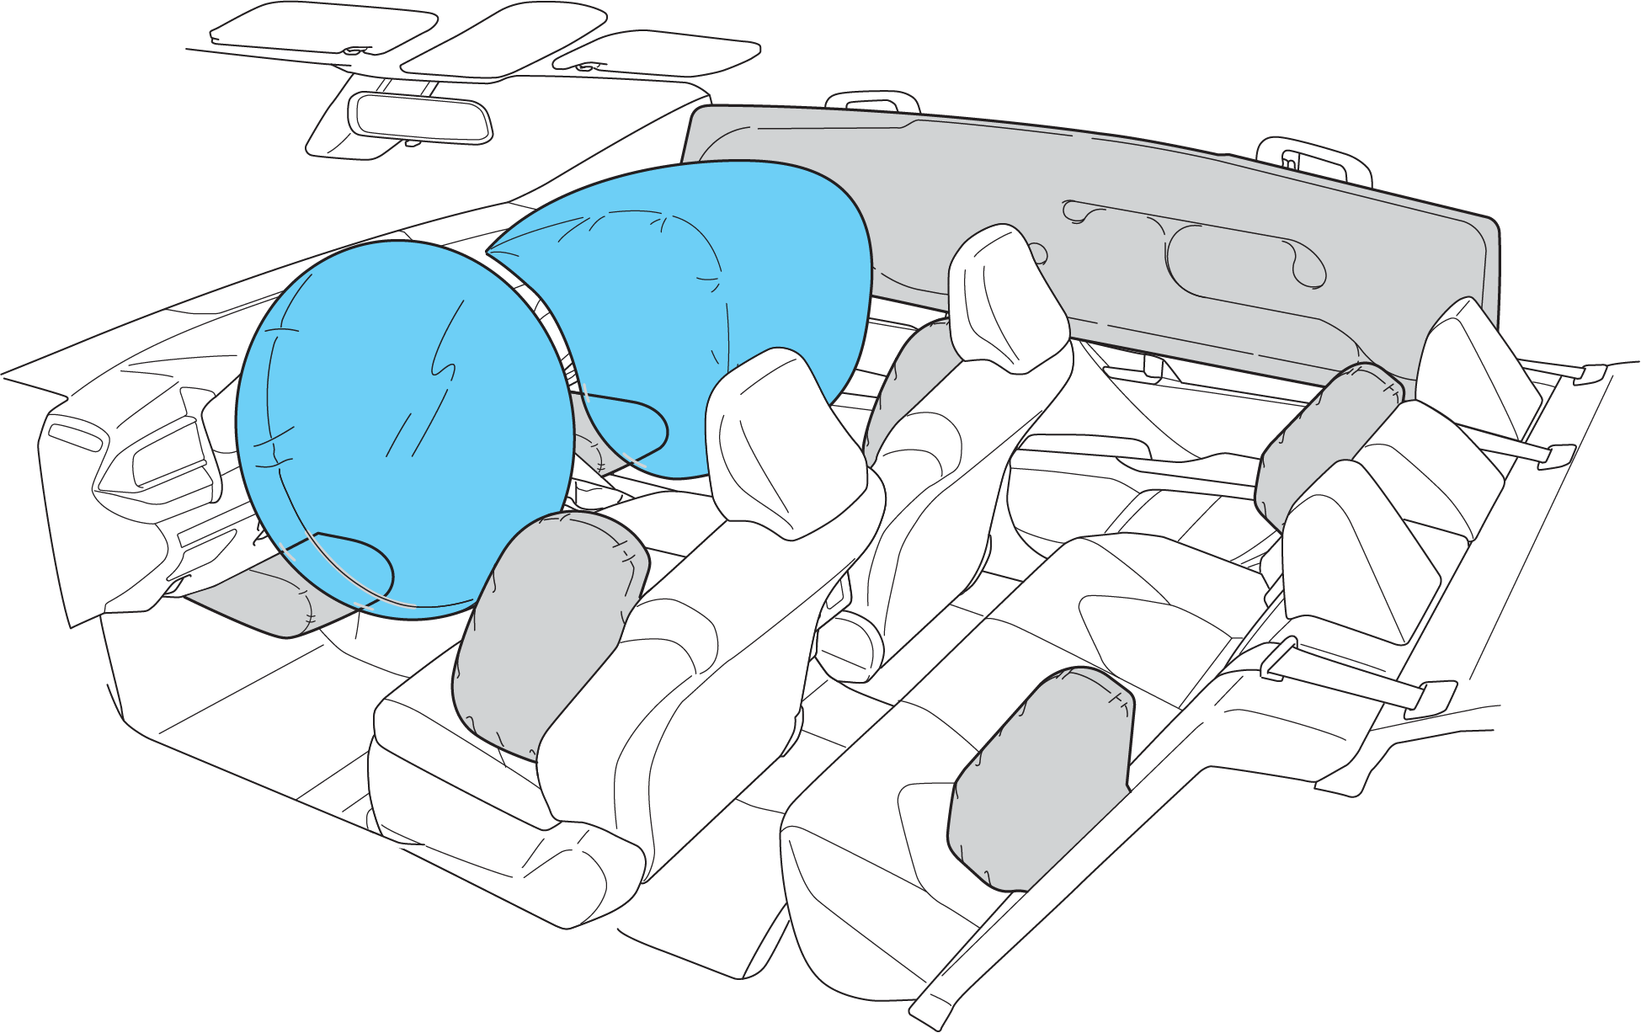
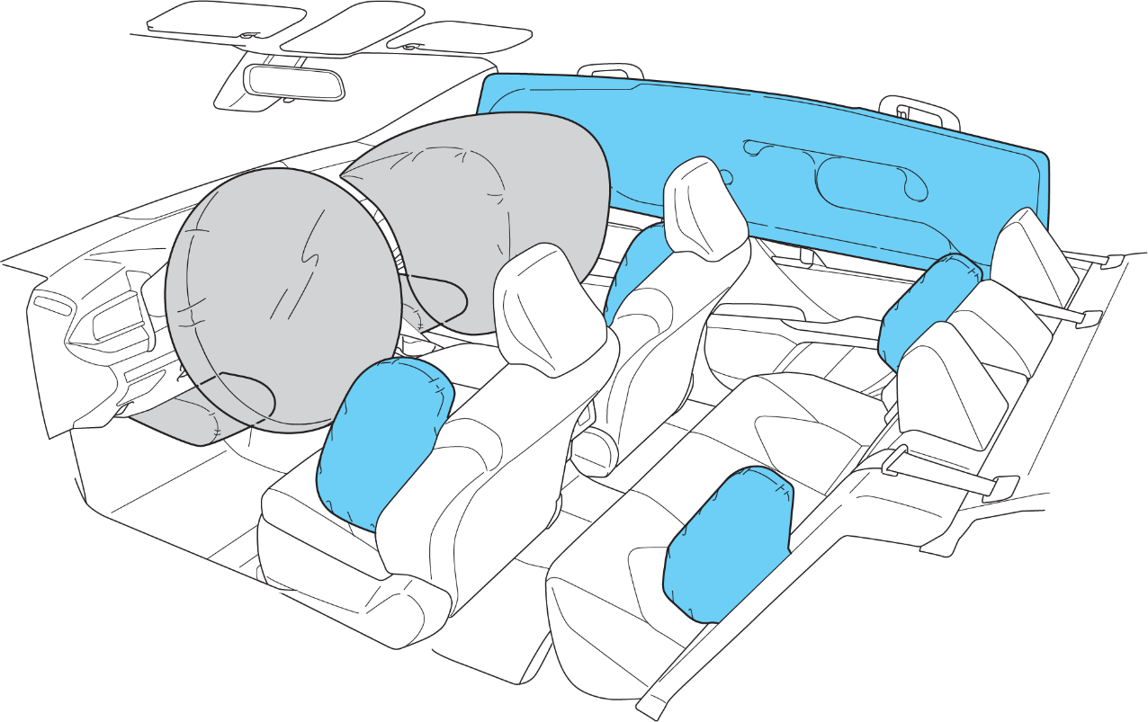
Types of Air Bags
Frontal Air Bags
Side Air Bags
Notes:
Types of Air Bags
(IG 204-237)
-ASK-
What types of air bags did you find your vehicle?
Where did you find markings for the air bags?
Where did you find air bag warning labels?
-DO-
Facilitate a brief discussion based on the student responses.
67, 75
TG

Slide 3
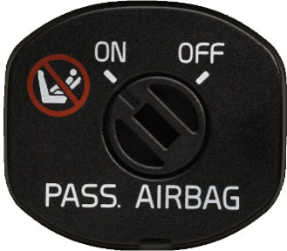
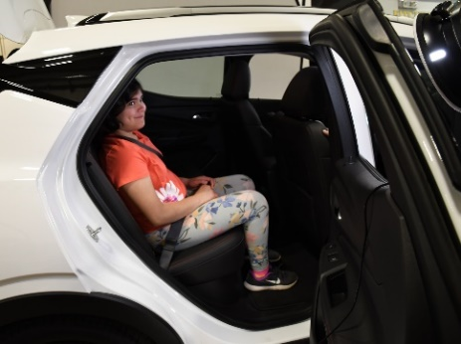
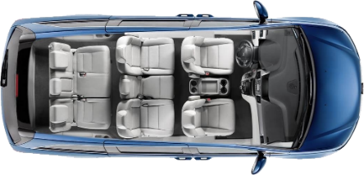
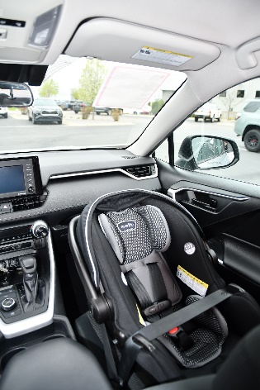
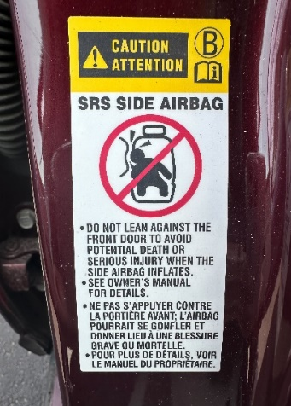
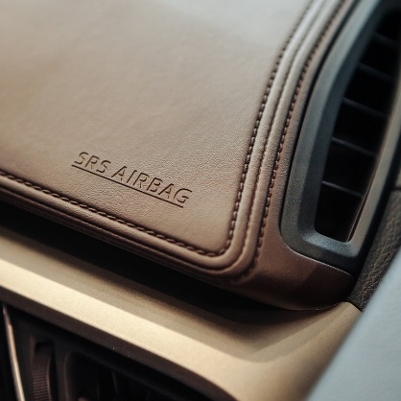
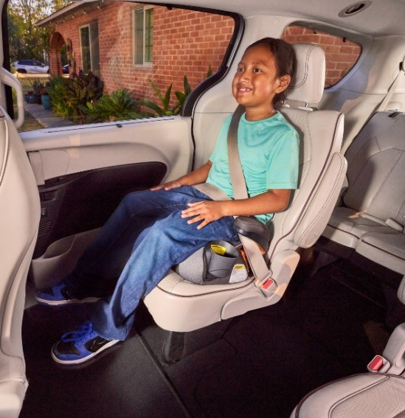
Best Practices • Air Bags
MOVE
NO!
Notes:
Best Practices • Air Bags
(IG p238-241)
-DO-
Use the Technician Guide to review best practices for air bags.
Emphasize the following point: Never install a rear-facing car seat in the front passenger seat in a vehicle with an active or advanced frontal air bag.
-ASK-
What questions about air bags do you have for me?
80, 81
TG

Slide 4
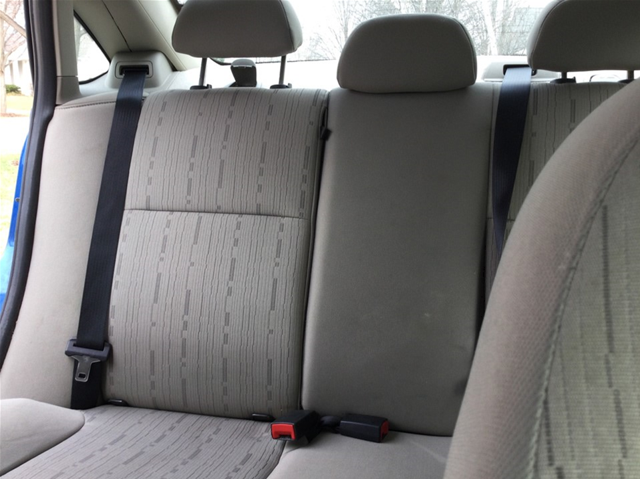


Vehicle Parts
Notes:
Vehicle Parts
(IG p260-261)
-ASK-
Was it easy or difficult to locate the lower anchors and tether anchors in your vehicle?
-DO-
Facilitate a brief discussion based on the student responses.
Remind the students that they can review the video demonstrations on lower anchors and tether anchors in the online learning.
88
TG

Slide 5
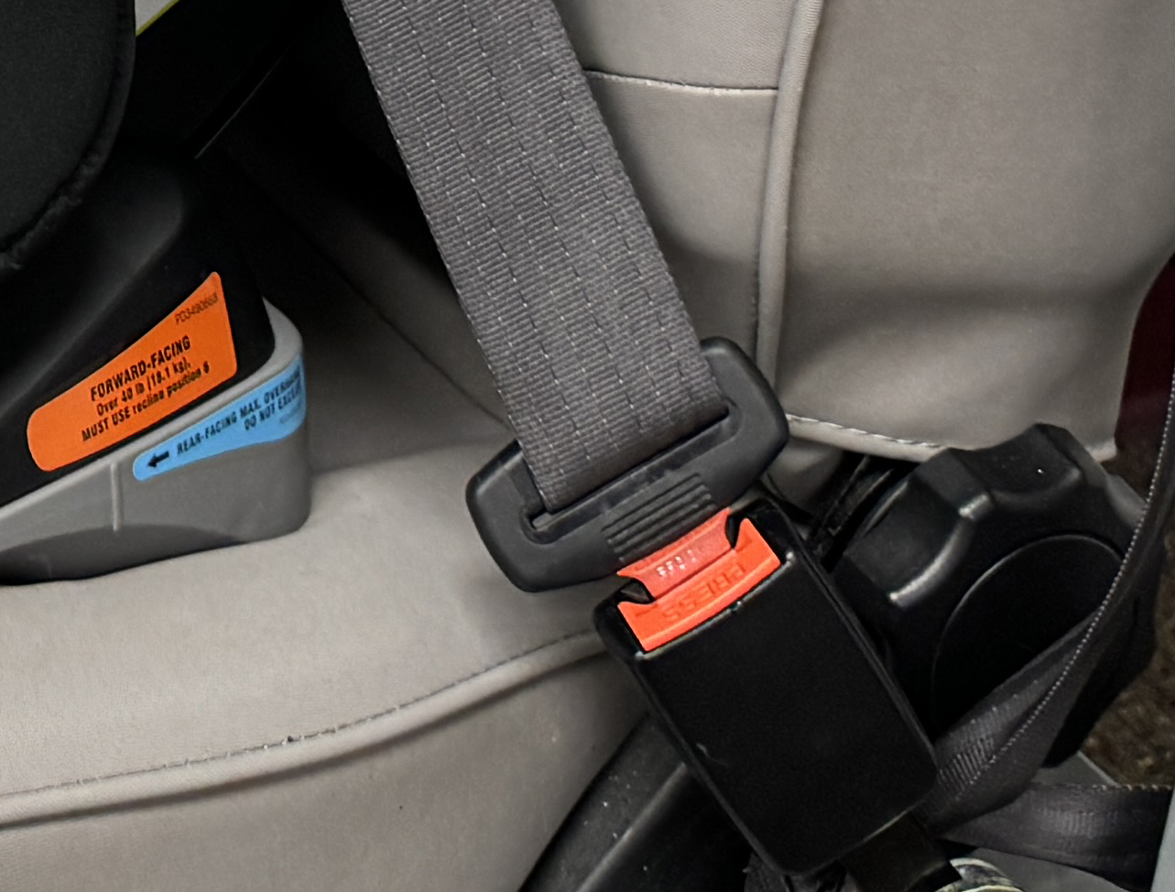
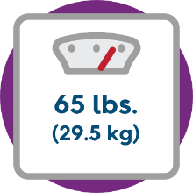
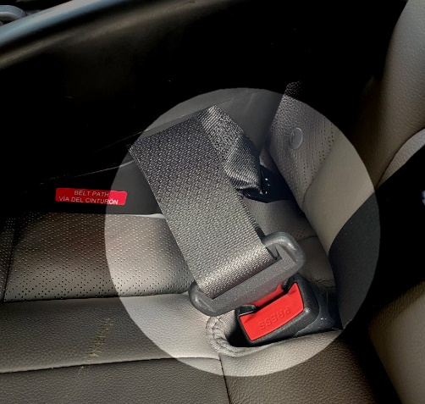



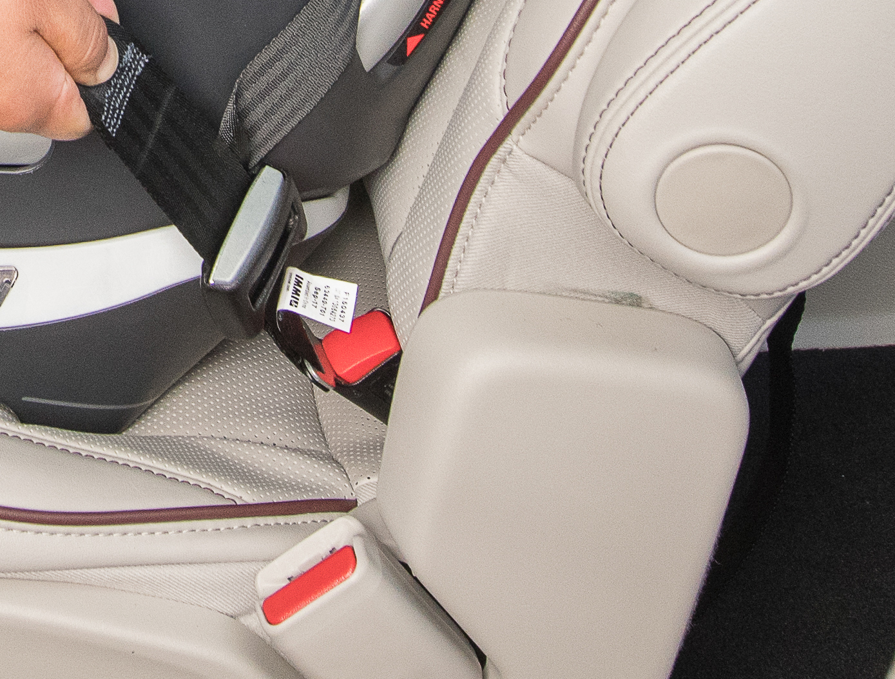


Educating Caregivers about Lower Anchors and Tethers
Notes:
Educating Caregivers about Lower Anchors and Tethers
(IG p348-351)
-DO-
Use the Technician Guide to review the reminders for educating caregivers about lower anchors and tethers.
Encourage students to ask questions as this a foundational module in the training.
-ASK-
What questions do you have for me about lower anchors and tethers?
119, 120
TG

Slide 6


Learn • Practice • Educate
Practice educating a caregiver about how to determine lower anchor and tether use weight limits.
Where do you find this information?
What do you do when the car seat manufacturer and the vehicle manufacturer have different weight use limits?
TG p113
Notes:
Learn • Practice • Educate: Lower Anchor and Tether Use Weight Limits
(IG p332-333)
-DO-
Conduct the Learn • Practice • Educate activity, ensuring that everyone has the opportunity to contribute.
113
TG

Slide 7
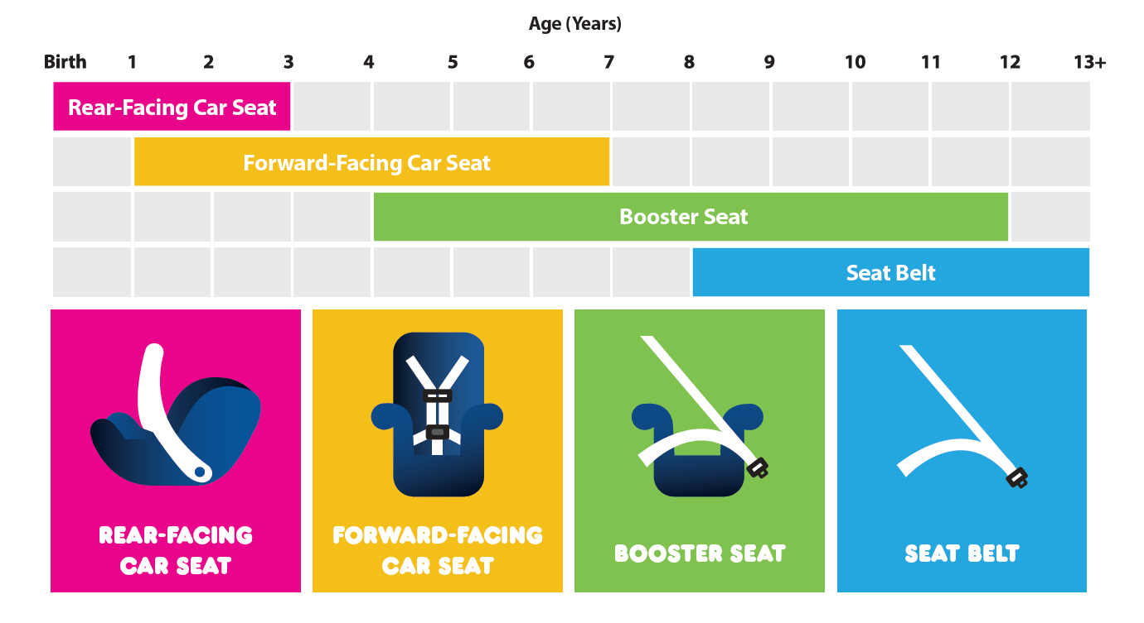
NHTSA Best Practice Recommendations
Notes:
NHTSA Best Practice Recommendations
(IG p390-399)
-DO-
Review how to read the NHTSA best practice recommendations chart including the overlapping bars on the age grid.
Remind students that this chart is available for download in the curriculum resources at cpsboard.org/curriculum-resources.
Review the applicable state/territory child passenger safety and seat belt laws available in the Governors Highway Safety Association’s State Law listing at ghsa.org/state-laws.
137
TG

Slide 8


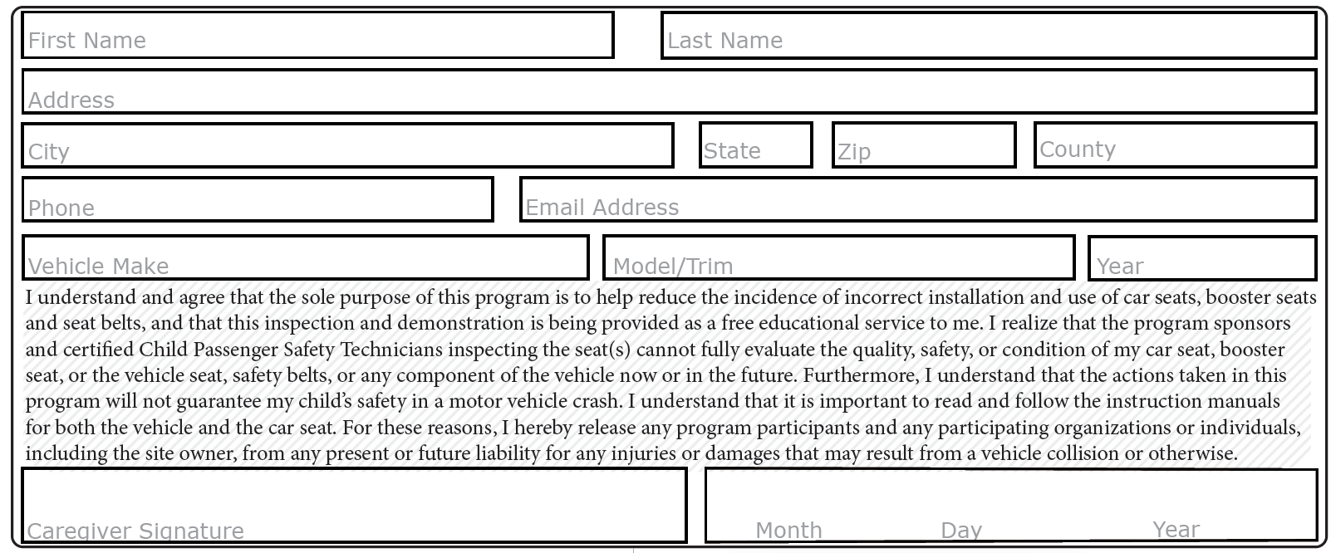
Caregiver Information
Notes:
Check Form Check
-Say-
Now is the time to begin applying some of your new knowledge with Check Form Checks.
On the NDCF, there is a section to record caregiver information.
Take a moment to locate this section on the paper version of the NDCF. You can also find it in the Caregiver Information section in the NDCF Training app.
NDCF Instructions
Caregiver Information. This section must be completed prior to beginning the car seat check.
First Name, Last Name
Street Address, City*, State*, Zip*, County*
Phone, Email
NOTE: *Only city, state, zip, and county will be entered into the electronic version of the NDCF. Local level data not captured on the paper version of the NDCF may be collected separately.
Vehicle Information: Complete the vehicle information even if the caregiver received a ride to the car seat check from someone else. This includes vehicle make, vehicle model/trim and year. If the caregiver did not arrive in a passenger vehicle, this information may be left blank. Document the reason in the Documentation Box. In the NDCF Training app, use the drop-down menu for vehicle make, model and year.
Liability Statement and Caregiver Signature: The caregiver must read the liability statement (or have it read to them), sign and date the form prior to beginning the car seat check.
NO PAGE
TG

Slide 9

Vehicle Information
Notes:
Check Form Check
-Say-
There is a section to look up a vehicle recall.
Take a moment to locate this section on the paper version of the NDCF. You can also find it in the Caregiver Information section in the NDCF Training app.
NDCF Instructions
Vehicle Information
Visit checktoprotect.org to check for open vehicle recalls.
Encourage the caregiver to use their cell phone (if available) or other electronic device to search for open vehicle recalls by using the photo tool or entering the vehicle license plate number or VIN.
If the caregiver is unable to do so, search for the caregiver. If a recall is found, ask the caregiver to use the Check To Protect website to locate a dealership to repair the recall for free.
Encourage the caregiver to call the local dealership to schedule an appointment to have the recall repaired for free.
NO PAGE
TG

Slide 10
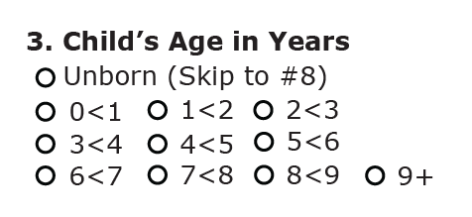
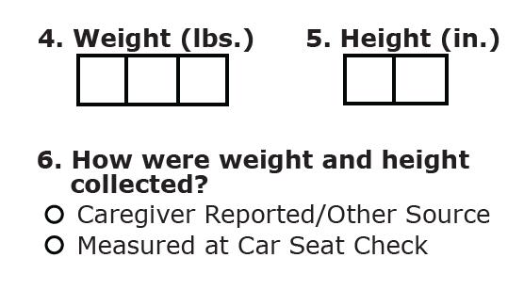
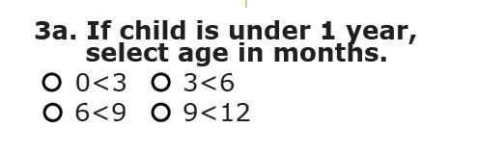
Child on Arrival
Notes:
Check Form Check
-Say-
There are sections for recording the child’s age, weight and height.
Take a moment to locate these sections on the paper version of the NDCF. You can also find them in Step 1: Child on Arrival in the NDCF Training app.
NDCF Instructions
Q3: Child’s Age in Years. Select the age range of the child even if the child is not present.
Q3a: If child is under 1 year, select age in months. Complete this question only if the child is born and less than 1 year old. Select the child’s age range in months.
Q4: Weight (lbs.). Document the child’s weight in pounds. If weight is unknown, document estimated weight. Make note in the Documentation Box.
Q5: Height (in.). Document the child’s height in inches. If height is unknown, document an estimated height. Make note in the Documentation Box.
Q6: How were weight and height collected?
Select whether the caregiver reported the child’s weight and height, or information was verified by another source (e.g., hospital records, WIC document, etc.).
Select Measured at Car Seat Check if the child was measured on site.
NO PAGE
TG

Slide 11
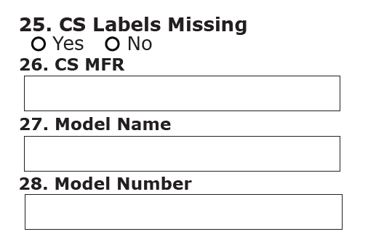
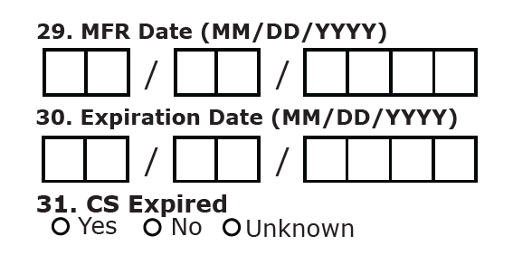
CS Findings on Arrival
Notes:
Check Form Check
-Say-
There are sections related to the car seat information including labeling, make and model, and dates.
CS stands for “car seat”.
Take a moment to locate these sections on the paper version of the NDCF. You can also find them in Step 3: Car Seat on Arrival – Part 2 in the NDCF Training app.
NDCF Instructions
Q25: CS Labels Missing. Document if the car seat being used on arrival is missing labels needed to identify general use information.
Yes: Complete as much information as possible in #25 - #31.
Q26: CS MFR. Document the manufacturer name of the car seat being used on arrival. In the NDCF Training app, use the drop-down menu.
Q27: Model Name. Document the model name of the car seat being used on arrival. Leave this field blank if a car seat model name is not identified. In the NDCF Training app, use the drop-down menu.
Q28: Model Number. Document the model number of the car seat being used on arrival.
Q29: MFR Date (MM/DD/YYYY). Document the date of manufacture of the car seat being used on arrival.
Q30: Expiration Date (MM/DD/YYYY). Document the expiration date, if available, of the car seat being used on arrival. Leave this field blank if the expiration date cannot be determined.
Q31: CS Expired. Determine and document if the car seat being used on arrival is expired.
Unknown: Check if unable to determine if the car seat is expired.
NO PAGE
TG

Slide 12
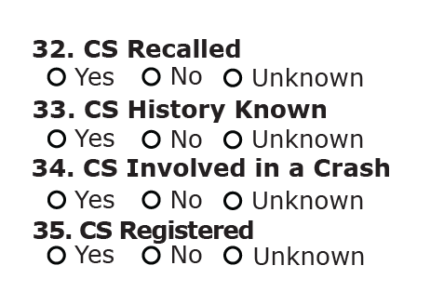
CS Findings on Arrival
Notes:
Check Form Check
-Say-
There are questions related to the car seat history including if it has been recalled, involved in a crash and/or registered.
Take a moment to locate these questions on the paper version of the NDCF. You can also find them in Step 3: Car Seat on Arrival – Part 2 in the NDCF Training app.
NDCF Instructions
Q32: CS Recalled. Using the car seat information collected, identify any recalls on the car seat being used on arrival and document in the Documentation Box. If the recall has been repaired, document in the Documentation Box.
Unknown: Check if unable to determine if the car seat is recalled.
Q33: CS History Known. Determine and document if the history of the car seat being used on arrival is known.
Q34: CS Involved in a Crash. Determine and document if the car seat being used on arrival has been involved in a crash. If the car seat has been involved in a crash or if the history of the car seat is unknown, consider the need to replace the car seat.
Q35: CS Registered. Determine and document if the car seat being used on arrival is registered with the car seat manufacturer, using the caregiver’s current address. If the car seat is not registered or if it is unknown if the car seat is registered, provide guidance to the caregiver on how to register the car seat. Consider registering the car seat on site prior to the caregiver leaving the car seat check.
NO PAGE
TG

Slide 13
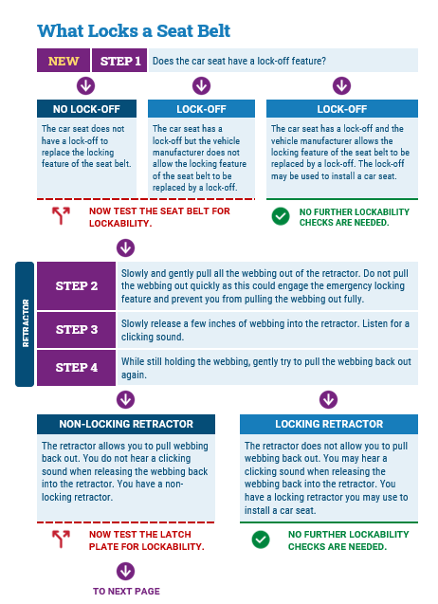
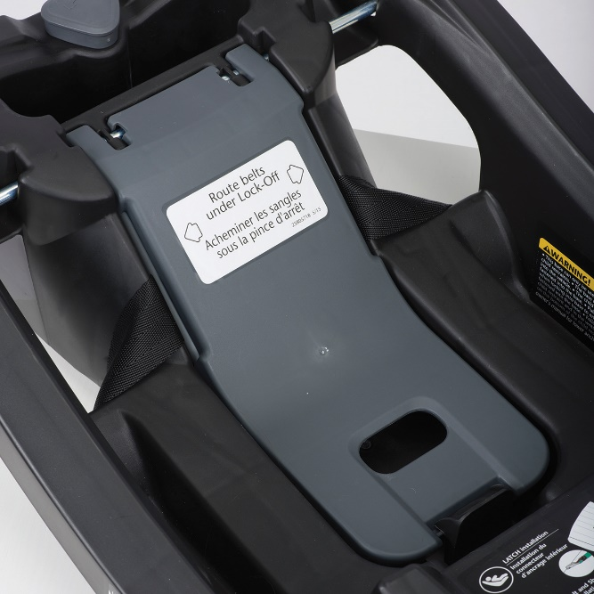
Lock-Off: The First Step
TG p184-185
Notes:
LOCK-OFF: THE FIRST STEP
(IG p526-531)
-DO-
Review the addition of the “Does the car seat have a lock-off feature?” as Step 1 of the What Locks a Seat Belt flowchart.
Remind the students that the updated What Locks a Seat Belt flowchart is available in the Technician Guide on p184-185 and for download in the curriculum resources at cpsboard.org/curriculum-resources.
Address any questions that the students may have. Remind the students that they can review the video demonstrations on what locks a seat belt in the online learning.
-ASK-
What questions about the What Locks a Seat Belt flowchart do you have for me?
184-185
TG

Slide 14

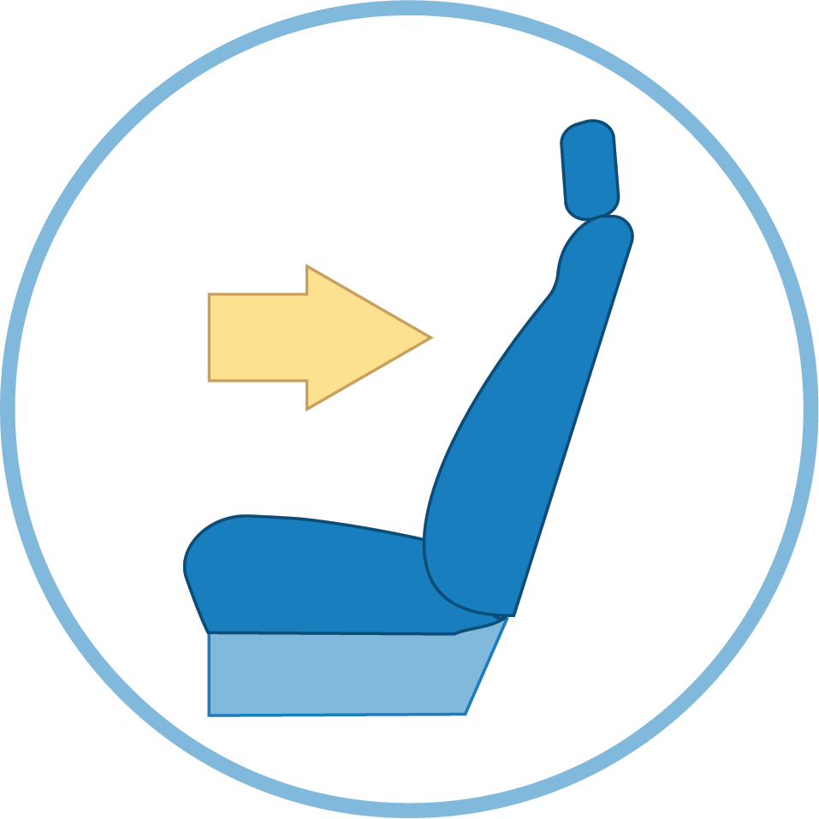

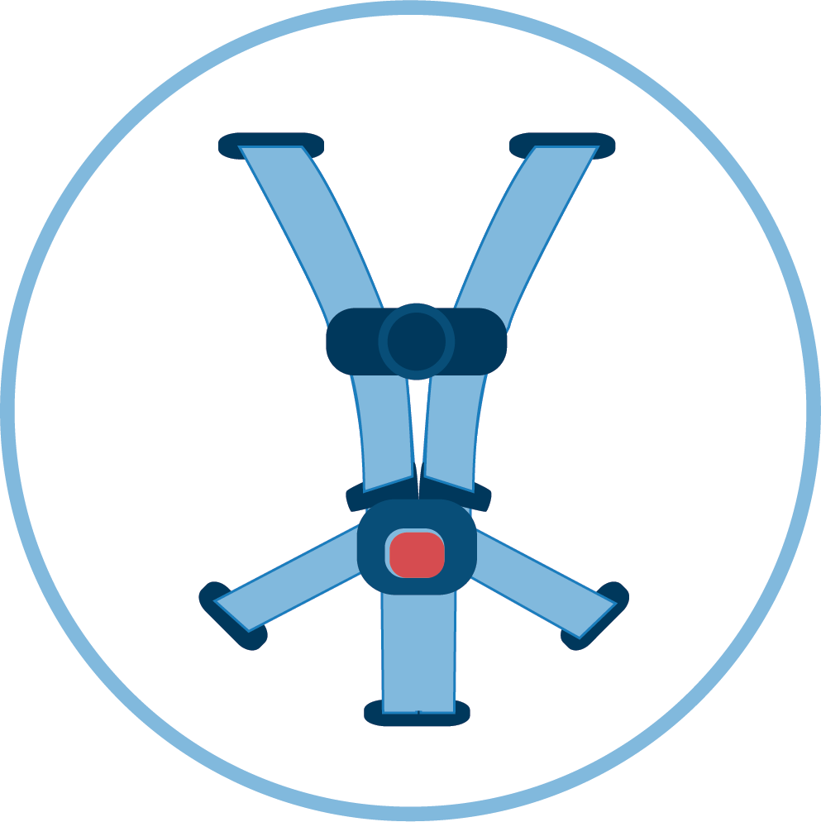

Steps for Rear-Facing Car Seat Use
STEP 1
STEP 2
STEP 3
STEP 4
STEP 5
Selection
Direction
Location
Adjustment
Installation
Notes:
Steps for REAR-Facing Car Seat Use
(IG p534-587)
-DO-
Using the Technician Guide, briefly review the five steps for rear-facing car seat use.
Remind the students that they can review the video demonstrations about rear-facing car seat use in the online learning.
-ASK-
What questions do you have for me about rear-facing car seat use?
186-203
TG

Slide 15

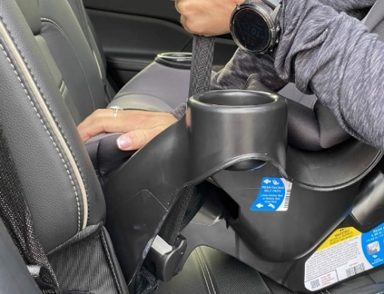
Activity Review: Install a Rear-Facing Car Seat
TG 210
Notes:
Activity Review: Install a Rear-Facing Car Seat
(IG 608-609)
-DO-
Encourage students to share about their experience with the Install a Rear-Facing Car Seat Activity at the end of Module 8.
Facilitate a brief discussion based on the student responses.
Remind students during the in-person session(s), they will have the opportunity to install rear-facing car seats with feedback from the Instructor Team.
-ASK-
Was it easier to do the car seat installations now that you have a foundational knowledge on how to lock a seat belt?
Was installing using the seat belt or lower anchor attachment system easier for you?

Slide 16

QUIZ 2 Review
Notes:
QUIZ 2 review
-DO-
Conduct a review for Quiz 2 using the suggested review questions in the Instructor Prep Guide available in the Protected Instructor Materials on cpsboard.org.
-SAY-
There are three quizzes during the course with a total of 50 questions.
To pass, 42 of 50 questions must be answered correctly. Retakes are not allowed.
Quiz 2 has 18 questions.
An audio option is available for each question.
Quiz 2 must be completed in 45 minutes or less.
You can exit the quiz and return to taking the quiz at a later point in time. Your progress and time remaining to complete the quiz will be saved.
Any questions not completed at the end of the 45 minutes are marked incorrect.
The quiz is graded once you click the Submit Quiz button. You will receive the results immediately.
-ASK-
What questions about Quiz 2 do you have for me?

Slide 17

Learning Block 1
AHEAD
Notes:
PREVIEW LEARNING BLOCK 3
-DO-
Preview Learning Block 3 content on the following slides.
-SAY-
In addition to completing the online learning for Modules 9-12, there is practice time in vehicles during this learning block.
PREVIEW CONTINUED ON NEXT SLIDE.

Slide 18
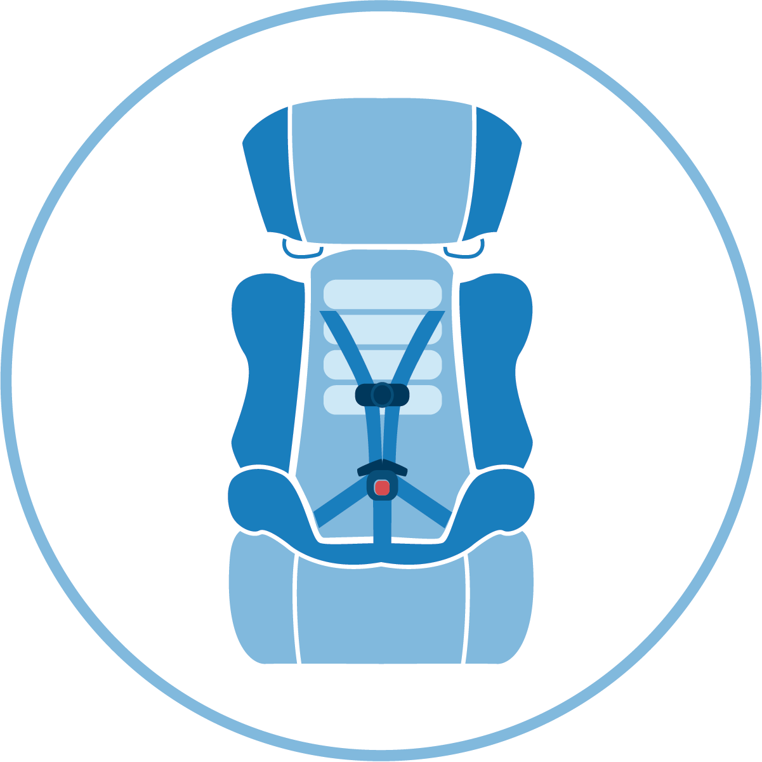
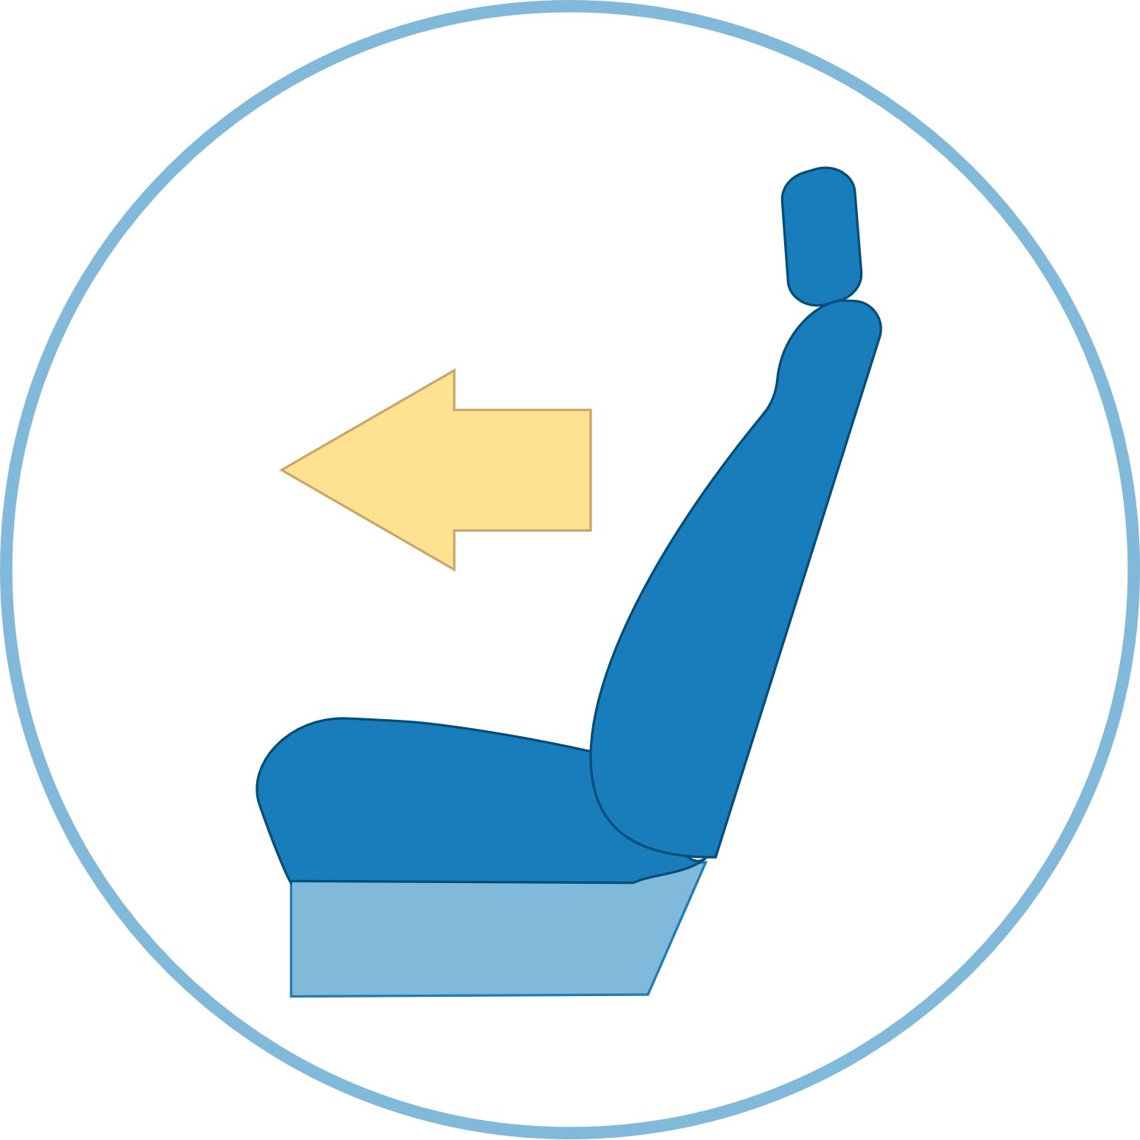
Steps for Forward-Facing Car Seat Use
STEP 1
STEP 2
STEP 3
STEP 4
STEP 5
Selection
Direction
Location
Adjustment
Installation
Notes:
PREVIEW LEARNING BLOCK 3
-DO-
Preview Learning Block 3 content.
-SAY-
In Module 9: Forward-Facing Car Seats, you will learn how the five steps of correct use apply to forward-facing car seats.
PREVIEW CONTINUED ON NEXT SLIDE.

Slide 19

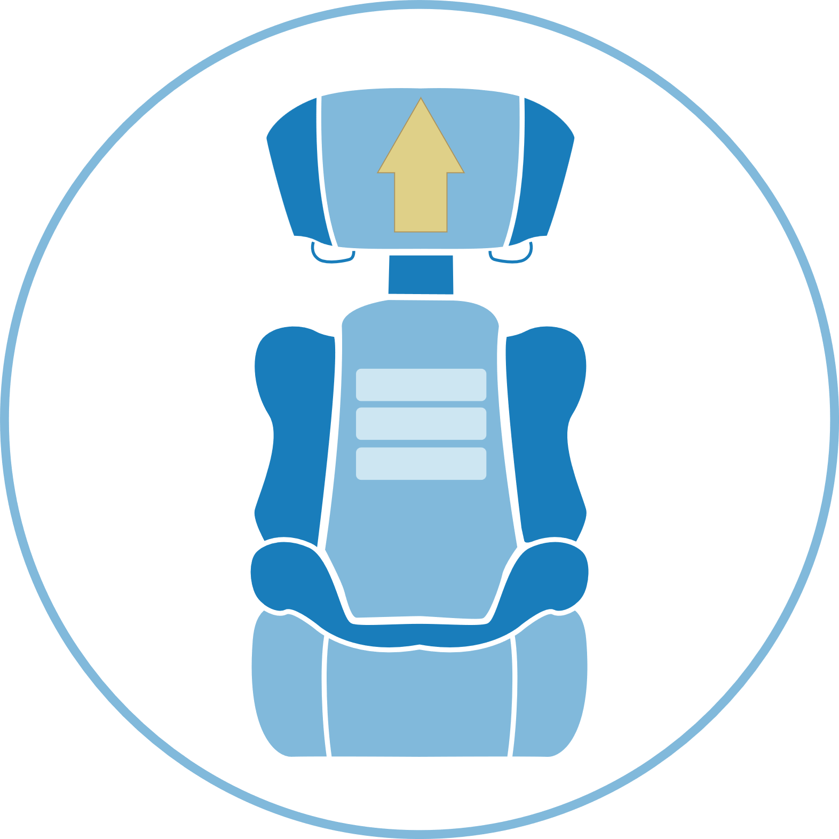

Steps for Booster Seat Use
STEP 1
STEP 2
STEP 3
STEP 4
STEP 5
Selection
Direction
Location
Adjustment
Installation
Notes:
PREVIEW LEARNING BLOCK 3
-DO-
Preview Learning Block 3 content.
-SAY-
In Module 10: Booster Seats and Seat Belts, you will learn how the five steps of correct use apply to booster seats and, also, when a child is ready to use a seat belt.
PREVIEW CONTINUED ON NEXT SLIDE.

Slide 20

Other Vehicles
Notes:
PREVIEW LEARNING BLOCK 3
-DO-
Preview Learning Block 3 content.
-SAY-
In Module 11, you will learn you will learn how to keep children safe in other vehicles.
In Module 12, you will learn about ways to use and build your new skills.
295
TG

Slide 21

Questions?
Notes:
Q&A
-DO-
Answer any questions that students may have.
-ASK-
What questions do you have for me?

Slide 22




Next steps…
Complete the Checkpoint 2 Assignment.
Complete all Learning Block 3 online learning segments and assignments.
Remember to use the Learning Block 3 Checklist.
Notes:
NEXT STEPS
-DO-
Review the next steps for the students as listed on the slide.
-SAY-
Complete the Checkpoint 2 Assignment as soon as possible following this session so you can be approved to more forward in the online learning to Quiz 2.
To advance to Quiz 2, the online learning content for Learning Block 2 must be completed and the following assigned Learn • Practice • Educate videos must be submitted to your Coach:
Air Bags (Module 5, Segment 8/Technician Guide p82)
Recalls (Module 7, Segment 8/Technician Guide p150)
Rear-Facing Best Practice Recommendations (Module 8, Segment 4/Technician Guide p169)
It is strongly suggested to complete all the Learning Block 3 online learning segments and assignments BEFORE our virtual Checkpoint 3 session.
Remember to use the Learning Block 3 Checklist to help you stay on track.

